Slide 1
Project Agora
Discussion Materials
10 September 2026

Slide 2




Executive Summary
Against a backdrop of resilient retail demand, strong Blacktown growth, and constrained new
supply, we recommend CFS proceed with the $25.0m Bayview co-investment, underwriting a
13.5% levered IRR and 1.6x MOIC over five years
Recommendation
Defensive retail backdrop – $12.7bn in Australia retail transactions (2025) against constrained new supply
High-growth catchment, with +15% population growth to 2036
(vs. 8% Syd)
Market-priced entry,
with 6.45% entry cap
rate vs. 6.43% Sydney
comparable median
Investment
Context
Blacktown growth and infrastructure deepen Bayview’s catchment and support exit demand
I
Grocery-led anchors
and services-based
tenants underpin resilient recurring income
II
The $10m plan targets $750k incremental
NOI, led by specialty
re-leasing
III
Investment
Theses
Risks and
diligence areas
Specialty leasing remix delay
Capex overrun increasing cost of value creation
Exit cap rate expansion from softer conditions
Minority governance risk from 13.4%
stake

Slide 3
Situation Overview
Section I

Slide 4
Property Market Overview
Prevailing macro conditions support the case for defensive, non-discretionary retail exposure
Rate relief pushed further out, keeping debt costs elevated¹
Cap rates have compressed across retail sub-sectors²
I
Delayed Rate Relief
Current swap curve sits above 6-month and 1-year curves at the short end – market has repriced away near-term cuts
2024
II
Elevated cost of debt
2025
Higher-for-longer cash rate keeps acquisition & refinancing costs elevated, lifting the hurdle rate for the Bayview Village co-investment
Rising construction costs constrain new supply pipeline³
Structural tailwinds supporting non-discretionary retail⁴
Based: 2020 = 0
Based: (2020 = 100)
$12.7B
9.4% p.a.
69%
2025 Australian retail transaction volume
Neighbourhood centre total returns over the past decade
Share of neighbourhood 2026–28 development pipeline
+2.3%
<5%
1.0M vs 0.7M sqm
Blacktown LGA population growth p.a.
National shopping centre vacancy
Forecast population growth vs shopping centre supply pipeline
Population growth in supply-constrained, convenience-led catchments like Blacktown are driving structural demand for non-discretionary retail, with record transaction volumes reflecting a flight to defensive income
Source: 1. RBA, 2. CBRE Retail Figures Q1 2026 (national/Adelaide); CBRE Australian Shopping Centres Outlook 2026, 3. CBRE Pacific Real Estate Market Outlook (Apr 2026); Turner & Townsend Construction Cost Outlook, 4. CBRE Australian Shopping Centres Outlook 2026; retailbiz/CBRE (May 2026); ABS Regional Population 2024–25; Blacktown City Council Population Forecast (.id, 2024)

Slide 5




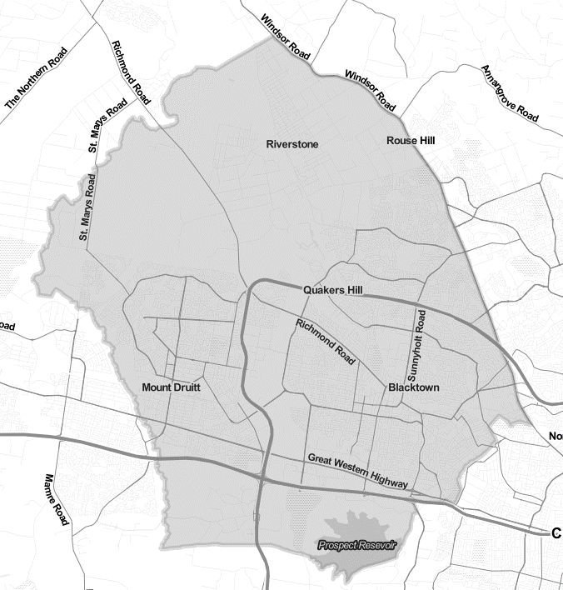
Asset Overview
Bayview Village is a defensive sub-regional centre in a high growth corridor, with strong repositioning potential
Bayview village is a defensive asset with resilient cash flows
…located in NSW’s largest and fastest growing LGAs…
A diversified tenant base
Blacktown
Sydney
Lettable area | 20,000 sqm
Site area | 4.5 ha
Occupancy | 96% (income)
Last valuation | A$186m
Cap rate | 6.45%
Expenditure Growth
(2026-36)
+17%
+7%
Population Growth
(2026-36)
+15%
+8%
Primed for repositioning
Underpinned by…
$60bn
Sydney Metro (Western Sydney focus)
58
3.1 yrs
7%
$25bn
Western Sydney Aerotropolis
Specialty tenants
WALE
Vacancy (NLA)
$1bn
Blacktown Council Budget (2026-7)
…well-positioned for its young, family-oriented catchment…
...with strong fundamentals anchoring its competitive position
Blacktown LGA household types (%)
Competing Retail Centres
Dense retail supply, though limited direct competition from sub-regional centres
Median Household Income (/wk)
Median
Age
Other
$2,105
34
E-commerce substitution
Anchor mix and experiential specialty tenants underpin resilience to substitution
vs. $2,077 (Sydney)
vs. 37 (Sydney)
New retail supply
Limited new retail supply, expected to be 48% below forecast retail demand for 2025-2030
Underpins resilient demand for Bayview’s essential-needs anchors and planned specialty remix
Barriers to entry for new centres
The rent and cost-to-build gap has widened to by 45%-75% (2016-26), challenging new supply
Sub-regional
Regional
Neighbourhood
Source: Blacktown City Council, CBRE Sydney Retail Figures, CBRE Pacific Market Outlook, CBRE Shopping Centre Outlook

Slide 6
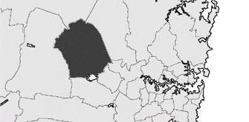


Situation Overview
Terralith has offered CFS a A$25.0m co-investment, aligning with CFSPF's underweight retail allocation
Colonial First State (CFS), via the CFS Property Fund (CFSPF), is a cornerstone investor in Terralith Unlisted Retail Fund (TURF), an open-ended core/core-plus fund targeting income-producing retail centres across Australia
CFSPF is currently overweight industrial and underweight retail relative to its target allocation ranges
TURF is acquiring Bayview Village, a 20,000 sqm sub-regional shopping centre in Blacktown LGA, Western Sydney, anchored by Coles, Woolworths, Kmart and Priceline
Terralith has offered CFS a $25.0m co-investment alongside TURF's ownership, providing CFS with direct exposure to the asset within CFSPF
The opportunity aligns with CFS's preference for convenience-led, defensive retail resilient to economic and e-commerce disruption
Terralith has proposed a $10.0m value creation plan across leasing remix, upgrades and development approval
I
Background
II
The Opportunity
III
Strategic Rationale
IV
Co-investors
Blacktown LGA
Retail portfolio concentration
Target GAV range
Aurum Capital Recommendation
Proceed with the A$25.0m Bayview co-investment, subject to confirmatory diligence on leasing, capex and minority-investor protections

Slide 7
Strategy Evaluation
Section II

Slide 8
Thesis 1: Location
Bayview is positioned to benefit from a deepening local demand base and improving connectivity
Entrenched catchment population growth drivers…
…& accessibility strengthened by infrastructure investment…
Net migration = 49% of growth
Established migrant communities creates chain migration
Blacktown LGA infrastructure investment runway ($m)
+15%
Blacktown
growth
(2026-36)
Strong natural increase = 51% of growth
High 1.78 birth rate (vs. 1.54 Greater Sydney)
New homes targeted by 2029 = +21.4k
Residential capacity supports catchment growth
Visible growth runway = expands customer base, sales density, and NOI
…bolstered by favourable household demographics…
…creating investor appetite across Blacktown retail assets
Target | Westpoint Blacktown | Stanhope Village | Schofields Village
Acquirer | Haben + Hines | Revelop | Wealth Property
Date | Jan-25 | Feb-23 | Mar-23
Value | ~$870m | $158m | $53m
Yield | ~5.8% | ~5.5% | ~5.5%
Notes | Record institutional investment | Closest Bayview precedent | Growth-corridor grocery retail
I
Larger households
3.1 people per household vs. 2.7 Greater Sydney
= recurring grocery & daily needs spend
II
Younger population
34 median age vs. 39 Greater Sydney
= health and wellness spending demographic
Source: Blacktown City Council; NSW Government; Haben; Revelop; Media Publications.

Slide 9




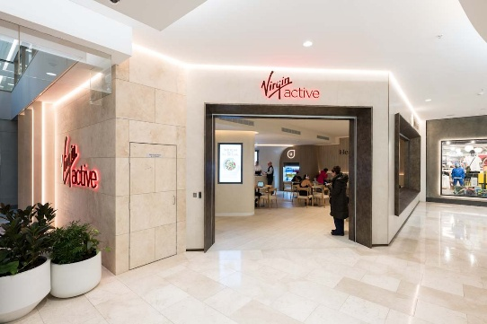
Thesis 2: Stable Income
Bayview’s anchor and services-based specialty retail tenants drive defensive recurring foot traffic and income
Anchor tenants generate stable income and foot traffic…
…supporting a defensive services-based re-leasing shift
42%
Bayview Centre anchor tenancy Annuity-like cash-flows
Sub-regional shopping centres retail floorspace allocations
Services re-leasing trend across Australian sub-regional centres
12%
FY25 median online sales %
~75% fulfilled via click-and-collect
Services
Goods
Omnichannel & experiential tenants defend against e-commerce headwinds
Minis
30%
Avg. anchor share total centre footfall
All tenants benefit from footfall
Majors
…underpinned by strong non-discretionary spend growth…
Bayview remix towards defensive health, wellness, and beauty
Household spend YoY growth (%)
COVID rebound
Non-discretionary (average 5.6% YoY growth)¹
Discretionary (average 3.4% YoY growth)¹
Case study: Westfield Bondi – Health, Wellness, and Fitness Precinct
Includes Virgin Active Social Wellness Club & Rebel rCX large format concept store
Contributed to +8.5% FY25 visitation growth at Westfield Bondi
Non-discretionary anchor tenants drive habitual, high-frequency trips
Source: Coles; Woolworths; Wesfarmers; ABS; Westfield; Dexus; Scentre Group. Note: (1) Average YoY growth across ex-COVID period, Mar-23 to Mar-26.

Slide 10


Thesis 3: Value Creation Plan
Support the $10m program, with highest conviction in leasing-led NOI growth
LOW
Value realisation visibility
HIGH
$1.0m development planning approval
$5.5m centre improvements
$3.5m specialty leasing remix
Exit optionality: secure development optionality in supply-constrained market, enhancing buyer appeal at exit
Asset competitiveness: upgrades protect asset quality, aligning Bayview with institutional demand for high quality retail
Income growth: benefits from health & wellness, & location tailwinds, defends against e-commerce – clearest NOI path
Approval timing uncertainty
No contracted NOI uplift; value depends on buyers pricing development optionality
Planning conditions / refusal could limit value realisation
Success depends on quality of execution and contractor delivery
Works may cause trading disruption or cost overruns before benefits realised
NOI uplift depends on successful tenant take-up at underwritten rents
Lease exits, downtime, and incentives could delay or dilute targeted uplift
Value impact
Illustrative underwritten value-add contribution $10m value creation plan ($000s)
Support Terralith’s $10m value-creation plan, with conviction weighted toward the initiatives where value realisation is most visible
Illustrative value-creation NOI levers
Value-add NOI uplift (from FY28)
1
Core value driver: specialty leasing remix
2
Supporting investment: centre improvements
3
Upside optionality: development planning

Slide 11
Portfolio Alignment
An investment in Bayview falls within CFSPF portfolio construction and investment guidelines
Portfolio by sector
Portfolio gearing
1
Reduce industrial conc. risk
Bayview investment maintains sustainable gearing levels
2
Increase favourable retail exposure
3
Dilute exposure to softer asset classes
Current % GAV
Pro forma % GAV
Max target % GAV
Current % GAV
Pro forma % GAV
Max target % GAV
Portfolio by region
Portfolio governance
Increase exposure to NSW experiencing favourable growth tailwinds
Improved governance & portfolio control
1
2
Maintain conservative exposure within portfolio GAV % targets
Current % GAV
Pro forma % GAV
Max target % GAV
Current % GAV
Pro forma % GAV
Max target % GAV

Slide 12
Valuation & Financing Considerations
Section III

Slide 13
Benchmarking Analysis
Comparable transactions confirm Bayview Village is priced in line with the market despite a shorter WALE than comparables
Property
Region
Sale Date
Sale Value
Benchmarking Analysis¹
WALE
Implied Cap Rate²
Rental Growth
Outgoings Growth
Vacancy Rate
Market liquidity remains strong for retail with deep pools of capital from both domestic REITs and offshore investors.
Sydney & other Australian assets continue to transact around 6.4-6.5% cap rates
Notes:
1. Benchmarking statistics reflect regional averages as at 1H2026/YoY changes from 1H2025
2. Implied capitalisation rate derived from JLL forecasted NOI
Source: S&P Capital IQ, JLL, CBRE, Knight Frank

Slide 14
Illustrative Property Returns Analysis
Our analysis indicates a levered IRR of 13.5% and 1.6x equity multiple is achievable
Assumptions
Illustrative Cash Flow Waterfall
Acquisition of Bayview Village, a 20,000 sqm sub-regional centre in Blacktown LGA, at the March 2024 valuation of A$186.0m (6.45% cap rate, $9,300/sqm)
Year 1 NOI $12.0m growing 3.0% p.a.; maintenance capex 5% of NOI, leasing fees $250k p.a., management fee 0.35% of GAV
$10.0m value creation programme drawn at entry, 100% debt-funded, at a 7.5% yield on cost — $750k NOI uplift from FY28
Key financing assumptions:
Acquisition LVR 35% ($65.1m); 40.4% including the capex facility
Interest-only, principal repaid at exit; all-in rate 5.0% (3.5% swap + 1.5% margin)
Debt establishment and acquisition costs 1.0% each
5-year hold from 30/06/2026, exit at 6.25% cap rate with 1.5% selling costs
CFS invests A$25.0m for 20.2% of project equity (13.4% of asset value)
($ in thousands) | FY26 | FY27 | FY28 | FY29 | FY30 | FY31
Unlevered Cashflows
Property Acquisition Price | (187,860)
(+) CapEx Programme | (10,000)
(+) NOI |  | 12,174 | 12,567 | 12,972 | 13,390 | 13,819
(-) Maintenance CapEx |  | (609) | (628) | (649) | (669) | (691)
(+) Proceeds on Sale |  |  |  |  |  | 228,193
(-) Selling Costs |  |  |  |  |  | (3,423)
Unlevered Free Cash Flow | (197,860) | 11,565 | 11,939 | 12,324 | 12,720 | 237,899
CAGR
3.2%
3.2%
Unlevered IRR |  | 11.1%
MOIC |  | 1.4x
Levered Cashflows
Unlevered Free Cash Flow | (123,511) | 11,565 | 11,939 | 12,324 | 12,720 | 237,899
(-) Interest Expense |  | (3,755) | (3,755) | (3,755) | (3,755) | (3,755)
(-) Debt Repayment on Exit |  |  |  |  |  | (75,100)
Levered Free Cash Flow | (123,511) | 7,810 | 8,184 | 8,569 | 8,965 | 159,044
0.0%
Sources & Uses
Sources
Acquisition Debt | 65,100
Capex Facility | 10,000
Buyer Equity | 123,511
Total Sources | 198,611
Uses
Purchase of Bayview Village | 186,000
Acquisition Costs | 1,860
Value-add Capex Program | 10,000
Debt Establishment Fee | 751
Total Sources | 198,611
Levered IRR |  | 13.5%
MOIC |  | 1.6x
Avg Distribution Yield |  | 6.8%
CFS Co-Investment CFs | (25,000) | 1,581 | 1,657 | 1,734 | 1,815 | 32,192
Analysis at various offer premiums
Entry Cap Rate
LTV
13.5% | 5.95% | 6.20% | 6.45% | 6.70% | 6.95%
5.75% | 12.8% | 14.7% | 16.5% | 18.3% | 20.1%
6.00% | 11.2% | 13.1% | 15.0% | 16.8% | 18.5%
6.25% | 9.7% | 11.7% | 13.5% | 15.3% | 17.1%
6.50% | 8.3% | 10.2% | 12.1% | 13.9% | 15.6%
6.75% | 6.9% | 8.8% | 10.7% | 12.5% | 14.3%
13.5% | 25.0% | 30.0% | 35.0% | 40.0% | 45.0%
5.75% | 15.3% | 15.9% | 16.5% | 17.3% | 18.1%
6.00% | 14.0% | 14.4% | 15.0% | 15.6% | 16.4%
6.25% | 12.6% | 13.0% | 13.5% | 14.1% | 14.7%
6.50% | 11.4% | 11.7% | 12.1% | 12.5% | 13.0%
6.75% | 10.2% | 10.4% | 10.7% | 11.1% | 11.5%
Exit Cap Rate
Exit Cap Rate
Notes: 1. Financial years ending 31 Aug; FY26 represents the acquisition date (1/9/2026). 2. Represents project equity at entry, i.e. total uses less total debt drawn. 3. Debt is interest-only for the full term with principal repaid from sale proceeds on exit. 4. Covenants pass in all forecast years (ICR 3.2x–3.7x vs. 2.0x min.; LVR 40.4% at entry declining to 35.1% vs. 55% max.). 5. Exit value capitalises forward (FY32) NOI at the 6.25% exit cap rate.

Slide 15
Financing & Capital Structure Recommendation
$75.1m of interest-only senior debt funds 37.8% of uses, with covenant headroom maintained across 2.0x ICR and 55% LVR tests
Financing Assumptions
Recommended Debt Structure
Property is valued at $186.0m:
Facility
Terms & Covenants
Rationale
$75.1m total debt funds 37.8% of $198.6m uses: a $65.1m acquisition facility at 35% LVR plus a $10.0m capex facility drawn at entry
Entry LVR of 40.4% including the capex facility, above the 15-35% CFSPF look-through range on a standalone basis
$123.5m project equity, with CFS contributing $25.0m for a 20.2% interest, or 13.4% of asset value, inside the <15% single-asset limit
5.0% all-in cost of debt (3.5% swap + 1.5% margin), fixed and fully hedged for the term — no refinancing or rate reset risk
Interest-only with principal repaid at exit, holding interest flat at $3.8m and supporting a 6.8% average distribution yield
Capex facility at a 7.5% yield on cost, accretive against the 5.0% cost of debt
35% LVR retained over the 45% tested: extra leverage adds c.130bps IRR but compresses ICR headroom as 35.3% of income rolls annually
Acquisition Facility | A$65.1m commitment at 35% LTV 55% LVR / 2.0x ICR maintenance 5.0Y bullet with no amortisation Pricing: BBSW + 150bps 1.0% upfront OID | Investment-grade-style pricing reflects daily-needs anchor covenant and sub-4.0x leverage at close Bullet structure defers refinancing risk to a single exit-aligned maturity
CapEx Facility | A$10.0m committed accordion 7.5% underwritten yield on cost Ranks pari passu with acquisition debt Pricing: BBSW + 150bps Fully drawn at close | Ring-fenced capital for the five-workstream repositioning; funded debt at 5.0% against a 7.5% incremental return is spread-accretive Pari passu ranking avoids structural subordination and second-lien pricing
5-Year Swap | 3.5% fixed base rate 1.5% all-in credit spread 5.0% blended cost of funds A$3.8m cash interest p.a. 100% notional hedged | Full-term hedge fixes debt service and eliminates basis and reset risk on an interest-only structure Locks the positive carry between the 6.45% entry yield and cost of funds, underwriting the 6.8% cash-on-cash
Senior Secured
Debt Covenants
LTV Ratio
Loan/Value (%)
ICR
NOI/Interest (x)
Max LTV covenant
Entry LVR peaks at 40.4% due to the capex facility drawdown
NOI growth throughout hold period sees covenants ease
Min ICR
Hedging
Source: Terralith Information Memorandum, S&P Capital IQ

Slide 16
Risks & Recommendation
Section IV

Slide 17

Environmental
Social
Governance
Environmental, Social and Governance
CFS must consider the potential ESG impacts of its co-investment into Bayview
$800k invested into ESG capex
$3.5m specialty leasing remix
$25.0m co-investment
Achieved by Investment in solar panels & sustainability initiatives
Target 5-star rating
Improves public reputation and marketing
$5.5m centre improvements
1
Improved sector diversification
(15.0% - 19.1% GAV retail exposure)
30% turnover target, total 17 specialty tenancies repositioned
Aligns with +6.4% FY24-25 health & wellness spend growth across Australians aged 25-34
2
Compliant geographical exposure
(66.7% PF GAV <70% portfolio limit)
3
4.8% Bayview share of PF GAV
(<15% individual asset limit)
15%
Emissions reduction
216 tCO₂e
Emissions avoided p.a.
~$74k
Illustrative cost saving p.a.
Aligns with daily service needs of Blacktown LGA’s younger, family-oriented community (34 median age; 44% family households)
No CFSPF investment guideline breaches
$32.2m FY31 exit
Weak ESG
Strong ESG
Weak ESG
Strong ESG
Weak ESG
Strong ESG
1
2
1
2
1
2
Bayview at 4.5-5 stars would improve materially, but would not qualify as top-15% “highly sustainable” shopping centre under NABERS (requires 5.5 rating)
Impact offset by social downside from tenant displacement risk; mitigate through lease-expiry cycling, negotiated exits, and relocation support
Strengthens sector diversification without breaching portfolio limits, delivering strong profit outcomes, although elevated concentration risk in NSW
Source: NABERS average emissions intensity guidance 2025; DCCEEW – Australian National Greenhouse Accounts Factors; ACT Government – Business Lighting Efficiency calculator; NSW Government.

Slide 18
Risks & Mitigants
CFS should actively manage three key risks that are most material to the Bayview investment
Risk
Likelihood
Cause
Mitigants
Impact on IRR
Specialty Leasing Remix Delay |  | Slower tenant exits, negotiations, or new tenant take-up delay the planned specialty remix and NOI uplift | Early tenant engagement with clear milestones Stage leasing remix to limit vacancy overlap Timeline sensitised to 18 – 24 months (vs. 12-month base)
Capex Overrun |  | Materials and labour inflation or scope creep increases the cost of centre improvements | 10% contingency allowance assumed Fixed-price contracts, defined scope Capex sensitised to $11.5m – $13.0m (vs. $10.0m base)
Exit Cap Rate Expansion |  | Cap rate expansion from softer conditions or weaker demand at sale | Value creation plan lifts asset quality Non-discretionary income supports demand Exit cap sensitised to 6.50% – 6.75% (vs. 6.25% base)
Existing Tenant Retention Risk |  | Anchor non-renewal, or prolonged vacancy on expiry reduces base NOI | Long-term leases with fixed 3% increases Early engagement ahead of expiries Vacancy sensitised to 9 – 15 months (vs. 6-month base)
Financing Risk |  | Higher debt costs from margin expansion or a higher-for-longer rate backdrop | Conservative 35% LTV; monitor ICR/DSCR Interest-only, principal repaid at exit Margin sensitised to 175 – 275bps (vs. 150bps base)
12.3%
13.5%
Execution Risks
12.8%
13.5%
10.7%
16.5%
12.9%
13.5%
Market & Exit Risk
14.8%
13.0%
Source: CBRE Pacific Market Outlook (April 2026); Turner & Townsend, CBRE Retail Figures Q1-26; Shopping Centres Outlook 2026 | Notes: Sensitivities are single variable, other inputs held at base case

Slide 19




A High-Conviction Co-Investment
Bayview combines defensive income, leasing-led upside, and strategic portfolio fit to deliver attractive returns
Defensive Income
National grocery anchors underpin recurring foot traffic and resilient cash flows, with 45% of NOI from anchors
Structural catchment growth
Blacktown population growth expands Bayview’s customer base, while constrained supply supports tenant demand
Visible value creation
$10m plan targets $750k incremental NOI, with highest conviction in the $3.5m
specialty leasing remix
Strategic co-investment fit
Direct co-investment gives CFS targeted Bayview exposure, improving retail diversification and asset-level underwriting
13.5%
Levered IRR
1.6x
MOIC
PROCEED
$25.0m co-investment
5-year hold, subject to confirmatory DD

Slide 20
Appendix
Supporting Materials

Slide 21
Appendix Network
Main deck
Executive Summary
Property Market Overview
Asset Overview
Situation Overview
Thesis 1: Location
Thesis 2: Stable Income
Thesis 3: Value Creation Plan
Portfolio Alignment
Benchmarking Analysis
Illustrative Property Returns Analysis
Financing & Capital Structure
ESG
Risks and Mitigants
Final Recommendation
Appendix
Aurum Capital
Australia Retail Growth
Retail Sales Growth Resilience
Australian Health & Wellness Thematic
Australian E-Commerce Thematic
Omni-Channel Retail Analysis
Anchor Tenants Overview
Value Creation Plan
ESG Capex Analysis
Capex Case Studies
Physical Asset Risk
Exit Strategy
Co-Investment Rationale
Due Diligence & Break Case
Blacktown Competitive Landscape
Blacktown LGA location analysis
Blacktown Transportation
Appendix
NSW Exposure Analysis
7 Powers Assessment
Alignment With CFS Investment Philosophy
Retail Sub-Sector Comparison
Precedent Transactions
Supporting Sensitivity Analysis
Property Valuation – Assumptions (1)
Property Valuation – Assumptions (2)
Property Valuation – Summary Cash Flows
Property Valuation – CFS Co-Inv. Returns
Property Valuation – Tenant Level NOI Build
Property Valuation – Lease Expiry & WALE
Property Valuation – Debt & Covenants
Property Valuation – Sensitivity Analysis
Weighted Average Cost of Capital
Portfolio Construction
Buyer Universe

Slide 22



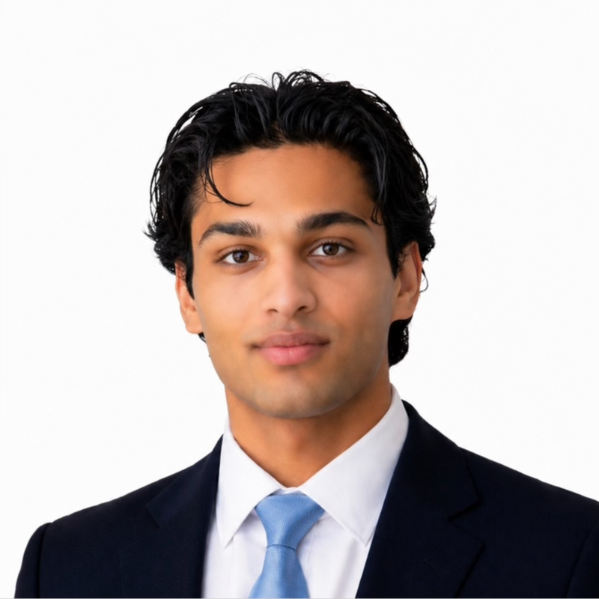
Aurum Capital
Kotaro Lindsay
Rose Sabu
Annabel Cox
Aryan Desai
Bachelor of Commerce (Finance & Accounting)
Bachelor of Commerce (Finance) / Laws (II)
Bachelor of Commerce (Finance & Accounting)
Bachelor of Science (Financial Mathematics & Statistics, Finance)
The University of Sydney
The University of Sydney
The University of Sydney
The University of Sydney
Graduating Class 2027
Graduating Class 2029
Graduating Class 2026
Graduating Class 2026

Slide 23
Australia Retail Growth
Strong forecast growth, with stable food retail turnover supporting significant specialty retail productivity gains
Overall retail market actuals & forecasts
Specialty retail productivity
Total retail turnover Australia per month ($m)
Average A-REIT specialty sales productivity ($ / sqm)
~5.0% CAGR forecast
5.1% CAGR
0.7% CAGR pre-COVID
Jun-15 – Jun-22
8.7% CAGR post-COVID
Food and grocery retail
Food retail turnover per month ($m)
Specialty sales productivity is supported by stronger foot traffic driven by non-discretionary anchors and rapid population growth concentrated in key trade areas like the Blacktown LGA
3.4% CAGR; annuity-style cash flows
Stable and growing food retail turnover supports annuity-like cash flows to grocery anchors, underpinning fixed annuity rents with 3% p.a. annual increases
Source: ABS; Colliers Research.

Slide 24
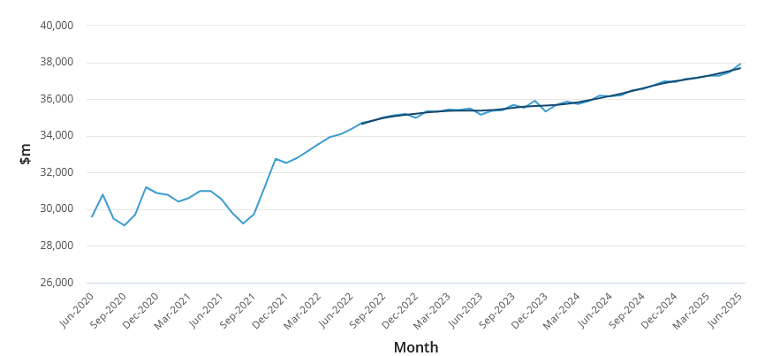
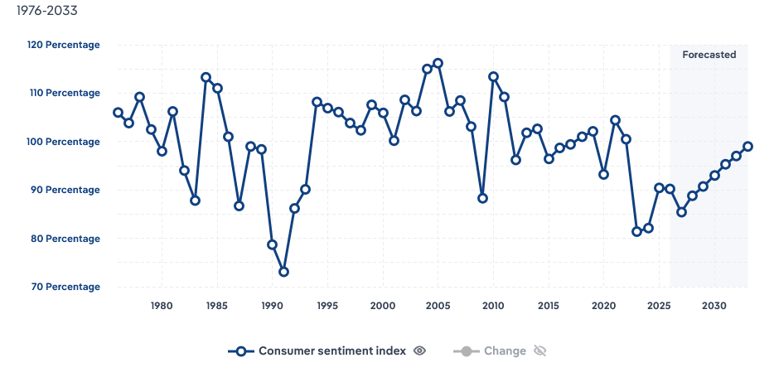
Retail Sales Growth Resilience
Retail sales are resilient, with total sales growing against historically volatile consumer sentiment
Increasing total retail sales…
…with growing consumer sentiment
Total retail sales in Australia
Consumer Sentiment Index
Retail sales have continued to grow despite historically volatile consumer sentiment, supporting the resilience of underlying
retail demand through the cycle
Source: ABS; IBISWorld

Slide 25
Australian Health & Wellness Thematic
Health and wellness spend growth outpacing CPI, with highest demand among Blacktown LGA demographics
Australia health thematic
Blacktown LGA alignment
YoY health spending growth by age group FY24-25
Young families account for the largest proportion of overall healthcare spending and see strong YoY growth – Blacktown’s median age is 34 with family households comprising 44% of all household types
Blacktown’s 2nd largest household demographic is couple households without dependents, comprising 19% of all households types, largely representing empty-nesters
Australia wellness thematic
Why this matters for Bayview
$194.4bn
Australian wellness market valuation
7.5%
Wellness market contribution to GDP
~$36bn
Wellness real estate sector size
Health & wellness tenants improve Bayview’s exposure to a large and growing service-led, experience-based nation-wide thematic
Source: CommBank Health Insights; Global Wellness Institute; NSW Government.

Slide 26





Australian E-Commerce Thematic
Grocery anchors and specialty health, wellness, and beauty retailing defend against e-commerce headwinds
E-Commerce in grocery & food retailing
Health, Wellness, and Beauty retailing
Proportion of industry group turnover online (%)
Australians accessing telehealth LTM
Declining telehealth post-COVID supports centre foot traffic to access healthcare
I
Wellness provider examples
Strong demand for wellness, resilient against e-commerce displacement
II
600+ locations
100+ locations
~12.7%
Coles & Woolworths online sales % FY25; both actively growing omni-channel experience e.g. Direct-to-Boot
~60+ locations
~75%
Of online sales fulfilled by omni-channel strategies including click-and-collect, maintaining foot traffic
Beauty service examples
Nail salons
In-store beauty
services, resilient
against e-commerce displacement
II
130+ locations
4,000+ locations
Online sales comprise a small and relatively stable proportion of food retailing, with the majority of online sales fulfilled through omni-channel formats including click-and-collect, supporting anchor tenants
190+ locations
Food Court
Service-led tenants require physical visitation and recurring footfall
Source: ABS; Coles; Woolworths; MA Financial.

Slide 27



Omni-Channel Retail Analysis
Omni-channel growth underpins the strategic value of convenience retail assets
82%
of Australians shopped online in 2025
69%
of shoppers want a range of delivery / collection options at checkout
+19.5%
YoY growth in online department-store spend, click and collect strong driver
~75%
of online orders are fulfilled through omni-channel strategies, e.g click-and-collect
Online growth complements physical retail through fulfillment, collection and cross-channel customer journeys
Pick-up represents 42.1% of eCommerce sales in Q4 FY25
~90% of Kmart Group sales still occur through physical channels
Click-and-collect available at all stores
+21.6% growth in Pick Up eCommerce sales
~1 in 3 online Kmart orders are collected in-store
95% of click-and-collect orders were available within two hours
785 Direct to Boot locations, 661 stores offering Direct to Boot Now
Omnichannel customers visit Kmart ~18.5x p.a vs 8.5x for in-store only
~83% of JB Hi-Fi Australia FY26 sales were non-online
Source: Australia Post; Woolworths; Kmart; JB HI-FI

Slide 28




Anchor Tenants Overview
Summary and recent performance
Coles Supermarkets is a major Australian retailer and supermarket chain, operating over 870 supermarkets across the nation
Woolworths Supermarkets is a major Australian retailer and supermarket chain, operating over 1729 supermarkets across the ANZ
Kmart is a discount department store chain offering a wide range of everyday household products, apparel and toys
Priceline Pharmacy is a leading Australian health and beauty retailer, operating over 470 stores nationally under Wesfarmers Health
Source: ASX filings for ASX: COL, ASX: WOW; ASX: WES;

Slide 29




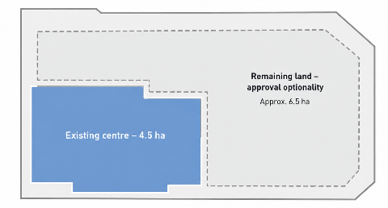
Value Creation Plan
Mechanics, Impact and Risks
$3.5m
Specialty Leasing Remix
Exit lower demand retailers
Illustrative value-add NOI decomposition from $10m value creation plan ($000s)
Repositioning to service-based offerings strengthens Bayview’s resilience to e-commerce disruption
Introduce health and beauty providers to align with demographic consumption patterns
Target turnover of 30% specialty tenancies
Strong demand for specialty tenant offerings underpins foot traffic and NOI growth
¹
$5.5m
Centre Improvements
$3.5m
Cosmetic refresh: signage, food court, amenities, and façade upgrades.
Upgrades complement leasing remix, strengthening tenant demand and attracting quality tenants
$1.2m
Loading dock upgrade to improve logistics and reduce congestion
IV
I
III
II
Greater alignment with tenant and exit buyer ESG commitments
I
Execution capability: CFS's minority stake yields significant dependency on Terralith's delivery of these capex initiatives
$0.8m
Solar and efficiency upgrades targeting 4.5 to 5 star NABERS rating
II
Leasing execution risk: new tenant take-up risk may materially delay NOI uplift and return targets
$1.0m
Development
planning approval
Obtain development approvals for
11 ha landholding
Secures development optionality without committing capital to construction, or delivery risk.
III
Capex delivery risk: underpinned by cost overruns, contractor delays, and ongoing trading disruption during works
Development area
~6.5 ha
Underpins stronger exit valuation, as buyers price in optionality without absorbing planning or refusal risk
Existing centre
4.5 ha
IV
Development approval: council approval timing is uncertain; delayed approval means exit valuations won't reflect capex
Note: (1) Tenants listed are for illustrative purposes only;
Notes:
Pros and cons,

Slide 30
ESG Capex Analysis
$800k in ESG capex could contribute a baseline 15% reduction in Bayview emissions p.a.
Bayview lettable area: 20,000 sqm
NSW centres avg. emissions intensity: 72 kg CO₂e / m² GLAR per year⁽¹⁾
Bayview est. emissions: 1,440 tCO₂e p.a.
Emissions reduction post-$800k capex program: 15% (below NABERS 25% benchmark)
1,440 tCO₂-e × 15%
Annual operational emissions avoided: ~216 tCO₂e per year
2025 NSW grid factor: 0.64 kg CO₂e/kWh⁽²⁾
Grid electricity avoided p.a.: 216 tCO₂e ÷ 0.64 kg/kWh = ~338 MWh p.a.
All-in commercial electricity cost: $0.22/kWh⁽³⁾
Indicative energy-cost saving post-capex: ~$74k p.a.
Scenario | Assumed emissions reduction | CO₂ emissions avoided p.a. | Implied electricity saved p.a. | Indicative cost saving p.a.
Downside | 10% | 144 tCO₂-e | 225 MWh | $49.5k
Base | 15% | 216 tCO₂-e | 338 MWh | $74.3k
Upside | 25% | 360 tCO₂-e | 563 MWh | $123.8k
Source: (1) NABERS average emissions intensity guidance 2025; (2) DCCEEW – Australian National Greenhouse Accounts Factors; (3) ACT Government – Business Lighting Efficiency calculator.

Slide 31
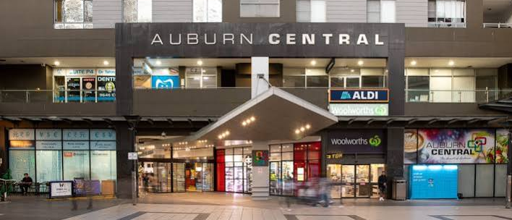
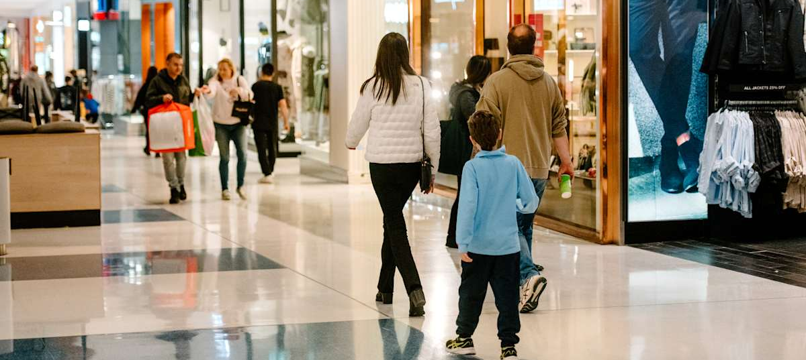
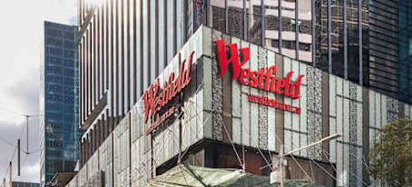
Capex Case Studies
Retail repositioning precedents support Bayview’s 7.5% blended yield-on-cost assumption
I
Auburn Central Tenant Remix
II
Roselands Centre Amenities
III
Westfield Sydney loading dock
Replaced underperforming DDS space with ALDI, Tong Li, food court, medical services, etc
~$20m development cost
Results:
12% income yield on cost
+6% occupancy increase
24.5% IRR on exit
Delivered 650-seat food court, upgraded skylights, refurbished upper levels
~$21m redevelopment
Results:
9% income yield on cost (1.0 ppt above forecast)
100% occupancy on opening
Introduced managed loading dock booking and logistics system
Analogous to $1.2m Bayview logistics capex
Results:
~43% reduction in average vehicle dwell time (44 to 25 minutes)
90%+ automatic bookings
7.5% yield on cost appears reasonable as a blended assumption for the Bayview value creation capex program (conservatively placed below ~9-12% comparables) – Bayview’s leasing, amenity, and logistics workstreams are supported by precedents
Source: Kyron Capital Group; Transport for NSW; Australian Securities Exchange.

Slide 32






Physical Asset Risk
Bayview’s physical asset risks are mitigated through prevention strategies and comprehensive insurance
Risks associated with a physical asset
Insurance and mitigants
Extreme rainfall and flooding
Low exposure to catastrophic events
Can overwhelm drainage systems and cause overland flooding of car parks, loading docks
I
NSW modelling records show no material Blacktown losses from cyclones or coastal hazards
Damage stock, electrical systems, and restrict deliveries and customer access
Localised rather than systemic hazard exposure
Hail and damaging winds
II
Flood and bushfire exposure is concentrated in specific flood catchments / bushfire prone areas, rather than the whole LGA
Damage roofing, facades, signage and rooftop equipment
Cause water ingress, power outages and temporary centre closure
Physical resilience and procedures
III
Drainage maintenance, roof inspections, secure equipment and emergency procedures reduce damage
Heatwaves and bushfires
Nearby bushfire can create ember, heat, and smoke exposure, impacting HVAC systems and air quality
Preventative measures
Prolonged high temperatures place stress on HVAC, refrigeration and electrical systems
IV
Bayview proposed Capex includes $0.8m of Solar PV and energy-efficiency upgrades
Catastrophic natural disasters
V
Insurance
Cause severe structural damage to buildings and infrastructure
Typically protected through commercial property / ISR insurance
Result in prolonged centre closures, significant repair costs
Source: NSW Reconstruction Authority, Blacktown City Council.

Slide 33








Exit Strategy
CFS should consider exit timeline, due diligence follow-ups with Terralith, and the potential buyer universe
Exit mechanics
Buyer universe led by Charter Hall and QIC
5-year hold period timeline
Institutional / Wholesale Capital
Deep capital pools and active defensive-retail appetite; high execution certainty
Entry
Stabilisation
Exit execution
FY27
Complete acquisition, deploy $10m value-creation capex
FY29
Occupancy, specialty mix and performance improve, progress development optionality
FY31
Binding bids, exchange & settle
Listed Retail REITs
Synergies & established retailer relationships; varying asset-size and format fit
Capital capacity
Specialist Retail Managers
Expertise and active management capability; likely to value leasing, remix and redevelopment upside
NOI uplift
Exit preparation
FY28
Releasing and capex initiatives start contributing to earnings – assumed $750k NOI uplift
FY30
Appoint selling agents, refresh valuation, align with TURF on sale
process
Value-Add / Private Capital
Flexible mandates, generally weaker scale or direct sub-regional acquisition evidence
Preferred exit pathway
Coordinated 100% sale at FY31; exit alongside TURF to
avoid liquidity / minority discount
Strategic fit
Highest conviction buyers
Due diligence areas
Proven sub-regional acquisition activity and capital capacity. Recent acquisitions closely match Bayview’s supermarket-anchored profile
I
Can CFS exit with TURF?
Right to participate in, approve, or initiate whole-asset sale, incl. tag/drag and consent provisions
Deep capital capacity, established NSW retail exposure and active expansion into convenience-led retail.
II
Can CFS exit without TURF?
Right to sell 13.4% interest independently, incl. transfer restrictions or buyout mechanism

Slide 34
Co-Investment Rationale
A co-investment is our preferred structure to gain exposure to Bayview
1
Precise portfolio construction
Reason:
CFS knows exactly what the $25m buys:
Retail exposure 15% to 19%
NSW exposure 65% to 67%
Bayview itself = 4.8% of GAV
Impact:
With incremental TURF investment, CFS is buying a portfolio with a changing composition. With a co-investment CFS locks in targeted retail and NSW exposure
2
Asset selection & underwriting transparency
Reason:
Through the co-investment, CFS can specifically underwrite tenant mix and leases, $10m value creation plan, capex economics, financing, and exit assumptions
Impact:
Given manager-level diligence is already complete, CFS can focus on the Bayview opportunity, giving direct visibility over the asset driving returns
3
Greater influence
over value creation
and exit
Reason:
Co-investment can provide CFS with negotiated asset-level rights over major capex decisions, exit process, consent rights, tag / drag, transfer or buyout rights
Impact:
Potential for stronger asset-level governance, subject to negotiated rights in the co-investment deed given 13.4% minority stake
4
Concentrated exposure to an asset with high conviction
Reason:
Co-investment lets CFS overweight Bayview specifically given our analysis concludes it has defensive income, Blacktown growth, leasing upside, and attractive pricing
Impact:
We already trust Terralith as a manager¹; the co-investment lets CFS selectively allocate more capital to the individual Terralith asset where we have highest conviction
Note: (1) According to the case brief. Terralith is a hypothetical manager, so no manager-level diligence is conducted in this paper.

Slide 35
Due Diligence and Investment Break Case
Key confirmatory diligence items
Outstanding due diligence questions
What would break the investment case?
Leasing pipeline & remix economics
Which of the 17 targeted specialty tenancies are approaching expiry / available for remix
What incentives, fit-out contributions, and downtime are required?
Leasing-led upside is not achievable
Tenant DD shows insufficient demand at underwritten rents or materially higher downtime
Mitigated via staged lease expiries rather than forced vacancies
Anchor income and lease security
Confirm remaining lease terms, 3% contractual escalators, options, and renewal intentions for anchors
Validate the defensive income floor
Defensive income floor is materially weaker than assumed
DD reveals unexpected break clauses, or weaker lease economics
Mitigated by anchors being major national retailers with entrenched demand and long-term leases with contractual escalators
Capex scope, delivery, and cost
Obtain contractor quotes and breakdown of $10m program
Confirm delivery timetable and contracts price structure (e.g. fixed vs. milestone)
Capex economics fail
Quotes exceed the $10m budget without a corresponding increase in achievable NOI or exit value
Mitigated by fixed-price contracts, clear scopes, staged deployment
Development approval and ESG feasibility
What is being approved across broader 11 ha site?
Confirm Bayview’s current NABERS baseline and whether the $800k ESG program can realistically achieve 4-5 star target
CFS cannot protect or realise its minority stake
Co-investment documentation prevents CFS from participating in a whole-asset sale, or leaves CFS trapped in a 13.4% minority position
Mitigate by making tag/drag, consent, transfer, and buyout rights conditions precedent to investment
Co-investment rights and exit mechanics
Rights to participate in, approve, or initiate whole-asset sale, including tag/drag and consent provisions
Confirm ability to sell 13.4% interest independently
Financing materially deteriorates before close
Final debt pricing / leverage materially exceeds underwriting or pushes ICR/LVR close to covenant thresholds
Mitigated by substantial covenant headroom in the base case

Slide 36
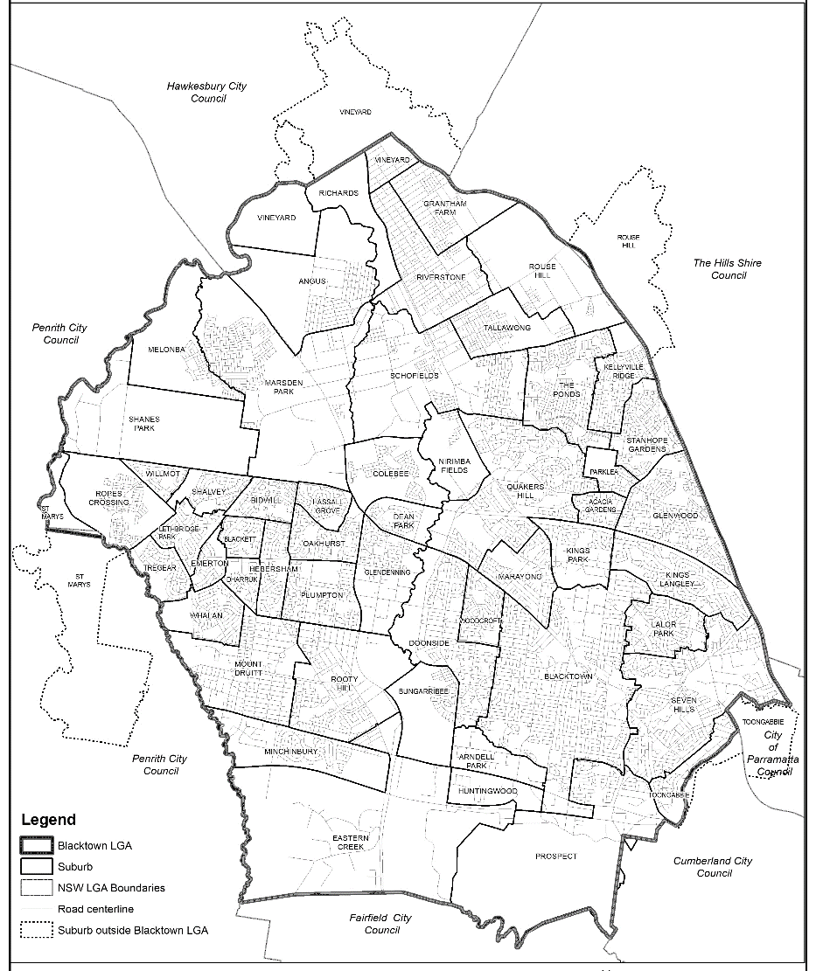
Blacktown Competitive Landscape
There are three other sub-regional centres spread across Blacktown LGA
Centre | Plumpton Central | Stanhope Village | Seven Hills Plaza
Size (GLA) | 36,900 sqm | 18,063 sqm | 20,986 sqm
Anchor tenants and tenant mix | Anchored by two national supermarkets, a discount department store, and a large format liquor store, with 60+ specialty stores | Anchored by Coles, Aldi and Big W with 80+ specialty stores | Anchored by Woolworths, and ALD with 85 specialty retailers
Catchment Area | Sub-regional | Sub regional | Sub-regional
Valuation | $200m+ | $158.0m (2022) | $82.5m (2013)
Cap Rate | Est. 6.00% | 5.5% | 6.25%
Source: Blacktown City Council; Haben; Revelop; AFR

Slide 37
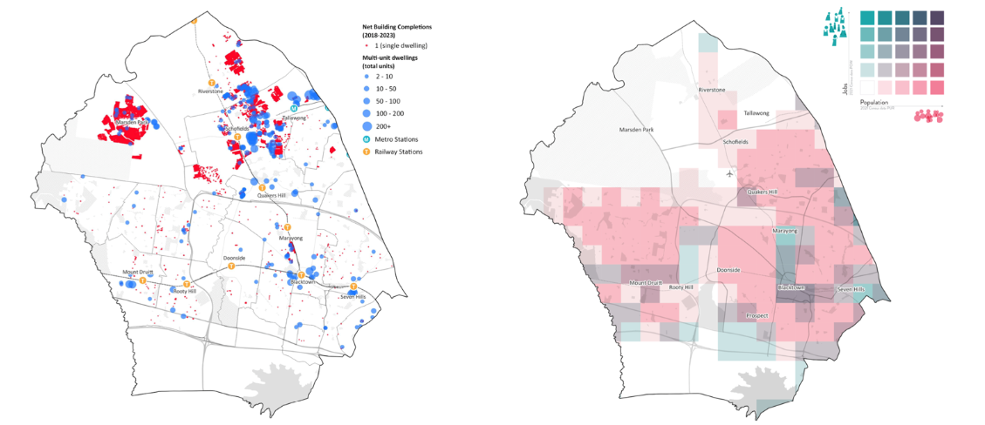
Blacktown LGA Location Analysis
Trade Area Analysis – Location of dwelling construction, public transport, jobs and population
Source: Blacktown City Council

Slide 38
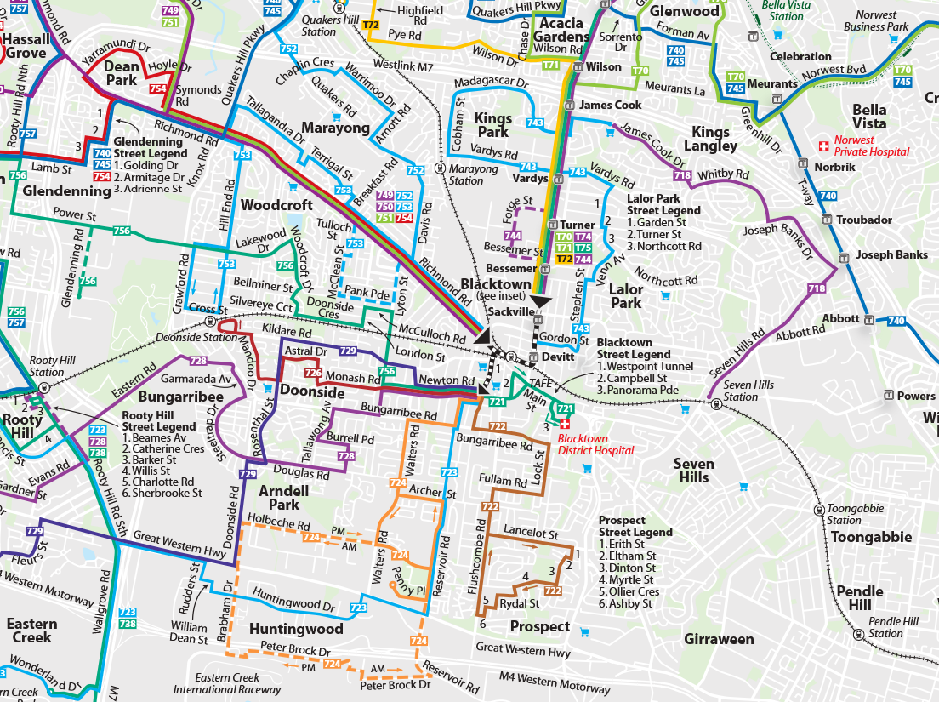
Blacktown Transportation Map
Location of public transport lines through Blacktown
Source: Transport for NSW, Busways

Slide 39
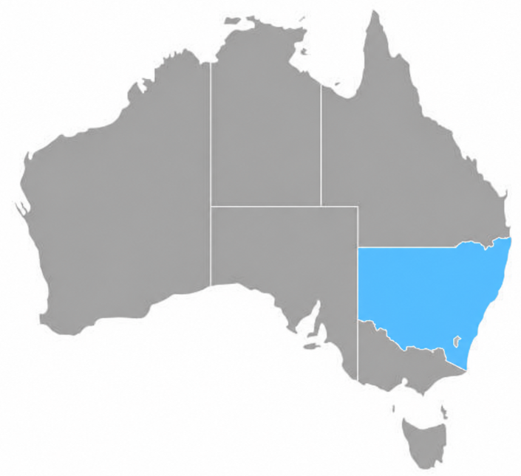
NSW Exposure Analysis
Incremental NSW concentration is supported by deep economic scale, strong retail fundamentals and Western Sydney growth
Deep, diversified economic base
$821bn – Australia’s largest state economy
8.6m → 9.6m population by 2035
75% economy is services, reducing reliance on commodity cycles
I
Strong retail fundamentals & constrained supply
+3.3% YoY NSW household spending in Feb-26
+1.0% QoQ Sydney sub-regional rents 1Q26
Only ~9k sqm of retail space delivered in 1Q26, supports rental growth through constrained supply
Bayview, Western Sydney, NSW
II
z
Deep investor liquidity supports exit
NSW represented ~50% of Aus retail transaction activity in YTD-25
NSW is the preferred domestic-capital destination (CBRE)
II
Incremental geographical exposure from the Bayview investment is to Western Sydney, not NSW as a whole
Western Sydney is home to 1 in 3 NSW residents
The 2026-27 NSW budget includes $3.5bn additional transport / road investment, $4.1bn for schools, and $3.8bn for hospitals in Western Sydney
Source: NSW Government, CBRE, NSW Budget 2026-27.

Slide 40
7 Powers Assessment
Scale Economies
Network Economies
Scale Economics
Large supermarket anchors support recurring traffic and spread centre operating costs
More attractive anchors and services increase visitation, supporting speciality tenants and improving centre offer
Network Economies
Counter Positioning
Counter Positioning
Switching Costs
Remix improves e-commerce resilience, but strategy does not structurally disadvantage competing centres
Relocation costs and established anchor leases support tenant retention
Branding
Cornered Resource
Process Power
Established community visitation, lacks destination brand strength of major regional centre
Established Western Sydney site with optionality and limited competing supply
Switching
Costs
Process Power
Branding
Cornered Resources
Tenant remix, leasing execution, centre upgrades and planning approvals can drive NOI uplift

Slide 41
Alignment With CFS Investment Philosophy
Bayview Village aligns with CFS's long term disciplined investment approach, risk tolerance and diversification objectives
CFS has a track record with retail real estate…
...and Bayview Village furthers diversification of the CFS Property Fund
1994, Platform Entry
CFS establishes CFS Retail Property Trust, becoming a top shopping centre owner and manager
Provides differentiated exposure to non-discretionary, convenience-led retail, reducing reliance on the fund's overweight industrial holdings
Grocery-anchored retail carries low correlation to office and industrial cycles, improving CFSPF's sector diversification
2013 to 2015, Structural Exit
Retail platform demerged as Novion, then merged into Vicinity Centres, ending CFS's direct exposure
Bayview Village's capital structure reflects CFS’s investment philosophy
CFS's guiding philosophy favours quality assets bought at sensible prices, capital deployed in a measured and disciplined way, and risk managed rather than avoided
Loan to Value: 35%
Entry Cap Rate: 6.45%
2026 to 2027
Re-Entry - CFS targets unlisted real estate at attractive prices; Bayview Village (A$25.0m) is the first step
Blacktown LGA is among the fastest growing municipalities in NSW; Western Sydney Airport (2026), Sydney Metro and WestConnex are expanding retail catchments and underpinning long term demand
1
Food and non-discretionary retail remains one of the few e-commerce resistant categories; online penetration in discretionary retail runs at roughly 2.5x the rate seen in food, reinforcing income durability
2
Source: Colonial First State, CBRE, Savills Research.

Slide 42
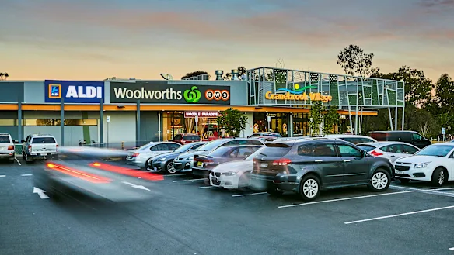
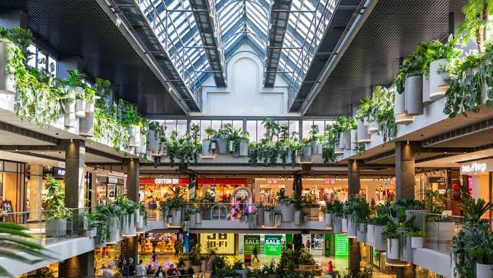
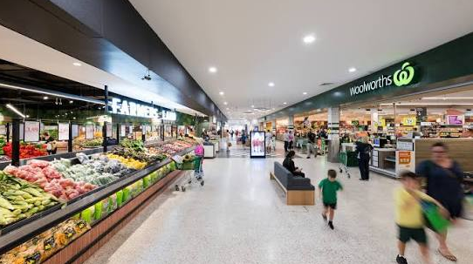
Retail Sub-Sector Comparison
Sub-regional centres combine defensive anchors with specialty-led growth potential
Asset Class | Neighbourhood | Sub-regional | Regional
Size (GLA) | 3,000-15,000 sqm | 15,000-40,000 sqm | 50,000 sqm+
Tenant mix | Supermarket, convenience focused | Department stores, fashion, entertainment | Supermarkets, entertainment, specialty retail
Catchment Area | Local | Metro | Metro
Source: ABS; CBRE

Slide 43
Precedent Transactions
Sub-regional comps at 5.5%–7.4% cap rates bracket Bayview Village's 6.45% entry and 6.25% exit
Category | Centre Name | Suburb | State | GLAR (sqm) | Sale Date | Sale Price ($AUD) | Stake | Cap Rate | $/sqm GLAR | Purchaser | Vendor
Large Format Retail | Bunnings Portfolio (6 Assets)* | Multiple | Multiple | 75,800 | Sep-25 | 290,000,000 | 100% | 5.10% | 3,826 | Charter Hall Direct Convenience Retail Fund (DCRF) | Wesfarmers
Large Format Retail | Logan Super Centre | Logan | QLD | 27,117 | Apr-25 | 115,000,000 | 100% | 6.68% | 4,241 | Centuria | HMC Capital (HDN - HomeCo Daily Needs REIT)
Large Format Retail | Joondalup Gate | Joondalup | WA | 24,682 | Jul-25 | 79,100,000 | 100% | 7.10% | 3,205 | AsheMorgan | APIL Group (Australasian Property Investments Ltd)
Neighbourhood Centres | St Ives Shopping Village | St Ives | NSW | 17,475 | May-25 | 450,000,000 | 100% | 5.25% | 25,751 | Iris Capital | EK Nominees
Neighbourhood Centres | Southport Park Shopping Centre | Southport | QLD | 20,012 | Dec-25 | 152,500,000 | 100% | 5.38% | 7,620 | Charter Hall (DCRF) | JVL Investment Group
Neighbourhood Centres | The Barracks (Retail + Office) | Brisbane | QLD | 19,433 | Oct-25 | 148,850,000 | 100% | 8.10% | 7,660 | Aware Super | Growthpoint
Regional Centres | Erina Fair | Erina | NSW | 114,598 | Oct-25 | 895,000,000 | 100% | 6.50% | 7,810 | Fawkner Property | Lendlease APPF Retail
Regional Centres | Macquarie Centre | Macquarie Park | NSW | 134,897 | Jun-25 | 830,000,000 | 50% | 5.25% | 12,306 | Unisuper JV Cbus Property | Dexus
Regional Centres | Westfield Chermside | Chermside | QLD | 176,585 | Dec-25 | 683,000,000 | 25% | 5.00% | 15,471 | Dexus Strategic Investment Trust 1 (SSIT1) | Scentre Group
Sub-Regional Centres | Burwood One | Burwood East | VIC | 26,597 | Dec-25 | 210,000,000 | 100% | 5.50% | 7,896 | Charter Hall | Si Feng
Sub-Regional Centres | Waverley Gardens Shopping Centre | Mulgrave | VIC | 39,553 | Jun-25 | 170,000,000 | 100% | 7.44% | 4,298 | Charter Hall | Elanor Investors Group
Sub-Regional Centres | Corio Village | Corio | VIC | 34,903 | Apr-25 | 146,000,000 | 100% | 6.75% | 4,183 | Charter Hall | IP Generation
Source: CBRE, JLL, CapitalIQ

Slide 44
Supporting Sensitivity Analysis
IRR sensitivity to key drivers
NOI Growth vs. Occupancy
LTV vs. Cost of Debt
Occupancy (%)
Cost of Debt (%)
 | 93.0% | 94.5% | 96.0% | 97.5% | 99.0%
2.0% | 9.2% | 10.0% | 10.9% | 11.7% | 12.5%
2.5% | 10.5% | 11.4% | 12.2% | 13.0% | 13.8%
3.0% | 11.8% | 12.7% | 13.5% | 14.3% | 15.1%
3.5% | 13.1% | 14.0% | 14.8% | 15.6% | 16.4%
4.0% | 14.4% | 15.3% | 16.1% | 16.9% | 17.7%
 | 4.00% | 4.50% | 5.00% | 5.50% | 6.00%
25.0% | 13.2% | 12.9% | 12.6% | 12.4% | 12.1%
30.0% | 13.7% | 13.4% | 13.0% | 12.7% | 12.4%
35.0% | 14.3% | 13.9% | 13.5% | 13.1% | 12.7%
40.0% | 15.0% | 14.5% | 14.1% | 13.6% | 13.1%
45.0% | 15.9% | 15.3% | 14.7% | 14.1% | 13.5%
NOI Growth (%)
LTV (%)
Holding Period vs. Exit Cap Rate
Capex Spend vs. NOI Uplift
Exit Cap Rate (%)
NOI Uplift ($000s)
 | 5.75% | 6.00% | 6.25% | 6.50% | 6.75%
3 | 22.2% | 18.6% | 15.3% | 12.1% | 9.1%
4 | 18.4% | 16.2% | 14.1% | 12.1% | 10.2%
5 | 16.5% | 15.0% | 13.5% | 12.1% | 10.7%
6 | 15.4% | 14.3% | 13.1% | 12.0% | 11.0%
7 | 14.7% | 13.7% | 12.9% | 12.0% | 11.2%
 | 250 | 500 | 750 | 1,000 | 1,250
6,000 | 12.4% | 13.4% | 14.4% | 15.4% | 16.4%
8,000 | 11.9% | 13.0% | 14.0% | 15.0% | 15.9%
10,000 | 11.5% | 12.5% | 13.5% | 14.5% | 15.5%
12,000 | 11.0% | 12.0% | 13.1% | 14.1% | 15.0%
14,000 | 10.5% | 11.6% | 12.6% | 13.6% | 14.6%
Holding Period (yrs)
Capex Spend ($000s)
Source: Aurum Capital estimates

Slide 45
Property Valuation
Assumptions
1.1 | Operating Assumptions
 | Net Lettable Area (NLA) | sqm | 20,000
 | Year 1 Net Operating Income (NOI) | $000s | 12,000
 | Annual NOI Growth | % | 3.0%
 | Leasing Fees (annual) | $000s | 250
 | Maintenance Capex (% of NOI) | % | 5.0%
 | Management Fee to Terralith (% of GAV) | % | 0.35%
 | Occupancy (by income) | % | 96.0%
 | WALE | Years | 3.1
 | Year 1 NOI per sqm | $/sqm | 600
 | Entry Price per sqm | $/sqm | 9,300
1.2 | Acquisition & Financing Assumptions
 | Acquisition Date | Date | 01/09/2026
 | Acquisition Value | $000s | 186,000 | 172,035
 | Implied Going-in Cap Rate | % | 6.45%
 | Acquisition Costs | % | 1.0%
 | Debt Establishment Fee | % | 1.0%
 | Loan to Value (LTV) | % | 35.0%
 | Debt Facility Terms | Terms | Interest Only
 | Base Rate (5yr Swap) | % | 3.5%
 | (+) Margin | % | 1.5%
 | All-in Interest Rate | % | 5.00%
 | Holding Period | Years | 5
 | Exit Date | Date | 31/08/2031
 | Exit Cap Rate | % | 6.25%
 | Exit Price | $000s | 228,193
 | Selling Costs | % | 1.5%
Source: Aurum Capital estimates

Slide 46
Property Valuation
Assumptions
1.3 | Value-Add Capex Assumptions | [Units]
 | Capex for Value Creation Plan | $000s | 10,000
 | Capex Timeline (FY incurred) | FY | 2026
 | Debt Funded % | % | 100.0%
 | Capex Yield on Cost | % | 7.5%
 | NOI Uplift from Value-Add (Yr 1+) | $000s | 750
1.4 | CFS Co-Investment Assumptions | [Units]
 | CFS Co-Investment Ticket Size | $000s | 25,000
 | Implied CFS Equity Stake | % | 20.2%
 | Current CFSPF Gross Asset Value (GAV) | $000s | 496,000
 | Ticket as % of Asset Value | % | 13.4%
Sources & Uses
2.1 | Sources
 | Acquisition Debt | $000s | 65,100
 | Capex Debt Facility | $000s | 10,000
 | Total Equity | $000s | 123,511
 | Total Sources | $000s | 198,611
2.2 | Uses
 | Acquisition Price | $000s | 186,000
 | Acquisition Costs | $000s | 1,860
 | Debt Establishment Fee | $000s | 751
 | Value-Add Capex Programme | $000s | 10,000
 | Total Uses | $000s | 198,611
 | Check | $000s | OK
Source: Aurum Capital estimates

Slide 47
Property Valuation
Summary Cash Flows
3.1 | Unlevered Cashflows
 | Property Acquisition Price | $000s | (187,860)
 | (-) Value-Add Capex Programme | $000s | (10,000)
 | (+) NOI | $000s |  | 12,174 | 12,567 | 12,972 | 13,390 | 13,819
 | (-) Maintenance Capex | $000s |  | (609) | (628) | (649) | (669) | (691)
 | (+) Sale Proceeds | $000s |  |  |  |  |  | 228,193
 | (-) Selling Costs | $000s |  |  |  |  |  | (3,423)
 | Unlevered Project Cash Flows | $000s | (197,860) | 11,565 | 11,939 | 12,324 | 12,720 | 237,899
 | Unlevered IRR | % | 11.1%
 | Unlevered MOIC | x | 1.4x
3.2 | Levered Cashflows
 | Initial Equity Investment | $000s | (123,511)
 | (+) NOI | $000s |  | 12,174 | 12,567 | 12,972 | 13,390 | 13,819
 | (-) Maintenance Capex | $000s |  | (609) | (628) | (649) | (669) | (691)
 | (-) Interest Expense | $000s |  | (3,755) | (3,755) | (3,755) | (3,755) | (3,755)
 | (+) Sale Proceeds | $000s |  |  |  |  |  | 228,193
 | (-) Selling Costs | $000s |  |  |  |  |  | (3,423)
 | (-) Debt Repayment on Exit | $000s |  |  |  |  |  | (75,100)
 | Levered Project Cash Flows | $000s | (123,511) | 7,810 | 8,184 | 8,569 | 8,965 | 159,044
 | Levered IRR | % | 13.5%
 | Equity Multiple (MOIC) | x | 1.6x
 | Avg. Distribution Yield (on equity) | % | 6.8%
Source: Aurum Capital estimates

Slide 48
Property Valuation
CFS Co-Investment Returns
3.3 | CFS Co-Investment Returns | [Units]
 | CFS Pro-Rata Share of Equity | % | 20.2%
 | CFS Equity Investment | $000s | (25,000)
 | CFS Share of Levered Cash Flows | $000s |  | 1,581 | 1,657 | 1,734 | 1,815 | 32,192
 | CFS Net Cash Flows | $000s | (25,000) | 1,581 | 1,657 | 1,734 | 1,815 | 32,192
 | CFS NPV | $000s | 2,963
 | CFS Levered IRR | % | 13.5%
 | CFS Equity Multiple | x | 1.6x
 | CFS Avg. Distribution Yield | % | 6.8%
 | CFS Asset Exposure as % of CFSPF GAV | % | 4.8%
Operating Cash Flows
Base NOI (pre value-add) | $000s | 12,000 | 12,360 | 12,731 | 13,113 | 13,506 | 13,911
(+) Value-Add NOI Uplift | $000s | - | 750 | 773 | 796 | 820 | 844
Gross Operating Income | $000s | 12,000 | 13,110 | 13,503 | 13,908 | 14,326 | 14,755
(-) Leasing Fees | $000s | (250) | (250) | (250) | (250) | (250) | (250)
(-) Management Fee to Terralith | $000s | (651) | (686) | (686) | (686) | (686) | (686)
Net Operating Income (NOI) | $000s | 11,099 | 12,174 | 12,567 | 12,972 | 13,390 | 13,819
Debt Schedule
Opening Loan Balance | $000s |  | 75,100 | 75,100 | 75,100 | 75,100 | 75,100
(+) Capex Facility Drawdown | $000s | 10,000 | - | - | - | - | -
Closing Loan Balance | $000s | 75,100 | 75,100 | 75,100 | 75,100 | 75,100 | 75,100
Interest Expense | $000s |  | (3,755) | (3,755) | (3,755) | (3,755) | (3,755)
Source: Aurum Capital estimates

Slide 49
Property Valuation
Tenant Level NOI Build
6.1 | Tenancy Mix (per Information Memorandum)
 | Anchor Tenants (Coles, Woolworths, Kmart, Priceline) | % inc | 42.0%
 | Mini-Majors (value / general merchandise) | % inc | 19.0%
 | Specialty Retail (food court, services, value retail) | % inc | 32.0%
 | Vacant (to be addressed via value-add) | % inc | 7.0%
 | Total |  | 100.0%
 | Occupied (income-producing) |  | 93.0%
6.2 | Passing NOI by Tenant Category
 | Anchor Tenants (3.0% contractual) | $000s | 5,419 | 5,582 | 5,749 | 5,922 | 6,100 | 6,283
 | Mini-Majors (3.0% market) | $000s | 2,452 | 2,525 | 2,601 | 2,679 | 2,759 | 2,842
 | Specialty Retail (3.0% market) | $000s | 4,129 | 4,253 | 4,380 | 4,512 | 4,647 | 4,787
 | Total Passing NOI | $000s | 12,000 | 12,360 | 12,731 | 13,113 | 13,506 | 13,911
 | Check: vs Base NOI (pre value-add) | $000s | OK | OK | OK | OK | OK | OK
6.3 | Value-Add NOI Decomposition ($10m Capex Program)
 |  |  | Capex | Yield o/c | Stab. NOI
 | Specialty Leasing Remix (target 30% turnover) |  | 3,500 | 7.5% | 263
 | Centre Upgrades (amenity, food court, facade) |  | 3,500 | 7.5% | 263
 | Loading Dock (anchor logistics / circulation) |  | 1,200 | 7.5% | 90
 | ESG / Solar PV (NABERS 4.5-5 star target) |  | 800 | 7.5% | 60
 | Development Approval (air rights / car park) |  | 1,000 | 7.5% | 75
 | Total Program |  | 10,000 | 7.5% | 750
 | Check |  | OK |  | OK
6.4 | Income Quality Metrics
 | % of NOI from Anchors (defensive, contractual) |  | 45.2%
 | Occupancy (by income) |  | 96.0%
 | WALE | yrs | 3.1
 | Stabilised NOI (Yr1 FY28, net of fees) | $000s | 12,174
Source: Aurum Capital estimates

Slide 50
Property Valuation
Lease Expiry & WALE Profile
7.1 | Category Lease Terms (WALE Build)
 | Anchor Tenants (long-term, contractual) | yrs | 4.0
 | Mini-Majors | yrs | 3.0
 | Specialty Retail (shorter-term, higher churn) | yrs | 2.0
 | Weighted Average Lease Expiry (WALE) | yrs | 3.1
7.2 | Re-leasing Assumptions
 | Tenant retention rate (on expiry) |  | 75.0%
 | Market rent reversion (re-lease vs passing) |  | 2.0%
 | Re-leasing downtime (non-renewal) | mths | 6.0
 | New-lease incentive (% annual rent) |  | 15.0%
7.3 | Expiry Profile & Income at Risk
 | % of passing income expiring p.a. | % |  | 35.3% | 35.3% | 35.3% | 35.3% | 35.3%
 | Passing income expiring | $000s |  | 4,364 | 4,495 | 4,629 | 4,768 | 4,911
 | Income at risk | $000s |  | 545 | 562 | 579 | 596 | 614
 | Cumulative income re-leased (% of roll) | % |  | 35.3% | 70.6% | 105.9% | 141.2% | 176.5%
Source: Aurum Capital estimates

Slide 51
Property Valuation
Debt & Covenant Compliance
8.1 | Facility Summary
 | Acquisition Facility (IO, 5yr swap + margin) | $000s | 65,100
 | Capex Facility (IO, 100% debt-funded) | $000s | 10,000
 | Total Debt | $000s | 75,100
 | All-in Interest Rate (swap 3.5% + margin 1.5%) | % | 5.0%
 | Acquisition LVR (senior, per IM) | % | 35.0%
 | Total Entry LVR (incl. capex facility) | % | 40.4%
8.2 | Covenant Thresholds (indicative senior terms)
 | Minimum ICR (NOI / interest) | x | 2.0x
 | Maximum LVR (debt / value) | % | 55.0%
 | Minimum DSCR (net op. cash flow / interest) | x | 1.5x
8.3 | Covenant Test Schedule (FY28–FY32)
 | Net Operating Income | $000s |  | 12,174 | 12,567 | 12,972 | 13,390 | 13,819
 | (-) Maintenance Capex | $000s |  | (609) | (628) | (649) | (669) | (691)
 | Net Cash Flow for Debt Service | $000s |  | 11,565 | 11,939 | 12,324 | 12,720 | 13,128
 | Interest Expense | $000s |  | 3,755 | 3,755 | 3,755 | 3,755 | 3,755
 | ICR (NOI / interest) | x |  | 3.2x | 3.3x | 3.5x | 3.6x | 3.7x
 | DSCR (net CF / interest) | x |  | 3.1x | 3.2x | 3.3x | 3.4x | 3.5x
 | Asset Value (NOI / going-in cap) | $000s |  | 188,697 | 194,793 | 201,072 | 207,540 | 214,201
 | LVR (debt / value) | % |  | 39.8% | 38.6% | 37.3% | 36.2% | 35.1%
 | Covenant Status |  |  | PASS | PASS | PASS | PASS | PASS
Source: Aurum Capital estimates

Slide 52
Property Valuation
Sensitivity Analysis
9.1 | Levered IRR — Exit Cap Rate vs. NOI Growth
 |  |  |  |  | NOI Growth
 |  |  | 1 | 2 | 3 | 4 | 5
 |  | 13.5% | 2.0% | 2.5% | 3.0% | 3.5% | 4.0%
 |  | 5.75% | 13.9% | 15.2% | 16.5% | 17.8% | 19.1%
 |  | 6.00% | 12.4% | 13.7% | 15.0% | 16.3% | 17.6%
 | Exit Cap Rate | 6.25% | 10.9% | 12.2% | 13.5% | 14.8% | 16.1%
 |  | 6.50% | 9.4% | 10.8% | 12.1% | 13.4% | 14.7%
 |  | 6.75% | 8.1% | 9.4% | 10.7% | 12.0% | 13.3%
9.2 | Levered IRR — Leverage (LTV) vs. Exit Cap Rate
 |  |  |  |  | LTV
 |  |  | 1 | 2 | 3 | 4 | 5
 |  | 13.5% | 25.0% | 30.0% | 35.0% | 40.0% | 45.0%
 |  | 5.75% | 15.3% | 15.9% | 16.5% | 17.3% | 18.1%
 |  | 6.00% | 14.0% | 14.4% | 15.0% | 15.6% | 16.4%
 | Exit Cap Rate | 6.25% | 12.6% | 13.0% | 13.5% | 14.1% | 14.7%
 |  | 6.50% | 11.4% | 11.7% | 12.1% | 12.5% | 13.0%
 |  | 6.75% | 10.2% | 10.4% | 10.7% | 11.1% | 11.5%
9.3 | Levered IRR — Entry Cap Rate vs. Exit Cap Rate
 |  |  |  |  | Entry Cap Rate
 |  |  | 1 | 2 | 3 | 4 | 5
 |  | 13.5% | 5.95% | 6.20% | 6.45% | 6.70% | 6.95%
 |  | 5.75% | 12.8% | 14.7% | 16.5% | 18.3% | 20.1%
 |  | 6.00% | 11.2% | 13.1% | 15.0% | 16.8% | 18.5%
 | Exit Cap Rate | 6.25% | 9.7% | 11.7% | 13.5% | 15.3% | 17.1%
 |  | 6.50% | 8.3% | 10.2% | 12.1% | 13.9% | 15.6%
 |  | 6.75% | 6.9% | 8.8% | 10.7% | 12.5% | 14.3%
Source: Aurum Capital estimates

Slide 53
Weighted Average Cost of Capital
Assumptions
Company Inputs |  | Value
Debt to Value Ratio |  | 35.0%
Equity to Value Ratio |  | 65.0%
Debt to Equity Ratio |  | 53.8%
Effective Tax Rate |  | 30.0%
Risk-free Rate | Value | Weighting
5Y Gov Bond Yield | 4.69% | 50.0%
10Y Gov Bond Yield | 5.07% | 50.0%
Risk-free Rate | 4.88% | 100.0%
Market Risk Premium | Value | Weighting
Bloomberg MRP | 5.84% | 33.3%
Damodaran ERP | 4.23% | 33.3%
Wright approach | 5.82% | 33.3%
Expected market return | 10.70%
Market Risk Premium | 5.30% | 100.0%
Cost of Debt | Value | Weighting
5Y BBSW + spread | 5.00% | 100.0%
SOFR | 3.66% | -
Cost of Debt | 5.00% | 100.0%
Beta | Value | Weighting
Comparator Beta | 0.94 | 100.0%
Beta | 0.94 | 100.0%
WACC
Cost of Equity
Market Risk Premium |  | 5.30%
Beta |  | 0.94
Risk-free Rate |  | 4.9%
Cost of Equity |  | 9.88%
Cost of Equity Portion |  | 6.4%
Cost of Debt
Cost of Debt |  | 5.0%
Tax Rate |  | 30.0%
After-tax Cost of Debt |  | 3.5%
Cost of Debt Portion |  | 1.2%
WACC |  | 7.65%
Beta Calculations
 |  |  | 3Yr Average |  |  |  |  |  |  | Unlevered
Company |  | Ticker | Tax Rate | Levered Beta | Net Debt (M) | Market Cap. (M) | Enterprise Val. (M) | Pref./Equity | Debt/Equity | Beta
Region Group |  | RGN | 29.78% | 0.89 | 1,627.2 | 2,584.7 | 4,211.9 | - | 63.0% | 0.62
Charter Hall Retail REIT |  | CQR | 0.00% | 0.90 | 1,545.6 | 2,307.5 | 3,853.1 | - | 67.0% | 0.54
HomeCo Daily Needs REIT |  | HDN | 0.00% | 0.85 | 1,853.5 | 2,343.3 | 4,196.8 | - | 79.1% | 0.47
Dexus Convenience Retail REIT |  | DXC | 0.00% | 0.69 | 237.9 | 375.8 | 613.7 | - | 63.3% | 0.42
Average |  |  | 7.4% | 0.83 | 1,316.1 | 1,902.8 | 3,218.9 | - | 68.1% | 0.51
Target - D/E |  |  |  |  |  |  |  |  |  | 53.8%
Tax Rate |  |  |  |  |  |  |  |  |  | 30.0%
TARGET Relevered Beta |  |  |  |  |  |  |  |  |  | 0.94
Source: Aurum Capital estimates

Slide 54
Portfolio Construction
Portfolio Composition
1.0 | Inputs
 |  | Current CFSPF GAV | $000s | 496,000
 |  | Bayview investment | $000s | 25,000
 |  | Pro forma CFSPF GAV | $000s | 521,000
2.0 | Portfolio Construction
 | 2.1 | Sector
 |  | Sector |  | Current % GAV | Current $000s | Investment $000s | Post-inv. $000s | Post-inv. % GAV
 |  | Industrial |  | 40.0% | 198,400 | - | 198,400 | 38.1%
 |  | Office |  | 30.0% | 148,800 | - | 148,800 | 28.6%
 |  | Retail |  | 15.0% | 74,400 | 25,000 | 99,400 | 19.1%
 |  | Residential |  | 10.0% | 49,600 | - | 49,600 | 9.5%
 |  | Listed RE |  | 5.0% | 24,800 | - | 24,800 | 4.8%
 |  | Total |  | 100% | 496,000 | 25,000 | 521,000 | 100%
 |  | CHECK |  |  | TRUE | TRUE | TRUE
 | 2.2 | Geography
 |  | Geography |  | Current % GAV | Current $000s | Investment $000s | Post-inv. $000s | Post-inv. % GAV
 |  | NSW |  | 65.0% | 322,400 | 25,000 | 347,400 | 66.7%
 |  | VIC |  | 15.0% | 74,400 | - | 74,400 | 14.3%
 |  | QLD |  | 15.0% | 74,400 | - | 74,400 | 14.3%
 |  | WA |  | 5.0% | 24,800 | - | 24,800 | 4.8%
 |  | SA & WA |  | 0.0% | - | - | - | 0.0%
 |  | TAS |  | 0.0% | - | - | - | 0.0%
 |  | Total |  | 100.0% | 496,000 | 25,000 | 521,000 | 100.0%
 |  | CHECK |  |  | TRUE | TRUE | TRUE
 | 2.3 | Gearing
 |  |  |  | Current % GAV | Current $000s | Bayview % | Investment $000s | Post-inv. $000s | Post-inv. % GAV
 |  | Individual investment |  | 45% | 223,200 | 100.0% | 25,000 | 248,200 | 47.6%
 |  | Look-through LTV |  | 30% | 148,800 | 35.0% | 8,750 | 157,550 | 30.2%
 | 2.4 | Exposures
 |  |  |  | Current % GAV | Current $000s | Bayview % | Investment $000s | Post-inv. $000s | Post-inv. % GAV
 |  | Direct/Co-investment |  | 35% | 173,600 | 100.0% | 25,000 | 198,600 | 38.1%
 |  | Individual manager |  | 20% | 99,200 | 100.0% | 25,000 | 124,200 | 23.8%
 |  | Individual fund |  | 15% | 74,400 | 0.0% | - | 74,400 | 14.3%
 |  | Individual asset |  | 5% | 24,800 | 100.0% | 25,000 | 25,000 | 4.8%
 |  | Individual tenant |  | 3% | 14,880 | 100.0% | 25,000 | 39,880 | 7.7%
(1)
Source: Aurum Capital estimates. Note: (1) Worst-case compliance test, assume that the entire $25m Bayview exposure relates to 1 tenant.

Slide 55
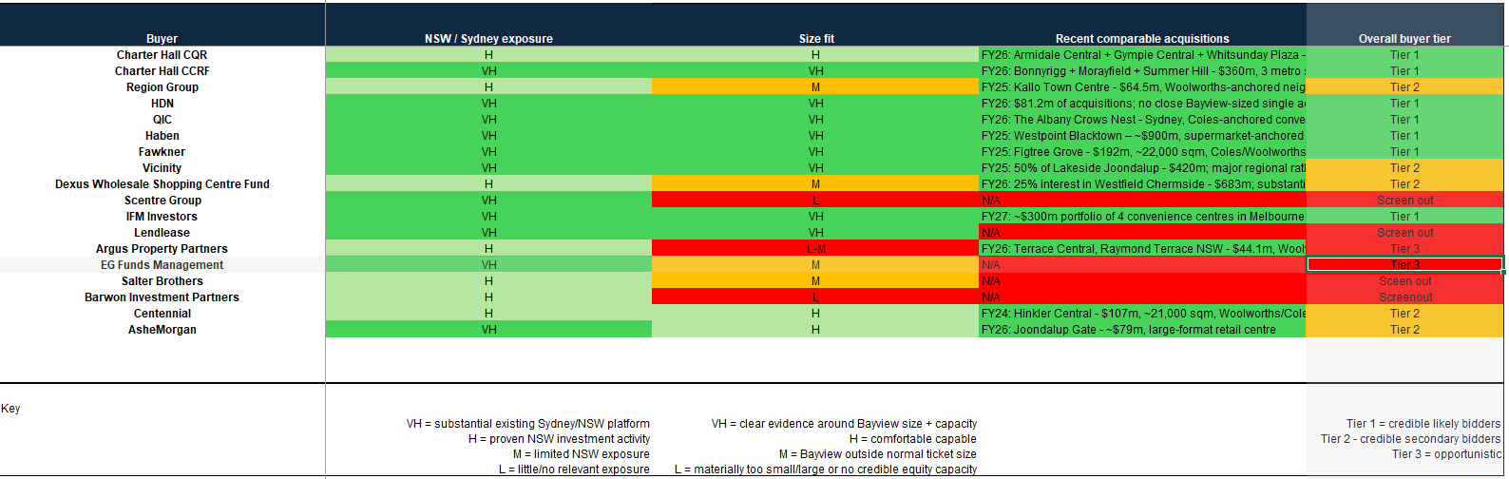
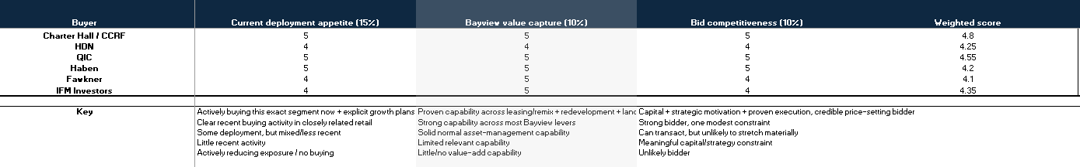
Buyer Universe

Slide 56
Disclaimer
Aurum Capital
Important notice. This presentation has been prepared by Aurum Capital ("Aurum") for the exclusive use of Colonial First State and the CFS Property Fund (together, the "Recipient") solely for the purpose of assisting the Recipient's evaluation of the proposed co-investment in Bayview Village (the "Transaction"). It is provided on a strictly confidential basis and may not be reproduced, redistributed or disclosed, in whole or in part, to any other person without the prior written consent of Aurum.
No offer or solicitation. This presentation is for discussion purposes only. It does not constitute an offer, invitation or recommendation to subscribe for, purchase or dispose of any security or interest, nor does it constitute a contract or commitment of any kind. It is not a product disclosure statement, prospectus or other disclosure document under the Corporations Act 2001 (Cth) and has not been lodged with the Australian Securities and Investments Commission.
Not personal advice. The information herein is general in nature and does not take into account the investment objectives, financial situation or particular needs of any person. It does not constitute personal financial product, legal, taxation or accounting advice. The Recipient should obtain independent professional advice appropriate to its own circumstances before acting on any information contained in this presentation.
Information sources and no verification. This presentation is based on information supplied by Terralith and its advisers, together with publicly available and third-party data, including CBRE, JLL, Knight Frank, S&P Capital IQ, the Australian Bureau of Statistics and Blacktown City Council. Aurum has not independently verified this information and assumes no obligation to do so. No representation or warranty, express or implied, is made as to the accuracy, completeness or reasonableness of any information contained herein.
Forward-looking statements and illustrative analysis. Certain statements constitute forward-looking statements, including projected net operating income, capitalisation rates, returns and distribution yields. Such statements are based on assumptions regarding future events and are subject to significant business, economic, market and regulatory uncertainties and contingencies, many of which are beyond the control of Aurum, the Recipient or Terralith. Actual results may differ materially from those projected. All valuation and returns analysis is illustrative and prepared for discussion purposes only. Past performance is not indicative of future performance.
No liability. To the maximum extent permitted by law, Aurum and its related bodies corporate, directors, officers, employees and advisers disclaim all liability for any loss or damage, whether direct, indirect or consequential, arising from reliance on this presentation. The Recipient must rely on its own enquiries, due diligence and assessment of the Transaction. Aurum is under no obligation to update or revise this presentation for subsequent events.

Slide 57
10 September 2026

