Slide 1
Target Price (USD): $174.10
Last Close (USD): $75.76
4-Year IRR: 22.0%

Slide 2
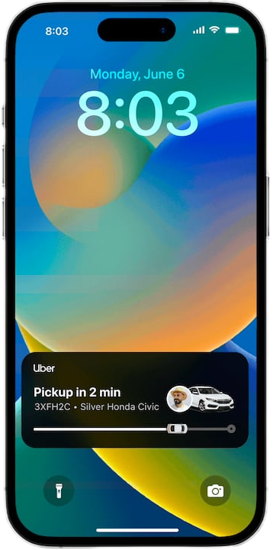
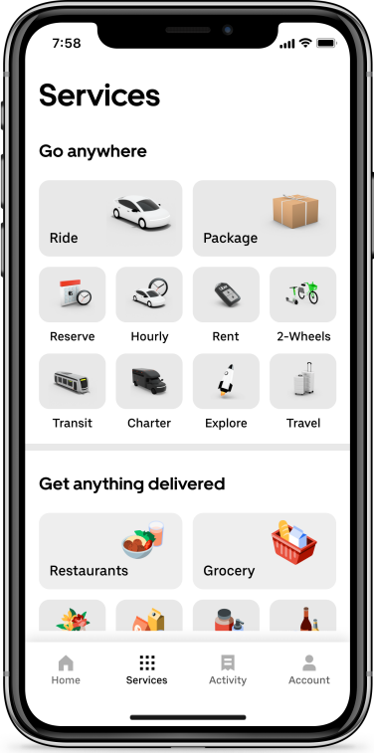
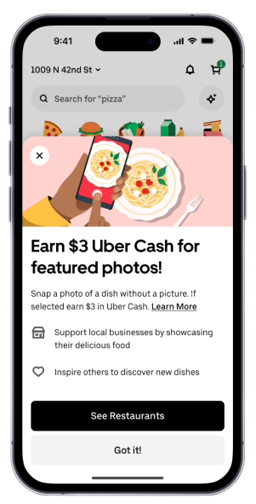


Uber has transformed from a ride-hailing app to a global mobility and delivery platform
Context
Ride
Delivery
Tap a button, get a car, anywhere in 70+ countries
Food, groceries, retail. All delivered in minutes through Uber Eats
Rentals
Employment
Need it for a day, not a trip? Book a car in-app
Turn spare hours into income, on your own schedule

Slide 3
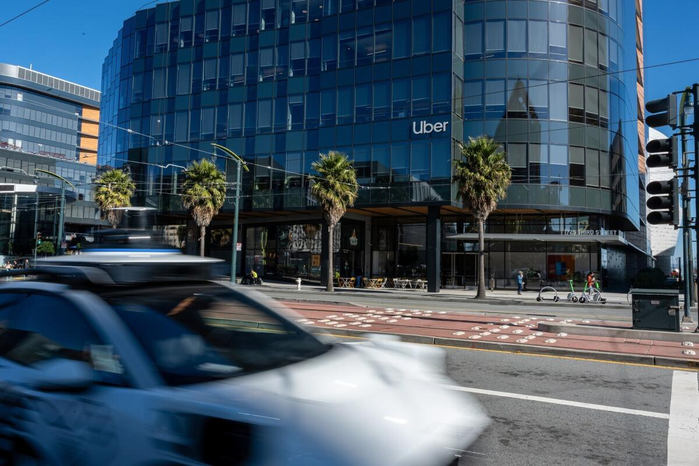
Underpinned by operating leverage & durable demand aggregation, Uber creates AV resilience
Executive Summary
Investment
Recommendation
BUY:
Uber can compound earnings materially faster than bookings, requiring neither AV upside nor Delivery Hero synergies to produce meaningful returns
Industry Overview
Company Overview
Overview
As AVs fragment vehicle supply, scaled demand aggregation becomes increasingly valuable
Uber’s 208m-user global platform connects Mobility and Delivery demand, creating multiple monetisation layers
Our view of Uber is underpinned by three earnings drivers the market continues to underestimate
Investment Thesis
Operating Leverage
Delivery Hero Optionality
AV Aggregation
Earnings can compound faster than bookings as Uber monetises existing demand
Base case assumes zero synergies, leaving monetisation and advertising upside incremental
Uber can remain the demand and distribution layer even as autonomous fleets gain share
22.0%
$105.61
34.6%
Valuation
4-Year IRR
Triangulated Valuation
Upside to Current Price
Risk and Mitigants
AV Disintermediation
Delivery Hero Execution
Margin & Regulatory Pressure

Slide 4
Overview

Slide 5
While AV changes who supplies the ride, ownership over customer segments remains unchanged
Industry Overview
Delivery is consolidating, remaining locally dense…
…with AV splitting mobility into three layers
2024E
2030E
1%
GB ($bn)
CAGR: 5.1%
Uber
Lyft
AV Businesses
2019
2020
2021
2022
2023
2024
2025
2026
2027
2028
2029
2030
2031
Ride-hailing is growing as a local-liquidity business…
…but regulation and cyclicality limit local growth
1
Mobility is separating into 3 layers: autonomy, fleet and demand
Segment | Mobility | Delivery | Freight
Q2 2026 GB ($bn) | 28.988 | 27.463 | 1.571
YoY reported | 22% | 26% | 25%
YoY const. Ccy | 20% | 25% | 25%
Segment op income ($m) | 2215 | 1055 | -24
2
Uber's $15bn Delivery Hero bid adds $42bn of gross bookings across 50 markets
3
15 years of licensing, insurance, tax and safety infrastructure raises cost of entry
4
Monetisation moves beyond take-rate through advertising

Slide 6
Uber is a diversified platform, turning scale into profit growth that outpaces gross bookings
Platforms & Business Structure
Uber’s platform has unmatched scale globally…
…monetising one demand base across multiple products
208M
MAPCs
3.9B Quarterly trips
$58B
Gross Bookings
Mobility
Rides, taxis and growing AV supply
Delivery
Food, grocery and retail, monetised via ads and members
Freight
Digital marketplace matching commercial shippers and carriers
Uber connects consumers across a global marketplace, moving into a chapter where operating income and cash generation must expand simultaneously.
Monetisation layers
Uber One, advertising and cross-sell
Earnings compound faster than bookings and revenue…
…with the demand base harder to replicate given Uber’s moat
Q2 2026 YoY growth
Segmented Operating Income Margins
1
Local liquidity: Recreating dense supply & demand repeatedly
 | 2026E | 2030E
Mobility | 30.1% | 32.6%
Delivery | 20.1% | 24.0%
Corporate G&A | 7.8% | 5.6%
2
Two products for each acquired customer: Superior customer-acquisition
3
Membership: Uber One deepens frequency and cross-product attachment
Margin expansion is driven by advertising, membership and cross-sell
4
Fixed infrastructure: Insurance, licensing, safety, payments, tax and workers

Slide 7




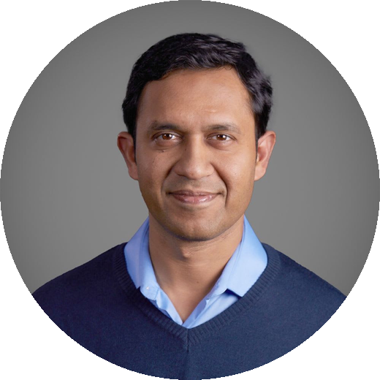

Uber combines strong discipline with a culture capable of sustaining long-term growth
Management Overview
Uber’s management team combines marketplace operating depth with broad consumer technology, product and finance experience
Dara Khosrowshahi
Andrew Macdonald
Jill Hazelbaker
Balaji Krishnamurthy
Sachin Kansal
Praveen N. Naga
CEO
President & COO
President & CCAO
CFO
CPO
CTO
Former CEO
Expedia
Former Bain & Co.
Consultant
Former Snap &
Google Executive
Former Goldman Sachs
Equity Research
Former VP Product
Lookout
Former Engineering
Leader LinkedIn
Tenured management and an institutional register…
…create a supportive and engaging internal culture
★
★
★
★
☆
Average
Age
49.5 Years
3.7 Star Glassdoor rating based on 16,398 reviews
Average
Tenure
6.0 Years
65% would recommend working at Uber to a friend
70% approve of CEO Dara Khosrowshahi
Employee ratings are in line with the Information Technology industry average
80% institutional, with 3.81% insider ownership

Slide 8
Investment Theses

Slide 9
Uber’s earnings are decoupling from bookings…
Investment Thesis 1
The market still anchors Uber's value to ride economics...
…overlooking revenue streams that monetise the customer
50M members, accounting for over 50% of gross bookings
208M MAPCs completing 3.87B trips quarterly
Uber One Subscription
Existing customer base
High-Margin Advertising
FCF Reinvestment
$10B towards member discounts and exclusive perks
Over $2B+ annual revenue run-rate, delivering 70-90% contribution margins
EBITDA is already outgrowing marketplace volume…
…with two scalable revenue layers driving the decoupling
1
Advertising
Uber's MAPCs create a differentiated first-party data asset for high-margin advertising
2
Uber One
A subscription platform doubles the likelihood of cross-platform use, increasing switching costs

Slide 10
…accelerating capital deleveraging and AdTech monetisation with Delivery Hero
Investment Thesis 2
The market believes scaling delivery is capital destructive…
…and low-margin, given DH’s EV/Sales compression
$14.8bn
Acquisition cost
99
Total countries
Marks a shift from Dara’s typical capital discipline in spending, towards debt-funded geographic expansion
Creates anti-trust scrutiny, and adds regulatory and integration complexities
But cross platform density unlocks 3x unit economics…
…accelerating capital deleveraging and AdTech monetisation
Metric | Single Product | Cross Platform
Gross Bookings | 1.0x | 3.0x
Operating Profit | 1.0x | 3.2x
12M Customer Retention | 48% | 78%
Customer Acquisition Costs | 100% | 35%
High Margin AdTech
Delivery Hero’s ~$2B ad business accelerates Uber’s high-margin Ads monetisation
1
2
Uber One Lock-in
Cross-platform membership lifts retention from 48% to 78%, reducing churn and acquisition costs
3
Balance Sheet Deleveraging
Uber can monetise non-core assets to fund deleveraging and strategic M&A

Slide 11
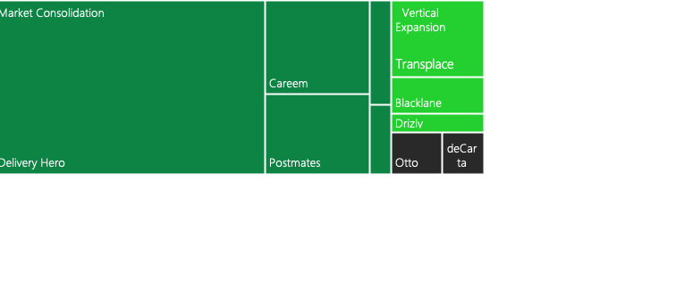
…but Uber’s investment case does not depend on Delivery Hero delivering guided synergies
Investment Thesis 2
Delivery Hero is 4.8x larger than any past Uber deals…
...so assumptions based on successful integration were moved
Assumption | Value | Basis
Take rate | 18% | DH's markets are lower-ARPU than Uber's core
+ explicit synergies ($m) | 0 | Management guides to >$1.2bn, independent of integration
Total segment operating income ($m) | 1472 | Roughly holds DH at current $1.1bn earnings for three years post-close
Analyst’s Consensus Estimate ($m) | 3314 | 56% cut to modelled DH earnings
With zero synergies, the acquisition is below Uber’s WACC…
…yet, capturing a margin of guided synergies clears the bar
WACC 9.65%
Synergy Capture | 0% | 16% | 25% | 50% | 75% | 100%
After-tax return on $13.7bn | 8.5% | 9.7% | 10.3% | 12.0% | 13.8% | 15.5%
Delivery Hero clears our cost of capital on 16% of the synergies management has guided to, based on the above sensitivities

Slide 12
No autonomous vehicle outcome breaks Uber’s results
Investment Thesis 3
The market sees AV as a binary outcome for Uber’s drivers…
…but the AV stack has three layers and Uber only needs one
Toll Road Uber captures every robotaxi | Neutral Demand Layer Aggregates fragmented AV supply | Disintermediated Waymo/Tesla own the customer
AV technology & vehicles
Waymo / Tesla / OEMs
Fleet ownership / Operations
Integrated operator of third-party fleets
Though some direct AV share loss is reasonable for Uber, Uber only needs to remain valuable to fragmented third-party AV supply
Demand Aggregation
Uber dispatch, utilization and demand
This reframe holds under the following conditions…
...so, this was modelled as a pure headwind and no upside
1
AV ecosystem stays fragmented
Resulting Valuation Range
2
3rd party fleets value utilisation enough to pay for distribution
 | DCF Value /Share | 4-Year IRR at 18.5x exit
Bear | $82.00 | 18.7%
Base | $93.07 | 22.0%
Bull | $108.51 | 26.3%
3
Uber’s demand density keeps improving fleet economics
4
Uber avoids bearing the full capital burden of AVs
5
The Mobility market expansion offsets lower market share

Slide 13
Valuation

Slide 14
Triangulated valuation shows a 34.6% upside, supported by conservative assumptions
Football Field Analysis
Methodology
Implied Share Price (US$/share)
Commentary
Relative
Comparable Companies
Weighting – 20%
EV / EBITDA & P/E
trading comps
$62.31
$84.11
Peer median P/E: 19.6x
Peer median EV/EBITDA: 15.6x
4-Year Exit P/E
Cross-Check
Weighting – 35%
$117.17
$139.34
Range: 18.0x – 22.0x NTM P/E
Exit NTM P/E multiple
on FY2030E EPS
Base case: 18.5x
Discounted at 10.4% cost of equity
Return
Bear / Base / Bull
DCF Range
Weighting – 0% (Reference Only)
$82.00
$108.51
Bear: $82.00 / Base: $93.07
Scenario DCF outputs
context only
Bull: $108.51
Avoids double-counting DCF
Intrinsic
Weighting – 45%
DCF (Base Case)
WACC: 9.7%
Enterprise DCF
9.7% WACC / 3.0% TGR
$71.03
$133.77
TGR: 3.0%
Sensitivity: 8.7%–10.7% WACC / 2.0%–4.0% TGR
$20
$40
$60
$80
$100
$120
$140
$160
Current Share Price
$75.76
Blended Current Value
$105.61

Slide 15
Defensive assumptions make for high levels of optionality in outcomes
Assumptions Analysis
Revenue Build Up
Operating Expenses
Capital Expenditure
Other Key Drivers
Mobility: Category growth offsets gradual U.S. share erosion
Delivery: Organic growth plus Delivery Hero consolidation
Mobility: Scale supports continued margin expansion
Delivery: Advertising and operating leverage improve profitability
Core Capex: Asset-light model keeps reinvestment requirements low
AV Investment: $5.4bn deployed; zero incremental AV revenue assumed
Delivery Hero: Base case assumes no explicit synergies
Capital Returns: $4bn annual buybacks offset SBC dilution

Slide 16
Near-term proof points can validate Uber’s AV positioning and earnings durability
Investment Catalysts
Catalysts
Description
1
1
Continued bookings growth and operating leverage can validate >20% long-term free cash flow compounding
Earnings & FCF Delivery
2
2
Robotaxi launches across Uber’s network can validate its role as the demand aggregator rather than a disrupted business
Likelihood
AV Commercialisation
3
3
Regulatory approvals and continued DH operating momentum can reduce deal uncertainty
Delivery Hero De-risking
Impact

Slide 17
Risk Analysis and ESG Considerations

Slide 18
The 22% base case 4-year IRR relies on margin expansion and Uber’s AV positioning
Base Case Return Risks
1
Fall of core operating leverage levels
2
AV disintermediation exceeds assumed levels
Advertising, Uber One attachment, cross-product usage and fixed-cost leverage are the key drivers behind earnings decoupling from gross bookings
The base case fails if, instead of Waymo, Tesla and other AV providers taking share, another third-party AV supply bypasses Uber entirely
Impact
Impact
Low
Probability
High
Low
Probability
High
Low
High
Low
High
Mitigants
1
Track key financials every quarter for signs margin gains are stalling
1
Base case deducts AV investment from DCF and assumes no AV revenue
2
Monitor Corporate G&A and platform R&D as % of the revenue
(fixed cost leverage)
2
Track direct AV operator share, third-party fleet partner launches and utilisation for fragmentation

Slide 19
Capital allocation, regulatory and valuation risks could further compress returns
Further Risks
3
Delivery Hero reduces value
4
Worker reclassification regulations
5
Multiple compression of 4-yr IRR
Uber’s largest-ever acquisition could earn poor returns, if not managed well
Licensing, insurance, tax and worker classification infrastructure continuously raise the cost of replication
At lower exit multiples (e.g. 18x, 14x) the 4-yr IRR falls short of the return objective
Impact
Impact
Impact
Low
Probability
High
Low
Probability
High
Low
Probability
High
Low
High
Low
High
Low
High
Mitigants
1
Adjusted base case removes reliance on management’s integration guidance
1
Track implementation of the Platform Work Directive and Uber’s pricing response
1
Track 20x multiple evidence factors: EPS durability, FCF growth, and marketplace quality
2
Every quarter, track regulatory clearances, leverage, integration cost and DH margins
2
Monitor labour litigation, and if higher costs pass onto consumers rather than margins
2
Re-test the exit-multiple assumptions each quarter against realised growth

Slide 20



Uber’s ESG exposure is concentrated in worker status and safety, while governance has improved
ESG Analysis
Environmental
Social
Governance
Electrification is progressing
Uber prides themselves on maintaining the safety of drivers and customers:
Governance has institutionalized alongside Uber’s transition to FCF discipline:
ZEV share of mobility trips (%)
7
1
Independent Oversight
Separated Chair and CEO roles
6
5
Board
Accountability
10-director board and annual Say-on-Pay
4
Identity Verification
Incident Reporting
Product Safety
2
3
But worker status provides the most exposure to P&L losses, as the EU Platform Work Directive and other reclassification rules could increase:
Driver and courier compensation
Payroll/benefit obligations
Compliance costs
2
Incentives
Alignment
96% of CEO target compensation variable
1
3
0
4
Profitability alignment
Non-GAAP EPS incorporated
With a target to be net-zero emissions by 2040, adoption is already scaling
Safety infrastructure is hard to replicate, but Uber must manage worker status
Governance is strong, though SBC dilution, acquisition discipline and smart capital allocation must be upheld
Uber holds an MSCI ESG rating of A, reflecting the strength of management of material ESG risks and opportunities
Average
UBER
Leader
Laggard

Slide 21
Final Recommendation

Slide 22



Scale and structural advantages support long-term free cash flow growth for Uber
Buy Recommendation
Uber aligns closely with TDM’s four investment pillars…
…fitting within a fund that serves its investors well
Growth
Mobility, Delivery, Ads and Uber One support 23.8% 5Y FCFF CAGR
1
Category leader
Advantage
Scale, network density and regulatory barriers reinforce Uber’s moat
2
Long-duration compounder
People & Culture
Dara-led execution has improved discipline and capital allocation, alongside internal culture
3
Investable at TDM scale
Valuation
Base case implies 22.0% 4Y IRR at a conservative 18.5x NTM P/E
4
>20% return potential
A durable moat and accelerating free cash flow supports a 22% base-case IRR, with additional upside from Ads, Uber One and AV
$75.76
$174.10
04/09/2026
26/08/2030

Slide 23
Appendix Network
Executive Summary
3
Why Uber for TDM?
24
AV Industry Analysis
40
Operating Schedule 1 & 2
59
Industry
5
Management Breakdown
25
TAM
41
Revenue Build 1 & 2
61
Company
6
Dara & Management Execution
27
Management Remuneration
42
Comparables 1 & 2
63
Management
7
M&A Record
28
Dara’s Views on Future
43
Football Field Analysis
65
Thesis 1: Operating Leverage
9
Share Price History
29
Uber’s Geographic Expansion
44
DCF
66
Thesis 2: Delivery Hero
10
Helmer’s 7 Powers
30
Broader Risk Landscape
45
Assumptions 1, 2 & 3
67
Thesis 3: AV Aggregation
12
Porter’s 5 Forces
31
Valuation Risks Assessment
46
Income Statement
70
Valuation
14
Ancillary Competitors
32
Trading Comparables
47
Balance Sheet
71
Assumptions
15
Tesla Analysis
33
Ratio Analysis 1 & 2
48
Cash Flow Statement
72
Catalysts
16
Waymo Analysis
34
Sensitivity Analysis
50
Risks & Mitigants
18
Lyft Analysis
35
Bear Case 1 & 2
51
ESG Analysis
20
DoorDash Analysis
36
Base Case 1 & 2
53
Final Recommendation
22
Uber & AI
37
Bull Case 1 & 2
55
Uber: Multi-Supplier Stack
38
TDM Return Hurdle
57
Ride-hailing Industry Analysis
39
WACC
58

Slide 24



Uber presents a great investment against TDM’s investment pillars for success
Why Uber for TDM?
TDM should invest now in Uber…
…given the company maps exactly to TDM’s framework
TDM looks for | Uber
Category leadership | #1 scaled global mobility platform
Large structural runway | Mobility + Delivery + Ads + AV
Durable competitive advantage | Density, liquidity, data and cross-platform demand
Long-duration compounding | 208m+ consumers monetised across multiple products
Scale building
Cash compounding
Inflecting operating leverage
Matured capital allocation
Mispriced overhangs
The investment is fit for a concentrated portfolio…
…that only needs to underwrite continued operating leverage
Scale
Resilience
Optionality
No heroic take-rate expansion required
No Delivery Hero synergies required
Uber does not need to win AV technology
Global demand pool across Mobility + Delivery
Diverse monetisation reduces dependence on take-rate expansion
AV, ads, Uber One and Delivery Hero are additive
The thesis works if Uber simply converts existing scale into higher incremental margins

Slide 25
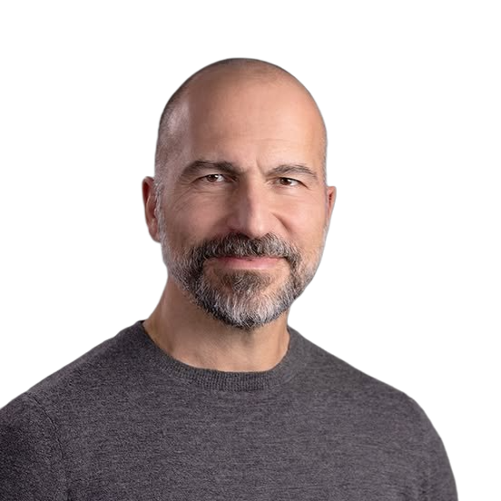


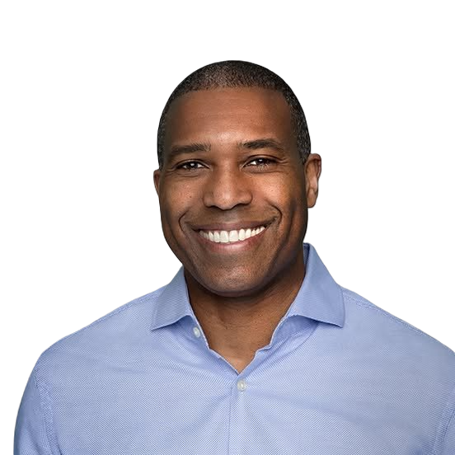




Uber boasts institutionalised leadership with key operator experience across various fields
Management Support
Dara Khosrowshahi, CEO
Appointed CEO in 2017; previously CEO of Expedia for 12 years
Shifted Uber from ‘growth-at-all-costs’ to sustained positive FCF
Balaji Krishnamurthy, CFO
Appointed CFO in 2026 after joining Uber in 2019
Focused on capital allocation across AV investment, Delivery Hero and buybacks
Andrew Macdonald, President/COO
Uber’s first GM; later led global Mobility across 70+ countries
Appointed President & COO in 2025
Tony West, SVP/CLO
Appointed CLO in 2017 from PepsiCo; former US Associate Attorney General
Leads Legal, Compliance & Ethics and Security globally
Sachin Kansal, CPO
Joined 2017 as Uber’s first product leader, focused on safety technology
Oversees Mobility & Delivery product strategy, incl. AV and subscriptions
Praveen Neppalli Naga, CTO
Joined Uber in 2015 after 7 years in engineering leadership at LinkedIn
Leads engineering & science strategy across Uber’s global platform
Pradeep Parameswaran, Head of Mobility
Joined Uber in 2017; led Mobility across India/South Asia, then APAC
Ex-CEO of DEN Networks; oversees mobility in 70+ countries
Sarfraz Maredia, Head of Autonomous
Joined Uber in 2014
Leads AV marketplace, fleet operations, and commercial partnerships

Slide 26
Uber boasts institutionalized leadership with assembled experienced operators across the fields
Key Management Team
Uber boasts institutionalised leadership with key operator experience across various fields
Management Support
1
Proven Turnaround Execution
Dara (CEO since 2017) shifted Uber from hypergrowth losses to sustained FCF and investment-grade status
Preserved entrepreneurial intensity while adding operating and capital discipline
Dara Khosrowshahi, CEO
Appointed CEO in 2017; previously CEO of Expedia for 12 years
Shifted Uber from ‘growth-at-all-costs’ to sustained positive FCF
Balaji Krishnamurthy, CFO
Appointed CFO in 2026 after joining Uber in 2019
Focused on capital allocation across AV investment, Delivery Hero and buybacks
Andrew Macdonald, President/COO
Uber’s first GM; later led global Mobility across 70+ countries
Appointed President & COO in 2025
Tony West, SVP/CLO
Appointed CLO in 2017 from PepsiCo; former US Associate Attorney General
Leads Legal, Compliance & Ethics and Security globally
2
Mitigated Succession Risk
Uber’s turnaround is no longer dependent on only Dara – operating discipline, capital allocation and FCF accountability prevalent throughout
Mobility, Delivery, Product and Finance are run by established operators, reducing key-person dependency
Sachin Kansal, CPO
Joined 2017 as Uber’s first product leader, focused on safety technology
Oversees Mobility & Delivery product strategy, incl. AV and subscriptions
3
Instilled Entrepreneurial Culture
Praveen Neppalli Naga, CTO
Joined Uber in 2015 after 7 years in engineering leadership at LinkedIn
Leads engineering & science strategy across Uber’s global platform
Pradeep Parameswaran, Head of Mobility
Joined Uber in 2017; led Mobility across India/South Asia, then APAC
Ex-CEO of DEN Networks; oversees mobility in 70+ countries
Sarfraz Maredia, Head of Autonomous
Joined Uber in 2014
Leads AV marketplace, fleet operations, and commercial partnerships
High ownership, flat hierarchy post-2017 onwards, with safety and candour emphasised
Strong internal succession: Macdonald (COO) and Krishnamurthy (CFO) both promoted from within

Slide 27
A Dara-led Uber has transformed the company from hypergrowth and cash burn into durability
Management Execution
2017
2019
2021
2022-23
2024
2025
Dara begins a cultural reset, following a period characterised by aggressive expansion, governance problems and cultural issues
Uber’s IPO creates greater accountability; focus changes from expansion towards platform economics and category leadership
First adjusted-EBITDA-positive quarter as a public company, where scale was key for Uber converting into a sustainably profitable business
An “inflection point” as per Dara, where free cash flow skyrocketed from $390mn in FY22 to $3.36bn in FY23
Free cash flow doubles again to $6.90bn, while Uber initiates and continues meaningful share repurchases
Cash generation becomes structural, with sustained improvements to free cash flow and GAAP operating income
In 2026,
Q2 TTM FCF surpasses $10bn for first time
Q2 Non-GAAP Operating Income grows 40% versus Gross Bookings growth of 22%
Funding AV expansion, Delivery Hero and buybacks, whilst cutting 10% of workforce for efficiency

Slide 28
Uber’s M&A record has become increasingly disciplined
M&A Track Record
Date
Transaction
Strategic intent
Funding
Outcome
Interpretation
2019/20
Careem
$3.1bn
MENA ride-hailing consolidation; regional super-app optionality
Cash + converts
$1.4bn + $1.7bn
Mostly strategic success: ride-hailing retained; Super App later partly monetised to e&
Local consolidation can create defensible scale, but super-app optionality is hard to value upfront.
2020
ATG → Aurora
strategic divestment
Exit capital-heavy in-house AV development while preserving future AV access
Sold ATG; invested
$400m in Aurora
Clear discipline: shifts Uber from owning AV stack to partnering with AV suppliers
Supports our thesis that Uber can win as demand layer without funding every technology stack.
2020
Postmates
$2.65bn
Increase U.S. delivery density, merchant coverage and consumer choice
All-stock
Successful integration: Delivery approached breakeven by Q3 2021, helped by Postmates synergies
Consolidation works when it deepens density in a core vertical.
2021
Drizly
$1.1bn
Alcohol delivery adjacency; extend Eats beyond restaurants
Stock + cash
>90% stock
Weak standalone outcome: Drizly shut in 2024; learnings folded into Uber Eats BevAlc
Cautionary case: not all adjacencies justify standalone acquisition value.
2021
Transplace
$2.25bn
Scale Freight into managed transportation and logistics software
Cash; partly financed by $550m Uber Freight preferred equity
Strategically logical but less proven; Freight remains cyclical and lower-contribution
Non-core M&A should be discounted until margin evidence emerges.
2026E
Delivery Hero
$14.8bn
Add 50 markets / $42bn GB; expand dual Mobility + Delivery markets from 34 to 58
Cash offer; $13.7bn net of prior stake; cash + debt, with 14 overlapping markets divested
Pending: management guides accretion and >$1.2bn synergies, but regulatory/integration risk remains
Model assumes zero explicit synergies and funds the debt; upside is incremental, not required.
Overall:
Core density deals have worked best
Adjacency M&A deserves caution
DH should be upside, not dependency
1
Postmates and Careem show consolidation is strongest when it deepens liquidity in markets Uber already understands.
2
Drizly and Freight prove not every expansion vertical deserves full credit before unit economics are visible
3
With no explicit synergy credit to Delivery Hero, the 22% base-case IRR can still be reached

Slide 29
Uber has proved resilient, delivering consistent returns despite a challenging environment
Share Price History
Uber’s share price has proved resilient in challenging environments
Share Price History
Throughout 2022: Rising inflation and aggressive interest rate hikes triggered a massive sell-off across all growth and tech stocks
March 2020: Global lockdowns brought ridesharing to an abrupt halt, plunging the share price to an all-time low
December 2025: Explosive growth in high margin advertising facilitating $10B FCF and 35% YoY EBITDA growth
Feb 2021: Food delivery demand surged amidst ongoing pandemic disruptions

Slide 30
We expect Uber’s advantages to remain durable as the platform transitions
Helmer’s 7 Powers
We expect Uber’s advantages to remain durable as the platform progresses
Helmer’s 7 Powers
Scale economies
Global scale spreads fixed costs, lowering unit costs and strengthening over time
Counter-Positioning
Network economies
Uber’s asset-light model displaced taxis and may strengthen in an AV world
Marketplace density improves ETAs and utilisation, though AVs may modestly weaken this edge
Switching Costs
Cornered Resource
Riders and drivers can multi-home easily, keeping switching costs structurally low.
Proprietary data and regulatory relationships help, but remain only moderately defensible
Branding
Process Power
Uber’s global brand supports trust and demand, and should remain durable
Pricing, matching and routing methods improve efficiency and should deepen over time

Slide 31
In a competitive industry, Uber’s liquidity and regulatory positioning create advantages
Porter’s 5 Forces
Competitive Rivalry
High competition from Lyft and DoorDash pressures pricing and margins
Threat of New Entrants
Threat of Substitutes
Scale, network density and regulation create high barriers to entry
Public transport, taxis and private vehicles remain viable alternatives
Supplier Power
Buyer Power
Drivers and merchants can multi-home, but Uber’s scale limits leverage
Low switching costs make consumers highly price-sensitive

Slide 32
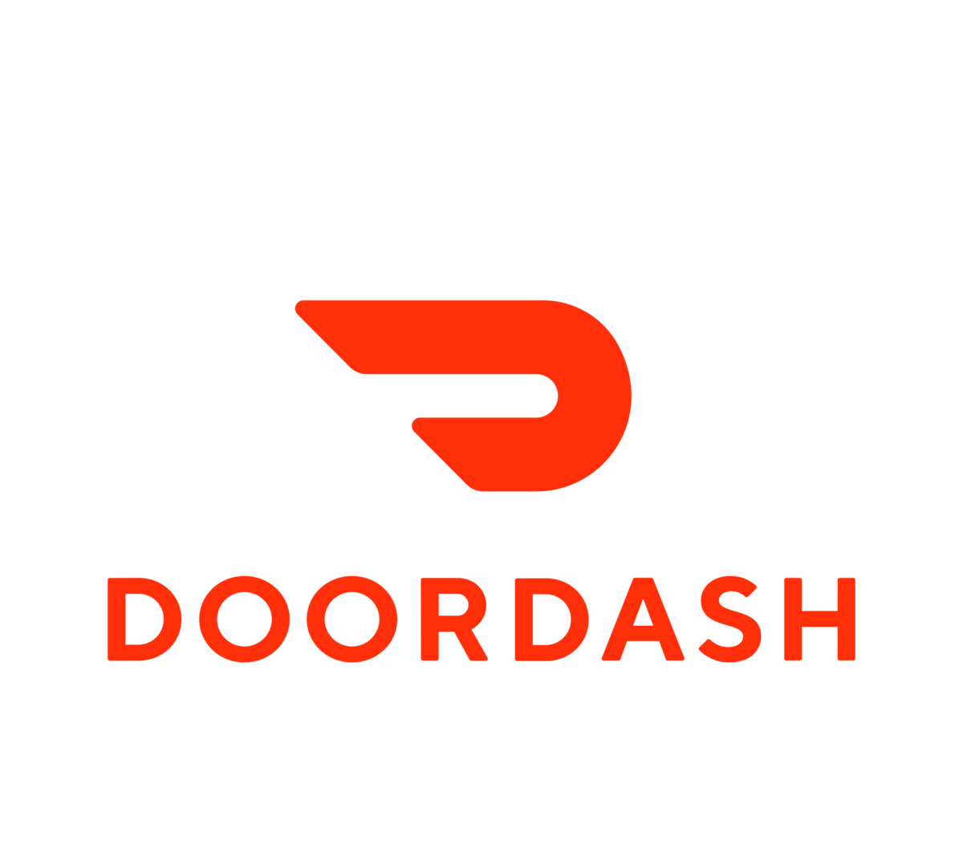


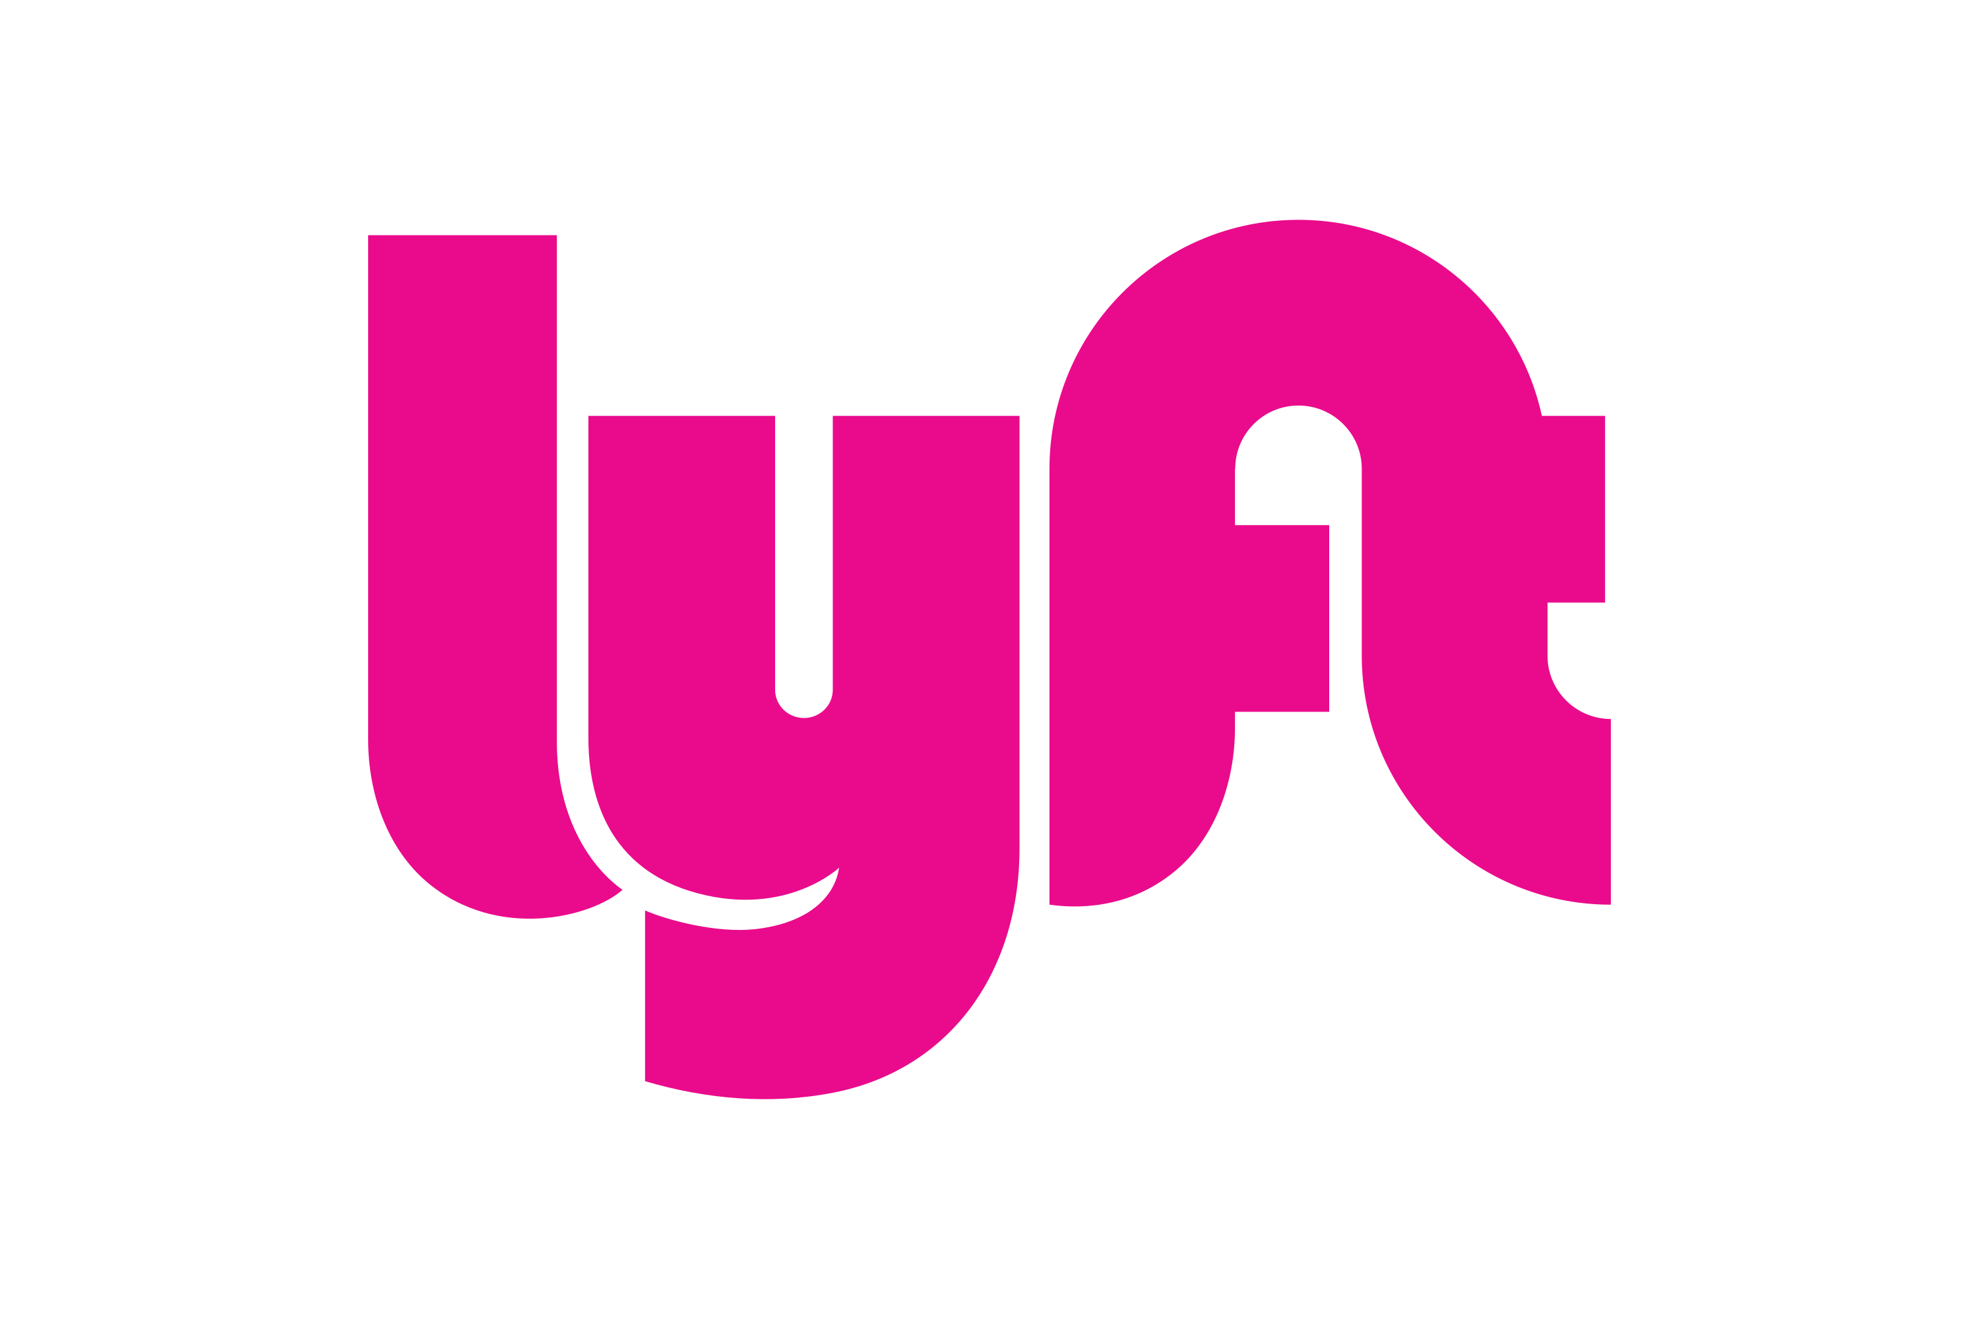


Uber’s network effects and lock-ins create higher switching costs
Ancillary Competitors
Mobility Competitors
Delivery Competitors
Waymo
Bolt
Didi
Lyft
DoorDash
Amazon
InstaCart
01
Autonomous Disintermediation
Direct-to-consumer AV apps erode Uber's marketplace dominance, creating localised supply leakages in high margin urban core regions
01
Platform multi-homing
Consumers increasingly switch across competing delivery platforms, with a focus on price over loyalty
02
Brand Control & Capital Risk
As Uber integrates third party AV fleets, it risks a loss of the primary customer relationship and brand control
02
Take Rate Squeeze
Emerging delivery alternatives undercut market[lace commission fees, squeezing the high margin take rates that drive cash flow
For convenience and grocery delivery, Uber must engage in continuous promotional burn to prevent structural churn
03
Price Competition & Driver Churn
Aggressive price undercutting by regional players forces continuous promotional spend to prevent driver churn, hindering profitability
03
Unit economic pressure
Intense competition for courier supply in crowded urban markets drives wage inflation and higher delivery costs, making it harder to achieve sustainable unit economics

Slide 33
C
Tesla is a disintermediation threat, but must recreate Uber’s demand liquidity to succeed
Tesla Analysis
Looking at Tesla:
Overall:
Tesla is building a closed-loop robotaxi network spanning the vehicle, autonomy stack, fleet and consumer app
Dimension | Uber | Tesla (Robotaxi)
Core model | Asset light, two sided marketplace aggregating supply onto one demand app | Vertically integrated marketplace: builds the car, owns the fleet, runs its own app
Revenue Model | Take rate on gross bookings + Uber one membership + advertising | Flat per ride fare
Current Scale | 208 MAPCs, 3.9B Quarterly trips, $58B quarterly gross bookings | Low tens of vehicles, 380K unsupervised miles, 7 metros
Expansion strategy | Sign new AV/EV partners; low increment per market | City by city regulatory approval + capital heavy fleet build
Primary Moat | Network effects, cross sell membership, regulatory/insurance infrastructure | Manufacturing cost-curve, in-house AI stack
Response to AV threat | Cut 3300 jobs (10% of staff) to fund AV commercialisation | Raised 2026 capex guidance to ~25B to increase fleet volume
Markets are pricing in a ~800B robotaxi valuation despite the firm only accumulating 0.17% of rider miles with 37% Waymo's fleet size
Tesla's low cost thesis depends on safety monitor removal and achieving a ~$0.2/mile target from a current ~$0.81/mile position
Tesla competes with Uber by bypassing the marketplace entirely through its own closed-loop app instead of partnering like Waymo
In comparison to Uber, Tesla has a:
51% higher fair premium
63% higher wait time gap

Slide 34
C
Waymo leads AV technology, but its Uber distribution partnerships show the need for demand
Waymo Analysis
Looking at Waymo:
Overall:
Vertically integrated AV operator scaling fast under Alphabet's balance sheet, still an order of magnitude smaller than Uber's core marketplace
Dimension | Uber | Waymo
Core model | Asset light, two sided marketplace aggregating supply onto one demand app | Vertically integrated AV + software/hardware stack + fleet operator
Revenue Model | Take rate on gross bookings + Uber one membership + advertising | Flat per ride fare + distribution revenue (via Uber)
Current Scale | 208 MAPCs, 3.9B Quarterly trips, $58B quarterly gross bookings | 3,000 active robotaxis, 500k paid weekly trips, >125M autonomous miles
Expansion strategy | Demand aggregation across fragmented AV market | Fleet partnerships w OEMs; city-by-city depot deployment
Primary Moat | Network effects, cross sell membership, unmatched global demand liquidity | Alphabet balance-sheet backing, proprietary multi-sensor autonomous stack
Response to AV threat | Cut 3300 jobs (10% of staff) to fund AV commercialisation | Licenses fleet supply to Uber for demand liquidity while expanding Waymo One footprint
Waymo leads Western robotaxi operations with ~3,700 commercial vehicles delivering over 500,000 paid weekly trips supported by a valuation of $126B
Capital intensive model carrying heavy fixed depreciation costs for sensor suites, fleet depot maintenance and localised support teams
Hybrid GTM strategy: building proprietary consumer app (Waymo One) in tier-one cities whilst acting as a third-party AV fleet supplier within Uber's expansion network
In comparison to Uber, Waymo has a:
21% higher fair premium
78% higher wait time gap

Slide 35
Lyft validates the hybrid aggregator model, but has less cross-sell potential than Uber
Lyft Analysis
Looking at Lyft:
Overall:
North American rideshare platform operating a narrower, mobility-focused model than Uber, relying on regional scale, brand strength and AV partnerships
Dimension | Uber | Lyft
Core model | Global app operating across 70+ countries (Mobility, Delivery, Freight) | Purely North American presence focused primarily on rideshare, bikes, and transit
Revenue Model | Take rate on gross bookings + Uber one membership + advertising | Take rate on gross bookings + Lyft pink memberships
Current Scale | 208 MAPCs, 3.9B Quarterly trips, $58B quarterly gross bookings | 29.2M active riders, 243.5M quarterly rides, $5.1B quarterly gross bookings
AV strategy | Demand aggregation across fragmented AV market | Dispatch API, fleet servicing and insurance offerings to AV fleet providers
Primary Moat | Self reinforcing global two-sided marketplace, yielding unmatched demand, high margin advertising leverage | Market taker with a narrow regional consumer brand, relying on physical depot infrastructure and B2B services
Lyft holds a ~26% U.S. rideshare spend share against Uber's ~74%, operating as a regional single-engine player rather than a global platform.
Lyft divested their in-house AV division, refocusing on monetising fleet management services through dispatch software, fleet servicing and insurance offerings.
Lyft fails to capitalise on Uber's cross-selling of mobility to delivery (Uber-eats) experiencing 43% higher driver acquisition costs
In comparison to Uber, Lyft has a:
$12/month less monthly spend
32% take rate, versus Uber’s 30%

Slide 36
DoorDash remains the benchmark in local commerce, but has not monetised like Uber
DoorDash Analysis
Looking at DoorDash:
Overall:
Vertically integrated AV operator scaling fast under Alphabet's balance sheet, still an order of magnitude smaller than Uber's core marketplace
Dimension | Uber | Doordash
Core model | Global app operating across 70+ countries (Mobility, Delivery, Freight) | On demand delivery platform spanning restaurants, convenience and grocery
Revenue Model | Take rate on gross bookings + Uber one membership + advertising | Take rate on gross bookings + DashPass memberships
Current Scale | 208 MAPCs, 3.9B Quarterly trips, $58B quarterly gross bookings | 56M active riders, 750M quarterly rides, $26B quarterly gross bookings
AV strategy | Demand aggregation across fragmented AV market | Sidewalk rovers and suburban drone delivery for short distances
Primary Moat | Self reinforcing global two-sided marketplace, yielding unmatched demand, high margin advertising leverage | Suburban merchant density, high frequency DashPass subscriber base and proprietary dispatch backing
DoorDash commands a ~68% U.S. meal delivery market share against Uber Eats’ ~24%, operating as the category leader in North America
Rather than passenger robotaxis, DoorDash focuses on sidewalk rovers and airborne drones to eliminate driver drop-off labour on short trips
DoorDash relies on its DashPass loyalty, whereas Uber counters with its unified Uber-one
In comparison to Uber, DoorDash has a:
2.8x market share lead
1.5% lower take rate

Slide 37

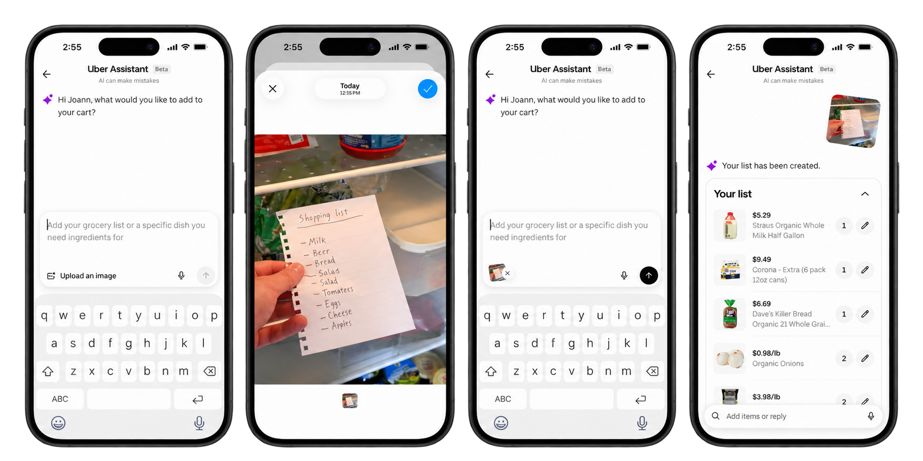
C
AI is becoming an operating leverage and conversion tool for Uber
Uber & AI
Uber has implemented AI to create consumer conversion…
…as well as assist in platform operations
Cart Assistant
Let consumers describe what they need rather than manually search
Resolve qualifying fare disputes
75bn
Trips as the data foundation
Customers using it for Grocery & Retail build baskets roughly 2x the size of normal orders
Lower support cost
Combined with internal productivity considerations…
…this has resulted real AI growth for the company
Falling cost/token
20k+
AI models trained
400+
ML models in production
200+
Languages
Uber has moderated hiring partly and laid off 10% of management
Increased adoption
AI lowers the cost-to-serve and increases conversion on an already scaled marketplace
Organisational efficiency

Slide 38




C
Uber is assembling a multi-supplier autonomous stack
AV Partnership Network
15 additional cities over the next 5 years
Distributes with Uber in Austin and Atlanta
Up to 25 cities by 2031
2,000 robotaxis planned across Europe
Recent London launch with Uber
7 live AV cities Q2 2026 → up to 15 by year end → 120k partner vehicles committed

Slide 39
Ride-hailing remains structurally underpenetrated, with strong category growth
Ride-hailing industry analysis
Market growth is accelerating:
Global ride-sharing market forecast
Value ($bn)
Year
Consumer behaviour is broadening use cases…
…meaning Uber’s economics improve as markets consolidate
Urban Density
Digital Adoption
Car-light Behaviour
Density
Lower ETAs
Higher utilisation
Margin leverage
208m
MAPCs
3.9bn
Quarterly trips
$58bn
Q2 bookings
Earnings
outgrow bookings
Use cases are expanding beyond airport and weekend trips into commuting, business suburban and lower-cost products

Slide 40
AV adoption is accelerating, but market dynamics favour fragmented supply
AV Industry Analysis
The global robotaxi fleet is accelerating:
Fleet size (mn)
Year
Deployment remains city-by-city and capital intensive…
…Meaning demand aggregation is highly valuable
$15-30mn per city
Up to 2 years to launch
4-6 years to scale across metro
Demand
Utilisation
Distribution
Fixed costs make utilization the key unit economics variable
AV adoption is a threat to human-driver supply, not Uber’s marketplace role

Slide 41
Uber has a massive addressable market with multiple compounding levers
TAM
Current platform scale is large…
…but the growth algorithm has visible headroom
Mobility
$116bn
Delivery
$110bn
208m
3.9bn
Freight
$6bn
MAPCs in Q2’26
Trips in Q2’26
+16% YoY; record consumer scale
~42m trips per day; +18% YoY
$232bn
Q2’26 gross bookings run rate
+22%
YoY constant currency
<5%
3.4x
2026 quarterly bookings are already split almost evenly between Mobility and Delivery; the incremental TAM is less about a single category and more about moving consumers into more use-cases
Monthly penetration
Multi-product spend
2023 management frame: 18+ population in operating countries
Multi-product consumers spend more than single-product users
Meaning that:
1. User TAM is still early
2. Frequency can do the heavy lifting
3. LTV expands without higher take-rate
Even after >200m MAPCs, Uber is not close to saturating the adult population in its operating markets.
Management says ~half of monthly consumers use Uber only once or twice per month, leaving an engagement runway.
Uber One, multi-product conversion and advertising convert existing demand into higher-margin revenue streams.

Slide 42
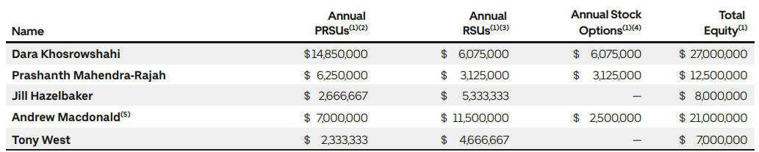
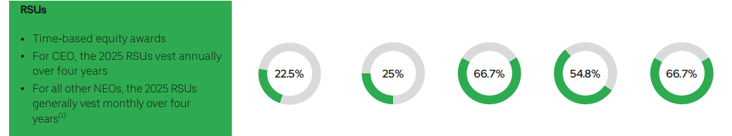
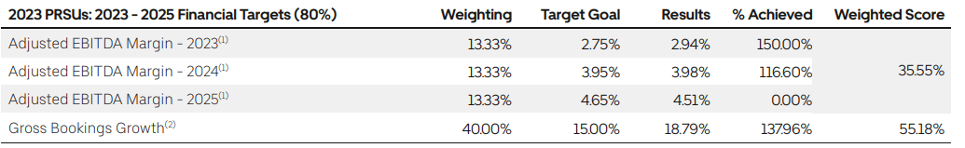
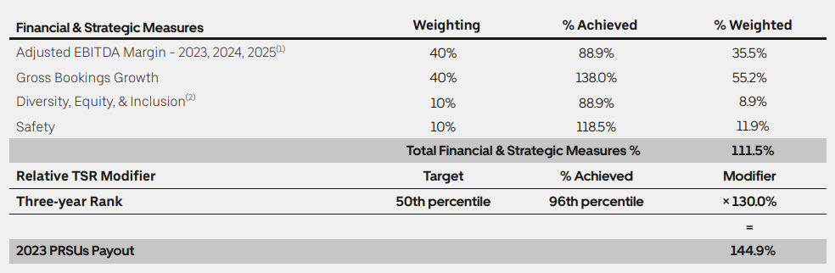
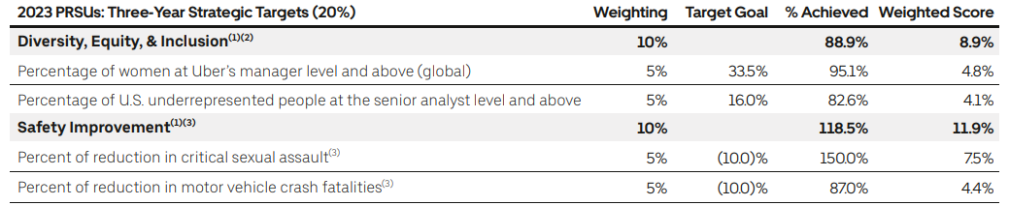
Uber Management Remuneration
Management Breakdown
The management is paid based on the following rates (FY26)
With the exact breakdown of Dara pay: US$35.6m (FY25)
Component | FY25 | %
Salary | $1.08m | 3%
Stock awards (RSU/PRSU) | $23.75m | 67%
Options | $7.37m | 21%
Bonus (non-equity plan) | $2.84m | 8%
Other (incl. $458k residential security) | $0.55m | 1%
PRSUs are tied to EBITDA margin and gross bookings growth
Strategic targets in line with safety & DEIs

Slide 43
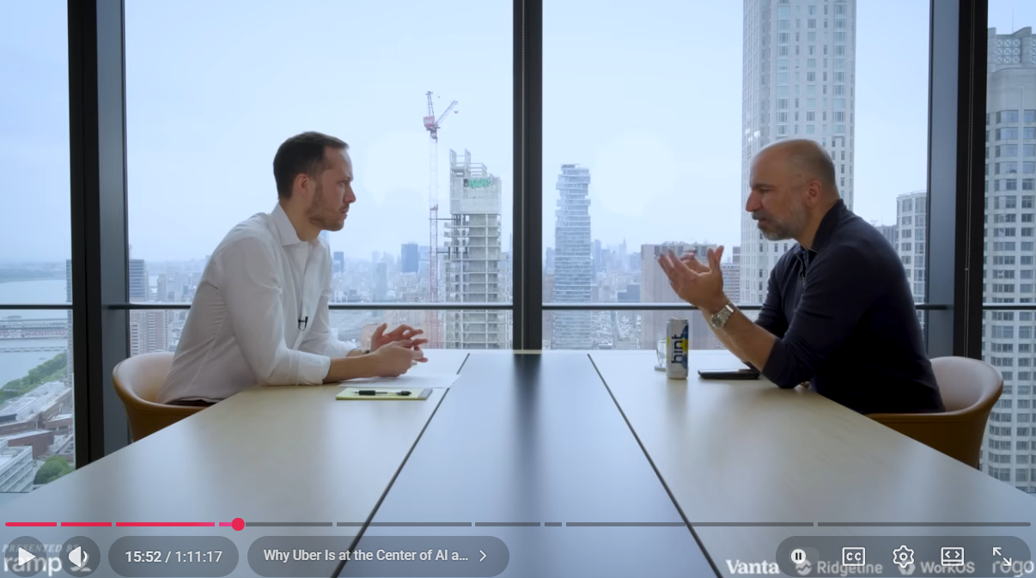
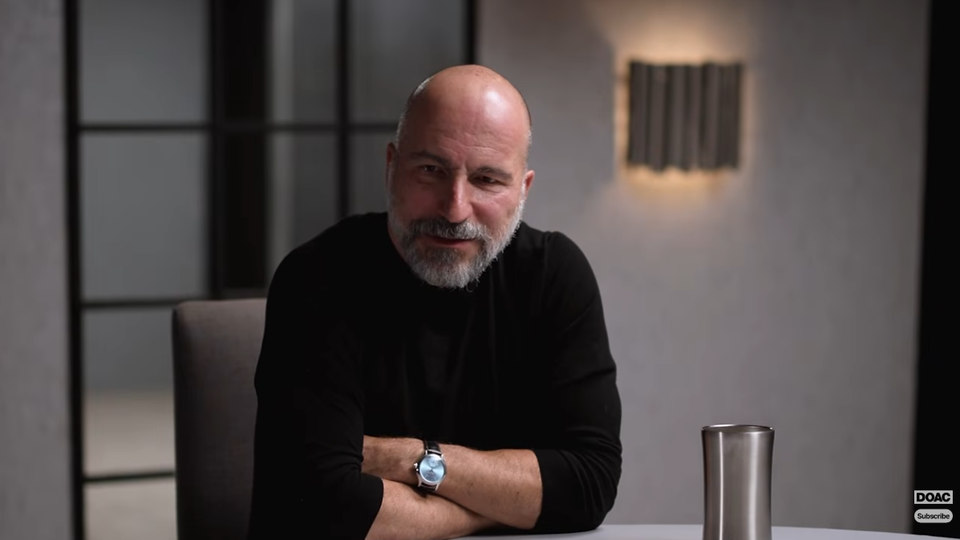
Dara’s Views showcasing future of Uber
Management Cuts
Dara has recently come to media, sharing views…
…on business growth in AI, AVs & future of transport
1
Positions Uber as the demand aggregator in a world of physical AI
2
Expects many AV winners, not one — hence 20+ partnerships rather than a single bet
3
Frames Uber as a supply-led business: win the vehicles and drivers, demand follows
Invest like the Best
3rd June 2026
Diary of a CEO
23rd Feb 2026
4
Company-wide AI adoption mandate, plus a push to consolidate rides, delivery and travel into one super-app
Results have reflected upon Uber’s business actions…
…and are in-line with TDM’s investment philosophy
20%+
Growth Bookings Growth (5th consecutive year running)
$10B Free Cash Flows (in USD) in FY25: investment-grade rating and first-ever buyback now in place
46M
Uber One members (55%+ YoY), with more than 40% of the consumers using more than one Uber product
1
Growth Opportunity: long-duration runway in a large, growing market; AV re-rates the TAM rather than replacing it
2
Structural Competitive Advantage: two-sided network and supply density are the moat, exactly the asset-light compounding TDM favours
3
People & Culture (TDM's "8th Power"): 9-year CEO tenure, internal CFO succession, and a leadership team that cut its own management layer by 20%

Slide 44
Uber’s Plans for Geographic Expansion
AV
Locations for Expansion
Timeline for Expansion
 | Next 2–3 yrs (FY26–28) — stated | 3–5 yrs (FY29–31) — stated / guided | 5–10 yrs (FY31–36) — directional
AV — US | LA, SF, Houston, Austin, Atlanta, Phoenix. Nvidia L4 launches LA + SF H1'27 | Scale-out across the 28-city Nvidia footprint; hybrid human/AV fleets in tier-2 US metros | AV as default supply in dense US metros; human drivers as peak-demand overflow
AV — International | Hong Kong, Madrid, Zurich, Tokyo (Nissan/Wayve pilot), Zagreb (Pony.ai/Verne), Munich (Autobrains/Nvidia) | Broader EU and APAC rollout; Uber targets largest global facilitator of AV trips by 2029 | "Dozens of markets worldwide" per the Nuro–Lucid six-year plan
Delivery | Delivery Hero close expected H2'27 → 99 markets; Getir (Turkey) integrated | Integration of foodpanda / talabat / PedidosYa across APAC, MENA, LatAm | Consolidated single-app delivery footprint ex-China
Dual mobility + delivery | 34 markets today → 58 post-Delivery Hero | Cross-sell push into DH-only markets | Full super-app convergence (rides, delivery, travel)
Fleet scale | 15 AV cities and ~100k AVs by end-2027; $10bn committed | Rivian up to 50,000 robotaxis by 2030; Lucid/Nuro 35,000+ over six years | Fleet economics, not geography, becomes the binding constraint
Exits | Nigeria, Uganda (Sep '26); DH's 14 overlapping markets sold to SSW Partners | — | —

Slide 45
Broader Risk landscape
AV
Risk | Context | Mitigants
Macroeconomic & Consumer | Weak spending may reduce trip frequency and Delivery demand | Geographic diversity, essential use-cases, dynamic pricing
Competition & Market Structure | Lyft, DoorDash and local players pressure share and take rates | Scale, network density, multi-product ecosystem
Autonomous Vehicles | AV platforms could disintermediate Uber's Mobility network | Multi-partner AV strategy, demand aggregation, fleet-agnostic platform
Driver & Courier Supply | Tighter supply or incentives could pressure service and margins | Large driver base, flexible earning model, marketplace optimisation
Legal & Regulatory | Worker classification and local regulation may increase costs | Regulatory engagement, compliance infrastructure, market diversification
Insurance & Safety | Claims inflation or incidents may pressure margins and trust | Pricing actions, insurance optimisation, safety investment
Technology & Cybersecurity | Outages or breaches could disrupt marketplace activity | Security investment, redundancy, monitoring and governance
Delivery Hero Integration | Regulatory delays or integration issues may dilute returns | No explicit synergies assumed, phased integration planning
Capital Allocation | AV investment or acquisitions may earn sub-par returns | Strong FCF, disciplined buybacks, hurdle-based deployment
Operational Execution | Product and geographic expansion raises execution complexity | Scaled infrastructure, local teams, platform standardisation
Reputation & Trust | Driver, rider or merchant dissatisfaction could weaken engagement | Safety tools, loyalty programs, service improvements
Financial & Treasury | FX, debt costs and acquisition financing may affect cash flow | Liquidity, diversified funding and deleveraging capacity

Slide 46
Key sensitivities center on Mobility growth, margin delivery and exit multiple assumptions
Valuation Risk Assessment
1
Multiple compression risk
2
Margin realisation risk
3
Capital allocation risk
If growth moderates, Uber may exit on a lower P/E than assumed
Delivery competition and AV investments may slow margin expansion
Delivery Hero integration or AV spending could dilute returns if execution slips
Impact
Impact
Impact
Low
High
Low
High
Low
High
Probability
Probability
Probability
Low
High
Low
High
Low
High
Mitigants
Base case uses a conservative NTM P/E
1
Use conservative margin assumptions
1
1
Model assumes no explicit DH synergies
Base IRR still clears 20% hurdle
Ads, Uber One and scale support upside
Strong balance sheet supports flexibility
2
2
2

Slide 47
Uber trades at a premium to most peers, supported by superior scale and long-term cash flows
Trading comparables
Forward P/E
EV/Adjusted EBITDA
EV/Revenue
FY26E Revenue Growth

Slide 48
FCFF compounds at 23.8% as margins expand without aggressive take-rate growth
Ratio Analysis 1
23.8% five-year FCFF CAGR
Operating margin expands 610bps
ROIC reaches 19.2% by 2030E

Slide 49
Deleveraging and buybacks convert operating growth into accelerating per-share value
Ratio Analysis 2
Deleveraging and buybacks convert operating growth into accelerating per-share value
Ratio Analysis 2
Leverage peaks at only 1.4x
EPS rises to $9.92 by 2031E
FCFF yield expands to 11.5%

Slide 50
Intrinsic value remains resilient across all but the most punitive DCF assumptions
DCF Sensitivity
Intrinsic value remains resilient across all but the most punitive DCF assumptions
Sensitivity Analysis
Downside requires stacked conservative assumptions
Base DCF implies $93.07/share
22 scenarios exceed current price

Slide 51
Even the bear case preserves >20% FCFF growth, with downside concentrated in exit multiple
Bear Case 1
FCFF still compounds at 20.8%
Bear DCF remains $82.00/share
18.5x exit delivers 18.7% IRR

Slide 52
International growth and buybacks cushion severe U.S. Mobility share erosion
Bear Case 2
International growth and buybacks cushion severe U.S. Mobility share erosion
Bear Case 2
Mobility GB still reaches $190.6bn
International Gross Bookings contribute to 64% of Mobility
Adjusted earnings rise to $16.9bn

Slide 53
Base-case FCFF compounding clears TDM’s hurdle at a conservative 18.5x exit
Base Case 1
Base-case FCFF compounding clears TDM’s hurdle at a conservative 18.5x exit
Base Case 1
FCFF compounds at 23.8%
Exit NTM EPS reaches $9.41
18.5x exit delivers 22.0% IRR

Slide 54
U.S. share can fall materially while total Mobility gross bookings still double
Base Case 2
U.S. share can fall materially while total Mobility gross bookings still double
Base Case 2
U.S. share falls 76% to 60%
International Mobility reaches $126.5bn
Total Mobility GB reaches $199.6bn

Slide 55
Bull-case operating leverage drives 27.3% FCFF growth and a 26.3% IRR
Bull Case 1
Bull case operating leverage drives 27.3% FCFF growth and a 26.3% IRR case
Bull case 1
FCFF compounds at 27.3%
Exit NTM EPS reaches $10.79
18.5x exit delivers 26.3% IRR

Slide 56
Stronger category growth pushes Mobility bookings above $224bn by 2031E
Bull Case 2
Stronger category growth pushes Mobility bookings above $224bn by 2031E
Bull Case 2
Mobility GB exceeds $224bn
International Mobility reaches $133.8bn
Adjusted earnings reach $22.0bn

Slide 57
4-Year IRR TDM Return Hurdle Test
Uber only needs a 17.3x exit multiple to clear TDM’s 20% return hurdle
Uber only needs a 17.3x exit multiple to clear TDM’s 20% return hurdle
TDM Return Hurdle
Only 17.3x exit clears TDM hurdle
$0.61 EPS cushion at 18.5x
Base case delivers 22.0% IRR

Slide 58
A 9.7% WACC incorporates Delivery Hero leverage within an equity-heavy capital structure
WACC
A 9.7% WACC incorporates Delivery Hero leverage within an equity-heavy capital structure
WACC
Cost of equity is 10.41%
Capital structure remains 88.6% equity
WACC-growth spread remains 6.7%

Slide 59
Segment scale more than doubles revenue while operating income nearly triples
Operating Schedules 1
Segment scale more than doubles revenue while operating income nearly triples
Operating Schedule 1
Revenue more than doubles by 2031E
Segment profit grows to $31.0bn
Operating margin expands to 21.5%

Slide 60
FCFF and EPS outgrow revenue even after explicit AV investment and SBC dilution
Operating Schedules 2
FCFF and EPS outgrow revenue even after explicit AV investment and SBC dilution
Operating Schedule 2
FCFF reaches $17.2bn by 2031E
$5.4bn AV investment fully deducted
EPS rises from $3.17 to $9.92

Slide 61
Gross bookings surpass $467bn as growth broadens across users, frequency and Delivery Hero
Revenue Build 1
Gross bookings surpass $476bn as growth broadens across users and frequency
Revenue Build 1
Gross bookings reach $467.6bn
Gross Bookings growth
normalises near 10%
MAPCs expand to 377m users

Slide 62
Mobility can nearly double despite U.S. rideshare falling from 76% to 60%
Revenue Build 2
Mobility can nearly double despite U.S. rideshare falling from 76% to 60%
Revenue Build 2
U.S. share falls 14 percentage points by 2030E
U.S. category more than doubles
Mobility GB approaches $200bn

Slide 63
Uber’s diversified model warrants triangulation across mobility, delivery and marketplace peers
CCA 1
Uber’s diversified model warrants triangulation across mobility, delivery and marketplace peers
Comparables 1
Peer median P/E is 19.6x
Peer multiples vary significantly
by quality
No single peer replicates Uber

Slide 64
Comparable companies imply $73.66/share, providing a conservative valuation anchor
CCA 2
Comparable valuation implies $73.66/share, providing a conservative anchor
Comparables 2
Comps imply $73.66/share
Valuation range spans
$62.31–$84.11
Comps deliberately anchor valuation conservatively

Slide 65
Triangulation implies $105.61/share today, representing 34.6% upside
Football Field Analysis
Triangulation implies $105.61/share today, representing a 34.6% upside
Football Field Analysis
Blended value reaches $105.61/share
Implied upside is 34.6%
Scenario DCF receives zero weighting

Slide 66
Base-case DCF supports $93.07/share despite AV investment and acquisition leverage
DCF
Base-case DCF supports $93.07/share despite AV investment and acquisition leverage
DCF
Intrinsic value is $93.07/share
FCFF reaches $17.2bn by 2031E
DH debt and AV spend included

Slide 67
Our base case assumes moderating growth, bounded take rates and gradual margin expansion
Model Assumptions 1
The base case assumes moderating growth, bounded take rates and gradual margin expansion
Assumptions 1
Growth normalises toward
high-single digits
Take-rate assumptions
remain restrained
Operating leverage drives
margin expansion

Slide 68
AV and Delivery Hero are fully funded while the base case assumes zero deal synergies
Model Assumptions 2
AV and Delivery Hero are fully funded while the base case assumes zero deal synergies
Assumptions 2
$5.4bn AV spend, zero AV revenue
Delivery Hero assumes
zero explicit synergies
Core capex remains below 1% revenue

Slide 69
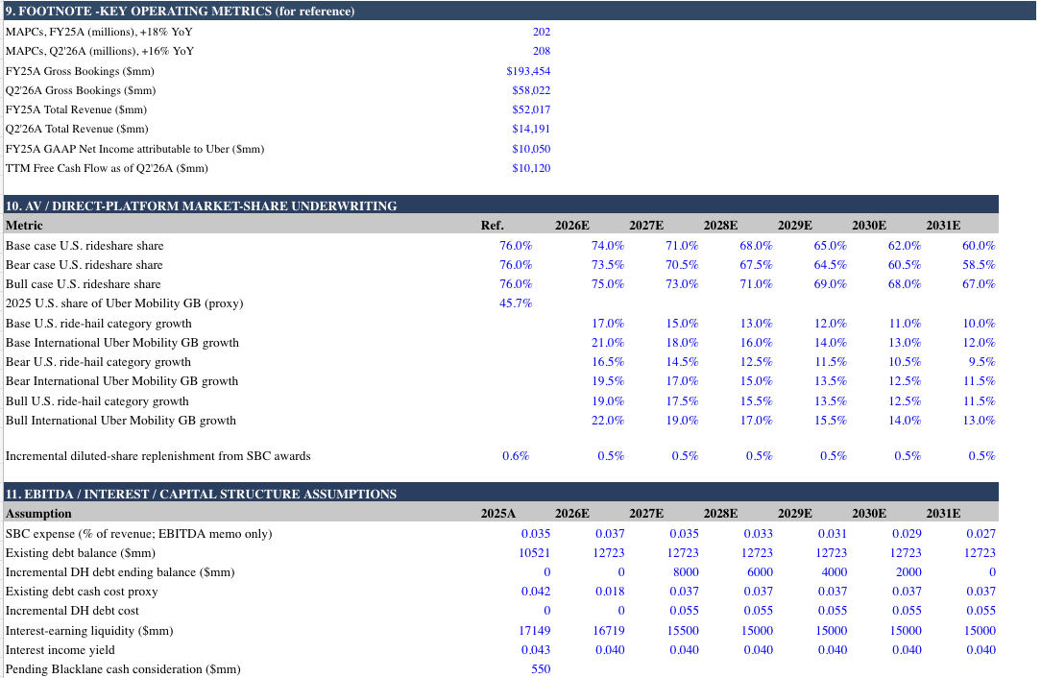
Model Assumptions 3
AV share loss, SBC dilution and Delivery Hero deleveraging are all explicitly underwritten
AV share loss, SBC dilution and Delivery Hero deleveraging are all explicitly underwritten
Assumptions 3
U.S. share erosion explicitly modelled
SBC dilution remains fully recognised
Delivery Hero debt fully repaid

Slide 70
Operating leverage nearly triples EPS while revenue roughly doubles
Income Statement
Operating leverage nearly triples EPS while revenue roughly doubles
Income statement
Revenue roughly doubles by 2030E
Operating margin expands 610bps
EPS more than triples to $9.92

Slide 71
Delivery Hero creates a temporary leverage spike before FCF restores a net-cash balance sheet
Balance Sheet
Delivery Hero creates a temporary leverage spike before FCF restores a net-cash balance sheet
Balance Sheet
Debt peaks at $20.7bn
Uber reaches net cash by 2030E
Book equity reaches $87.7bn

Slide 72
FCFF reaches $17.2bn despite absorbing $5.4bn of cumulative AV investment
Cashflow Statement
FCFF reaches $17.2bn despite absorbing $5.4bn of cumulative AV investment
Cash Flow Statement
FCFF compounds at 23.8%
FCFF margin expands to 14.7%
AV investment is fully self-funded
by core FCF

