Slide 1


Slide 2

Executive Summary
MONITOR: 14.31% Upside
Target Share Price: US$86.60
Uber is a global marketplace across Mobility, Delivery, and Freight, monetised via high-margin advertising, and multi-partner AV integrations.
Company Overview
Ride-hailing boasts strong moats, while standalone delivery faces structural pressures, followed by the AV sector is shifting to hybrid platforms.
Industry Overview
Profit Beyond Core Fees
Delivery Hero Expansion
Asset-Light AVs
Investment Thesis
Uber expands margins without raising base fares via a barbell ride mix, high-margin advertising, grocery and retail.
The acquisition expands cross-platform reach to more markets targeting synergies.
Uber acts as the demand layer for AV partners, whilst strictly avoiding heavy capital investment.
16.91%
4-Year IRR
22.89%
Gross Bookings Growth
18.16x
NTM P/E
Valuation
1
Monetisation Crowding
2
Asset Erosion
Risks
3
Fleet Ownership Creep
4
Member Migration

Slide 3


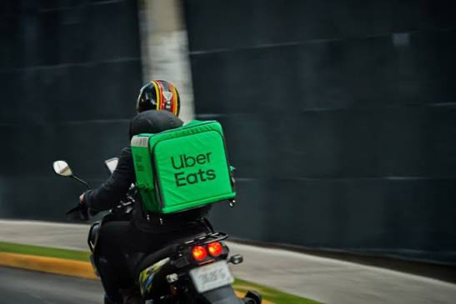

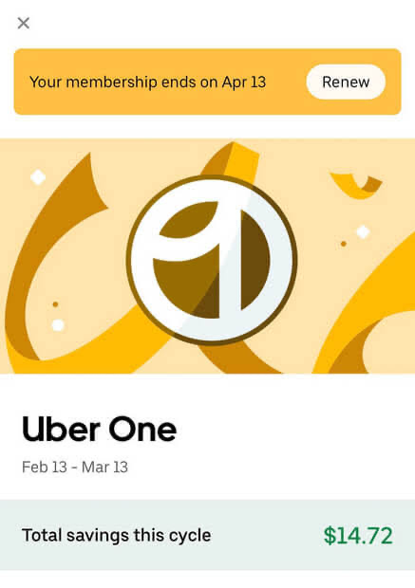

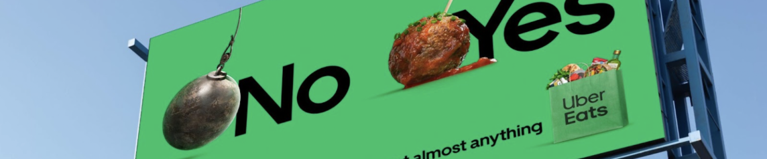
Uber is a global marketplace connecting consumers with mobility and delivery through a singular platform …
Company Overview
Uber’s Business Model
Performance Snapshot
Marketplaces
Mobility, Delivery and Freight Services
3.9bn
50m
$10.12bn
Trips
(+18% YoY)
Uber One Members
(+50% YoY)
TTM Free Cash Flow
(+18.5% YoY)
208m
$58bn
Membership
Uber One Subscription Fee
Gross Bookings
(+22% YoY, constant currency)
Monthly Active Platform Consumers
(+16% YoY)
Advertising
Merchant and Brand Funded
Total Addressable Market
Gross Bookings by Segment
Uber has redrawn the size of its own opportunity – from restaurant delivery to general commerce. The pending Delivery Hero deal adds a second lever on top of this.
+ $10 tn
Mobility GB
Delivery GB
Freight GB
Mobility Margin on GB
Delivery Margin on GB
US $ bn
% of Gross Bookings
Food
+ Grocery & Retail
Total Delivery TAM
58.1
Growth Opportunities
46.8
  Monetisation Mix
40.0
7.6%
  Organic
7.3%
  Uber’s Growth Vectors
  AV network
3.5%
3.8%
  Inorganic
  Delivery Hero
Q2 24
Q2 25
Q2 26
  Getir

Slide 4



Operating in fragmented local markets, where value capture is shifting beyond headline take rates
Industry Overview
Scale is concentrated in a handful of platforms, primarily single-category specialists
… with revenue capture varying largely by platform model
Platform Scale: Annualised Gross Bookings / GMV by Company
Mobility
Delivery
Freight
Revenue margin (take rate), % of volume
Profit per dollar of volume (%)
$232 bn
$132 bn
$80 bn
$58 bn
$26 bn
$22 bn
4.9%
3.2%
25%
2.8%
2.6%
Revenue margin
50.0%
67.3%
1.8%
14%
13%
Profit / volume
47.3%
Lyft
Delivery Hero
Uber
DoorDash
Grab
32.7%
Gross-basis reporters (Lyft, Uber) show wider revenue margins than net-basis reporters (DoorDash, Grab).
⇨ Revenue margin is not a reliable guide to underlying profitability.
2.7%
Uber
DoorDash
DiDi
Delivery Hero
Grab
Lyft
Global players compete locally through density, breadth and execution
... whilst affordability, regulation and AV-enabled supply reshape future profit pools
Local Supply Liquidity
1
Global platforms need critical mass of riders, drivers and merchants in every local market.
More local demand
Denser
marketplace
2
Membership and multi-category offerings reduce reliance on price wars.
Consumer affordability and supply costs drive trip volumes, pricing and margins.
As core markets mature, growth shifts toward retail delivery, subscriptions and advertising.
AVs and regulation will determine future supply costs, revenue presentation and value capture.
Higher
utilisation
Better
experience
Shorter
ETAs
3
Local leader is determined by reliable supply, strong merchant choice, regulatory navigation.
Near term:
Macro Conditions
Medium term: Industry Evolution
Long term:
Supply & Regulation

Slide 5
Uber’s scaled platform drives strong profit-per-booking growth without raising core fees
Investment Thesis 1
Consumer price sensitivity limits how far core fees can rise
Merchant-funded advertising adds revenue on top of existing transactions
Well-established and low-cost alternatives that have been available for decades, low barriers to entry, low switching costs, and well-capitalised competitors in nearly every major geographic region.
Implied Annualised Delivery Ad Revenue
Applied to Q2'26 Delivery Gross Bookings, annualised
Uber Q2 2026 10-Q Risk Factor Summary
2.00%
Ad penetration
(% of Gross Bookings)
~$550m
per 50 bp
1
Historically, Uber has cut fares to protect market share – its commission has therefore tended to fall over time.
2
Price sensitivity is local, and fares are set city by city – there is no single dial to raise take rate globally.
2.50%
3.00%
Implication: with base fares locked in by competition and local markets, margin growth must come from better mix, advertising, and scale – rather than raising the fee.
Advertising enables Uber to earn incremental revenue from merchants and brands, without raising checkout prices for riders or eaters.
A barbell portfolio captures willingness-to-pay without raising the base price
Grocery and retail add transaction volume on existing infrastructure
Uber converts one price point into a ladder of price-service trade-offs, with yield expanding through mix, rather than fare increases.
Delivery Gross Bookings
Total demand Q4 ‘25
(up 26% YoY)
$25.4 bn
> $15 bn
Grocery & Retail Gross Bookings
Using existing app, courier network, merchant relationships, and delivery technology.
75% higher trip frequency
3.5x profit $ per user
Core demand engine
Prices held stable
Delivery Segment Adjusted EBITDA
Delivery profit grew 40% YoY
(faster than Gross Bookings growth)
$1.02 bn
Low Cost
Moto, Share, Shuttle
Standard
UberX, XL, Taxi
Premium
Black, Comfort, Elite
As Uber adds more delivery volume, it can spread shared platform costs across more orders – improving profitability without raising prices.

Slide 6
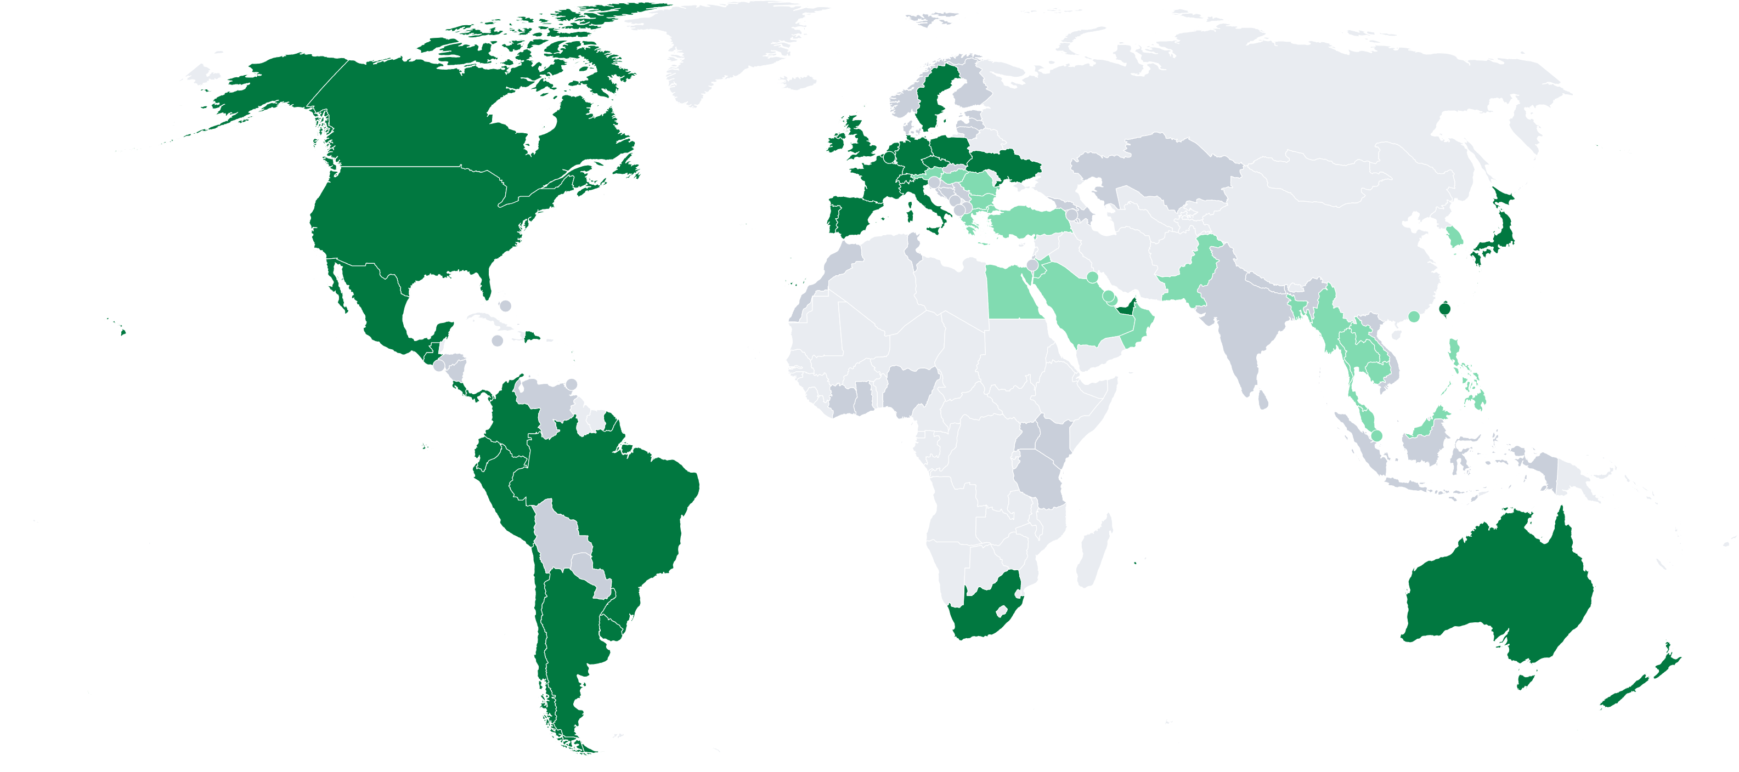
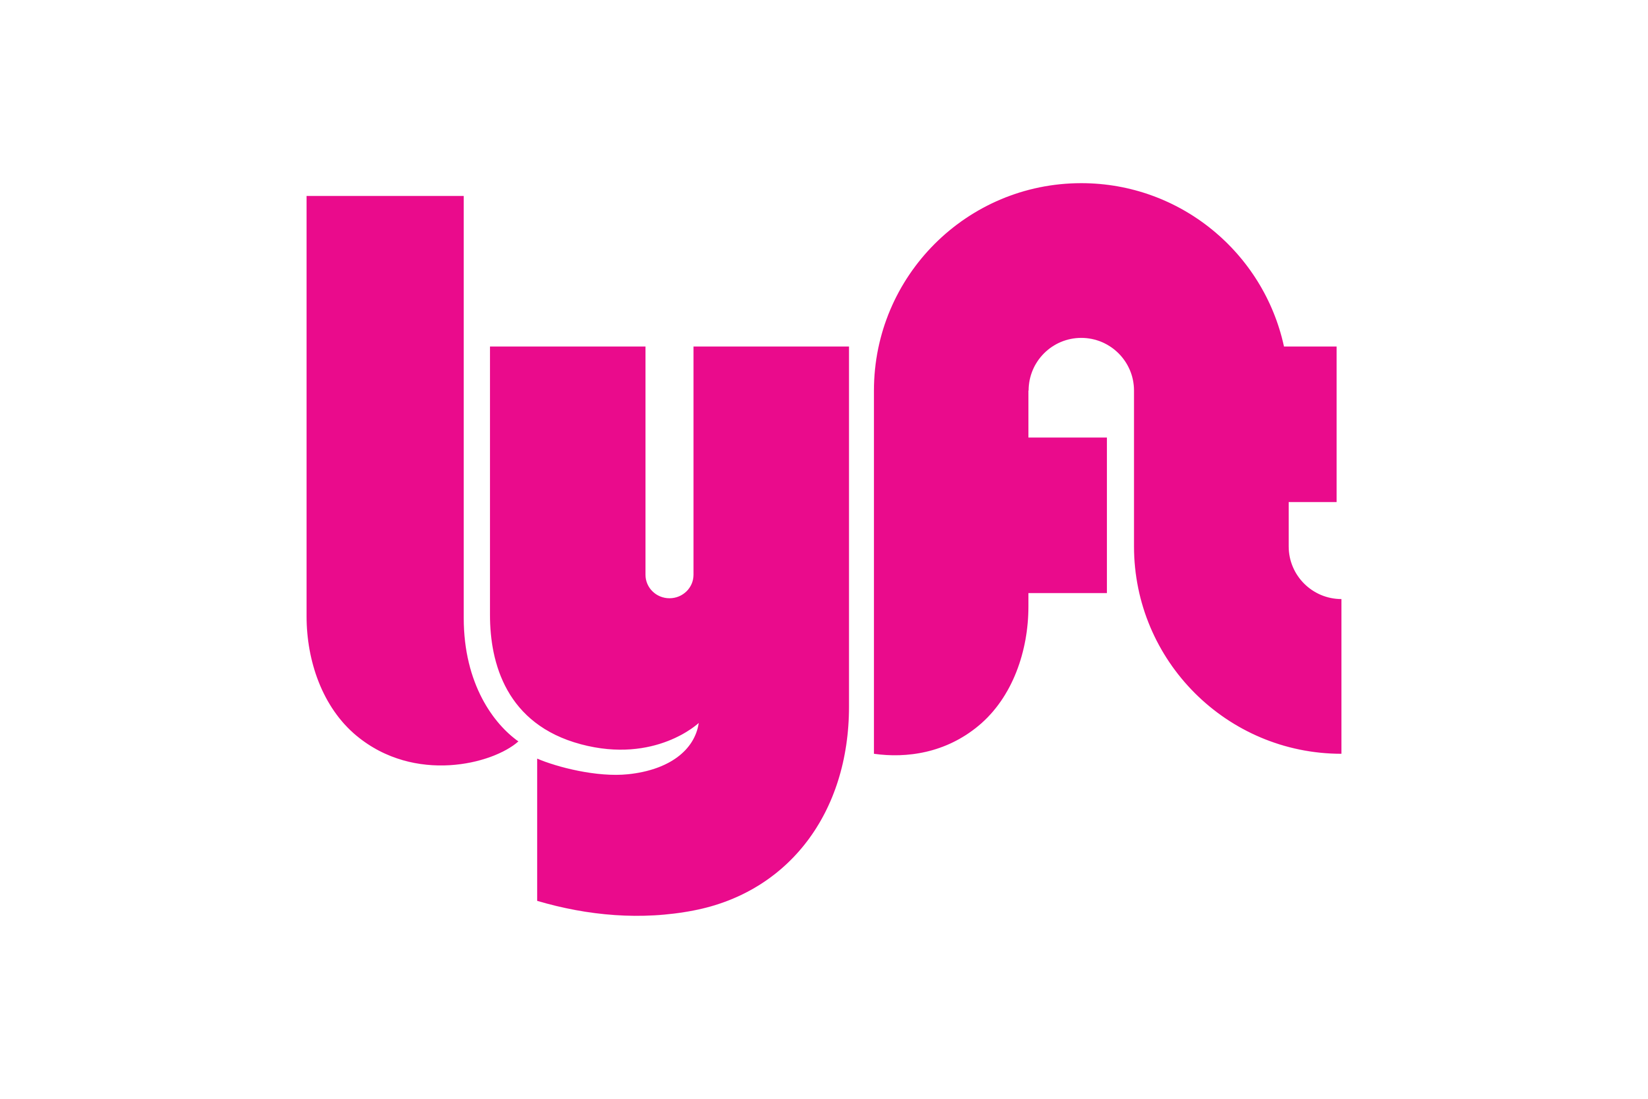


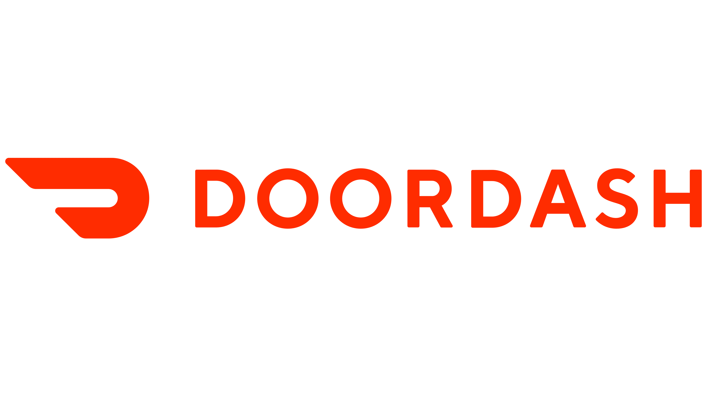

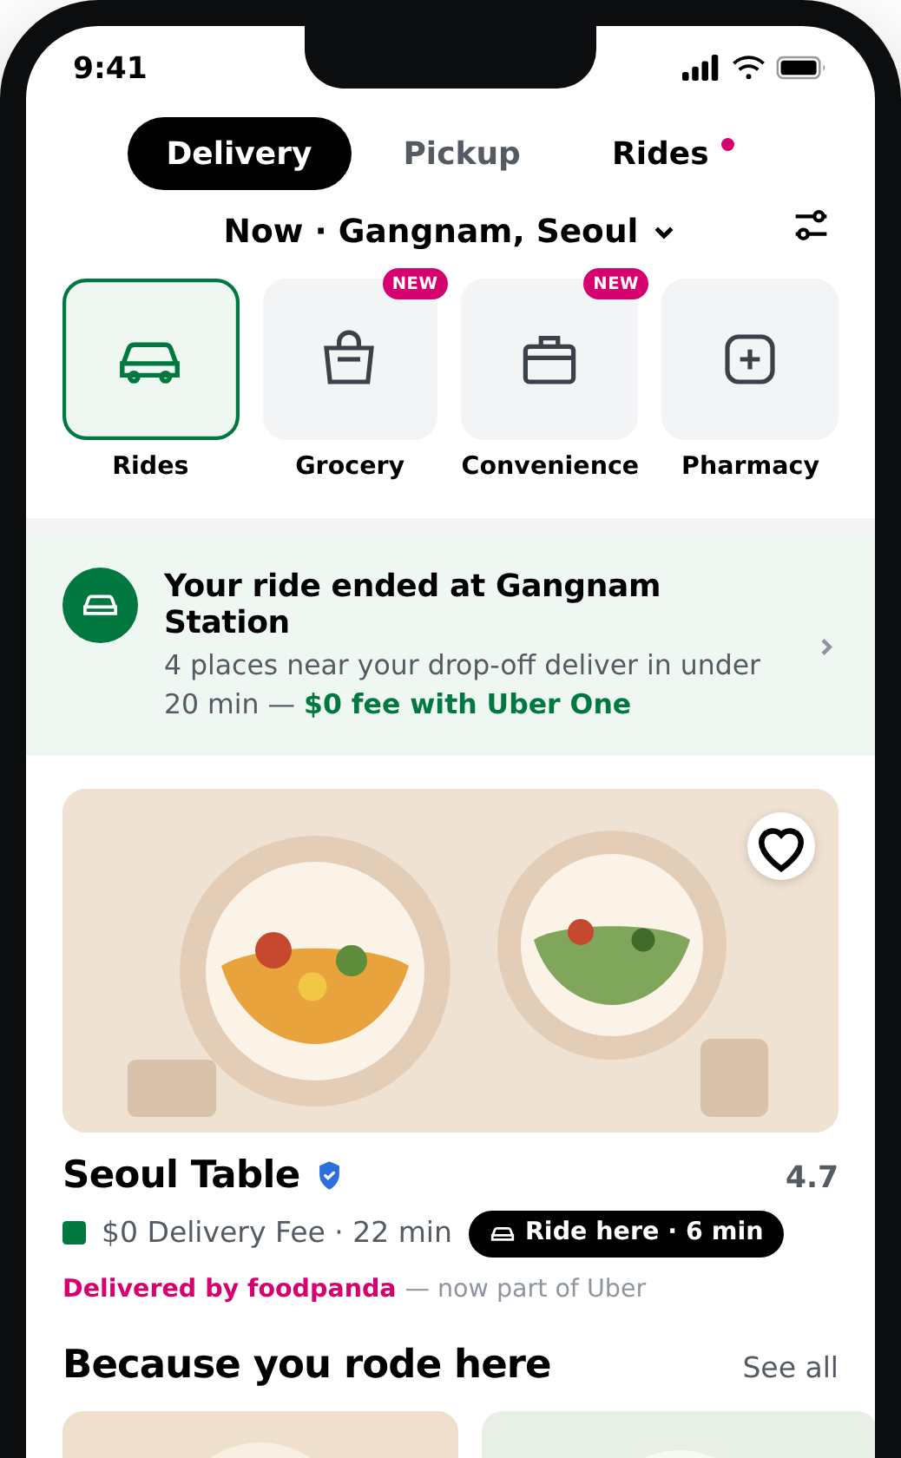
Delivery Hero expands Uber’s cross-platform overlap, but demands a margin of safety before pricing in
Investment Thesis 2
Current Market Chain & Structure
How Uber can reach more markets and close the gap
The Conditional Upside
A large delivery scale is not a moat…
We value Uber as if the deal never closes…
Consumers
Merchants
Couriers
Gained via Delivery Hero
Jul-26
Uber-Operated
Offer announced with US$14.8bn all-cash equity value; Prosus’s 17% committed
>
>
Pending Deal
Every component of the business model shops around to competitors, resulting in a gap in Uber’s business model
Regulatory clearance, financing and price all outstanding; remedies could strip out the strategic overlap that justifies the deal
Acquiring Delivery Hero expands the reach of Uber One
18 months after close
1
A completed ride surfaces four nearby merchants, a completed order surfaces a ride to collect it
An increase from 34 to 58 dual markets results in a total of 99 combined markets
US$1.2bn of annualised synergies from shared payments, mapping, trust & safety and support are management targets, not cash flows
2
Uber One patches up the consumer gap; through targeted deals and cross-selling ecosystem → each transaction generating the next
Gross bookings ($US bn), including Delivery Hero Projections
50m Uber One members now drive ~half of gross bookings
Cross-platform users are worth ~3x single-product users

Slide 7



Uber’s targeted AV investments keep robotaxi suppliers fragmented and preserve platform control
Investment Thesis 3
North America’s AV rideshare market is projected to grow at an exponential rate
… with Uber’s strategic role in the ecosystem
$ (bn)
1|
R&D & manufacturing
Major AV partnerships
America: Zoox, May Mobility & Volkswagen/MOIA
Europe: Verne, Pony.ai
2|
Deployment of AV’s
Optimising fleet management with vehicle cleaning and operations
Data enrichment through mapping & historical training data
Regulatory compliance for commercialisation
% share of total
rideshare miles
3|
US ridesharing market
Connecting customers
Uber: 74%
Lyft: 26%
0.3
2030E
Access to ~ 60 bn customers in the US alone
3.75 bn trips completed in Q4 2025
2025E
2026E
2027E
2028E
2029E
Unlikely to be disrupted due to….
Uber has currently invested….
High Operating Costs
Invaluable Databases
Global Reputation
$2.85 bn non-GAAP operations and support (2025)
100+ petabytes of data with minute latency
~70 countries globally use Uber
Fleet purchases (75%)
Yet only accounts for 0.5% of all bookings
Amazon bought Zoox for $1.2bn (2020)
May mobility estimated valuation of $734m
AV companies focusing on R&D do not have the FCF to replace Uber’s services
17 years of real-world roadway data, high-definition mapping and fleet management intelligence to train and scale AV progress
Equity Stakes
(25%)
>
27%
35%
25%
Hence, AV success is contingent on:
Uber retaining an asset-light aggressor model
Disclosed returns compared to the current US$10bn program
Complex and evolving robotaxi legislative landscape
Notes:
https://www.uber.com/au/en/autonomous/
- Growth through economies of scale

Slide 8
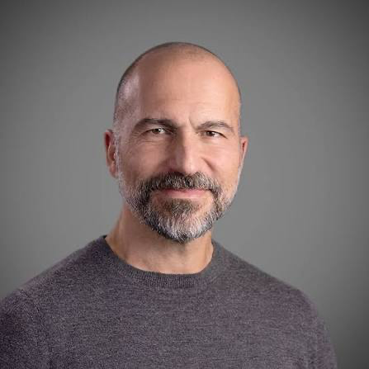



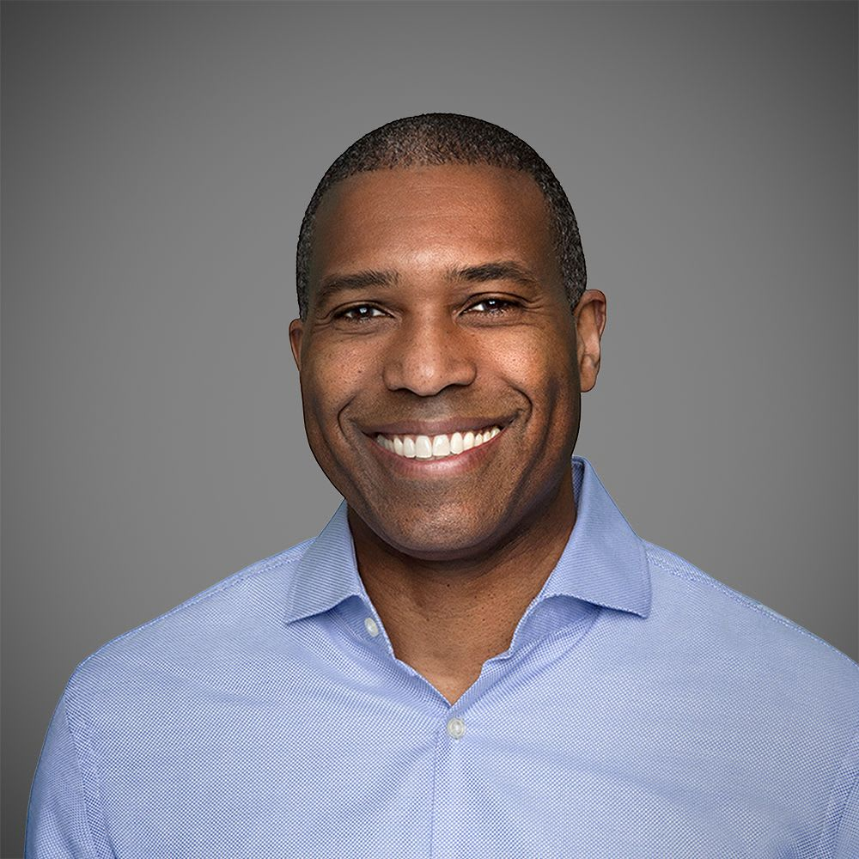
Uber’s growth is supported by durable CEO leadership
People and Culture
Uber’s CEO Dara Khosrowshahi has now led for nearly nine years
2017
2018
2019
2021
2022
2026
Reforming Culture and Leadership
Surviving the Pandemic
Profitability and Platform Growth
“direct channels” with engineers and teams
"We do the right thing. Period."
Covid-19 pandemic: ride requests fell by 85% → pivot to Uber Eats
Turning yearly $1.1bn operating profit
Uber One → expanding into a super-app
Dara Khosrowshahi
Chief Executive Officer
Supported by a dedicated and strategic team
… evident through their share buy-back tactics
However, P&C remains concentrated within leadership
Andrew Macdonald - COO
$20bn
share repurchase program
(July 2025)
~50%
of FCF directed
towards buybacks
Joined Uber in 2012
Leads Mobility and Delivery segments + AV’s
Balaji Krishnamurthy - CFO
$3.0bn
"commenced or suspended at any time” at management's discretion
- Uber 10-Q
3.7/5 Glassdoor rating based on 16,363 reviews
Joined Uber in 2019
Ranked top IR professional 3 times
With polarising ratings....
Reflected through....
$0.51bn
Senior managers rating at 4.7 ​
Eats delivery role at 3.2
Culture and values at 3.3/5​
Absence of “direct channels”: California Gig Workers Union, 350,000 drivers
$966m fine by Dutch Data Protection Authority (AP) Aug 2026
Tony West – CL:O
Q1 26
39.7m sh
Q2 26
6.9m sh
Joined Uber in 2017
Leads public policy, legal compliance, and regulatory affairs
Source: Diary of a CEO podcast, Institutional Investor Magazine , Reuters, Glassdoor,
Notes:
Want to mention that the time, path dependence and human complexity makes high barriers of replication
Durability -> dara has built over years, uber strives for a clear company motto
Considier market impact: evidence that Uber's competitive position or ability to sustain profitability is because of culture/ leadership --> think can tie with the timeline (uber had a huge turnaround --> consider in the appendix put a graph/ timeline of profitability and label)
https://www.cnbc.com/2017/11/14/arianna-huffington-on-ubers-new-culture-we-do-the-right-thing.html
https://yuanchang.org/en/posts/doac-dara-khosrowshahi-transcript/
STUFF TO ADD/ EXPLAIN IN APPENDIX
Why is it not high convinction ownership --> consider low insider ownership? Is it normal for sector/ industry?
CFO churnover
Have a slide/ section about his pay structure
High pay governance means having strict, transparent, and structured oversight policies to ensure that compensation—especially high executive packages—is fair, legally compliant, and tied to long-term company performance rather than decided informally

Slide 9
Weighted Blend of $86.60 per Share (14.31% Upside)
Football Field
Methodology
Comments
0
20
40
60
80
100
120
140
160
180
200
220
  WACC: 10.82%
  Terminal Growth Rate: 2.50%
  Beta 1.23
  Exit Multiple: 10.90x
DCF Terminal Growth (30%)
106.8
DCF Exit Multiple (30%)
117.1
61.0
$70.71
Bear Case
EV / Adjusted EBITDA (10%)
46.0
90.0
76.5
$86.60
Base Case
P / E (0%)
155.5
38.7
EV / Gross Bookings (15%)
31.8
68.0
$107.34
Bull Case
81.2
EV / FCF (10%)
102.5
DCF-weighted (60%) blend of intrinsic and market-based methods converges on $86.60, bracketed by a $70-107 bear/bull range, supporting 14% upside to the current price.
On the same base-case cash flows, a four-year hold returns 16.91% p.a.
Broker Estimates (5%)
212.5
75.8
52-Week Trading
65.4
$75.76
$86.60
Target Price
Current Price

Slide 10
Despite downside mitigants, risks in Uber concentrate in capital deployment, reinforcing a monitor
Risks & Mitigations
Low Risk
Medium Risk
High Risk
1
2
Monetisation Crowding
Asset Erosion
Risk: Advertising is funded from the same merchant P&L as commission → total platform cost rises, pushing fees onto the consumer
Risk: Fixed cash consideration means Uber commits US$14.8bn while target asset value can be eroded by competitors during regulation
3
✓ Measure merchant cost of Uber through commission & ad spend as a % of their GMV
✓ Cap advertising at a stated share of gross bookings; never grow it to fit the answer
✓ Increase conversion rate or time-to-order worsening two quarters running as ad load climbs
✓ Stress-test acquired market profitability assuming Talabat’s Gulf margin is halved by Keeta/Didi
✓ Model the transaction at three competitive erosion scenarios and ensure competitiveness of Delivery Hero
✓ Enforce the base-case IRR clears the 22% hurdle with zero Delivery Hero contributions
1
Likelihood
2
4
3
4
Fleet Ownership Creep
Member Migration
Risk: Offtake on 120,000 vehicles is a purchase obligation in all but name, US$10bn against <0.5% of trips invites a fleet-owner multiple
Risk: Uber entering new markets does not guarantee usage, Delivery Hero's users must migrate onto Uber One, and migrations leak
✓ Measure trips per AV per day, mid-20s to low-30s today, and the aggregator case rests on it holding
✓ Count vehicles Uber is contracted to buy separately from vehicles partners own
✓ Commit AV capital above 1.5x TTM free cash flow, it is ~1.0x today
✓ Delivery Hero's own subscriber base must be converted through acquisition methods
✓ An explicit conversion rate to acquired users – no assumption that the bundle installs itself in model
✓ Uber One penetration in acquired markets below half the group average 12 months after close
Impact

Slide 11
We Recommend a MONITOR Position
Recommendation
$75.76
Closing Price
as at 4 Sept
+14.31%
$86.60
Target Share Price Base Case
Thesis
Valuation
Risks
MONITOR
Under 9 years of consistent leadership, strong on culture and disciplined on capital
Uber compounds profit per trip without raising fares, extends Uber One through Delivery Hero, and stays the demand layer for AVs without owning the fleet.
A $86.60 base case implies 14% upside, but only a 16.9% IRR over a four-year horizon.
Monetisation crowding, asset erosion, fleet ownership creep and member migration may induce volatility.
However, Uber’s holistic ecosystem provides strong defence.
Uber's business is strong, but it does not leave enough margin of safety to clear TDM's >20% IRR hurdle.
We recommend monitoring.

Slide 12
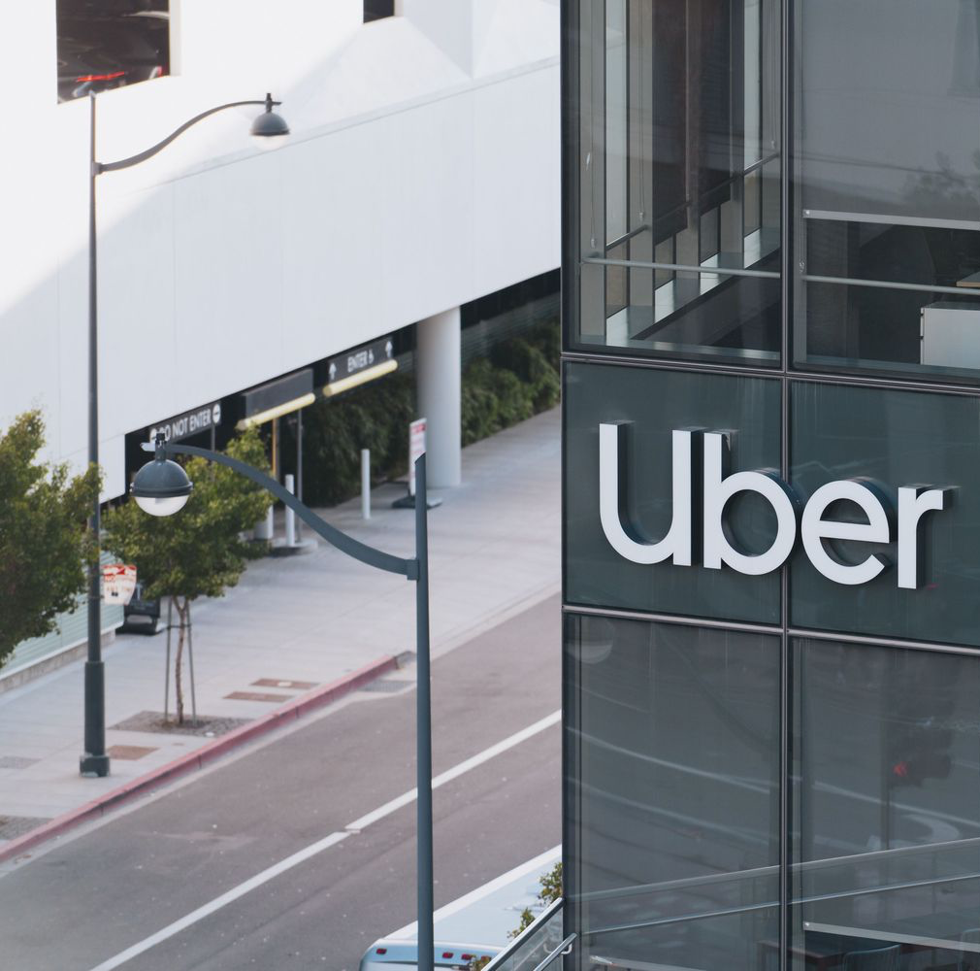
Appendix

Slide 13
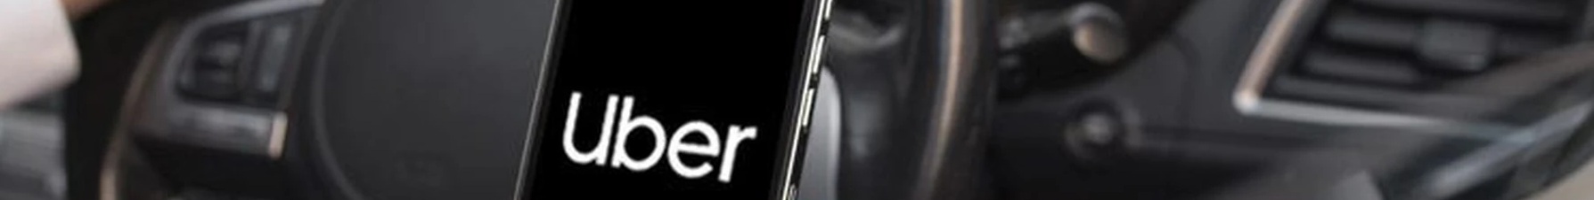
Appendix Network
Presentation
Title
1
Financials
Revenue Build
16
Interest Build
29
Executive Summary
2
Assumptions – Volume & Take Rate
17
Beta
30
Company Overview
3
Assumptions – Gross Bookings
18
DCF Assumptions
31
Industry Overview
4
Assumptions – Gross Bookings
19
DCF Calculations
32
Investment Thesis 1
5
Delivery Hero Build
20
DCF Free Cash Flow
33
Investment Thesis 2
6
Delivery Hero Build
21
Company Comparable Analysis
34
Investment Thesis 3
7
Cost & Income Statement
22
Company Comparable Analysis
35
People and Culture
8
Balance Sheet
23
Football Field and Sensitivity
36
Football Field
9
Cash Flow Statement
24
Risks & Mitigations
10
Supporting Schedules
25
Recommendation
11
Supporting Schedules
26
Supporting Schedules
27
Supporting Schedules
28

Slide 14
Appendix Network
General
Delivery Hero as a Catalyst: What would drive a recommendation to BUY?
37
Delivery Hero Group GMV (Quarterly Statement, Q1 2026)
51
What would drive a recommendation to NOT BUY?
38
Local Competitive Intensity – Risk Factor Summary
52
Macroeconomic Exposures
39
Local Competitive Intensity – Risk Factor Summary (cont.)
53
Financial and Operational Highlights for Second Quarter 2026
40
Uber Pricing and Incentive Strategy
54
Q1 2026 Earnings Call Transcript
41
Uber Barbell Portfolio (Q1 26 Earnings Supplemental Data)
55
Free Cash Flow (Q2 26 Earnings Supplemental Data)
42
Barbell Strategy: Trip Frequency and Profit-per-User by Price Tier
56
Segment Operating Performance Measure Change, Effective Q1 2026
43
Delivery Gross Bookings – Base Figure for Ad Revenue Sensitivity
57
Segment Operating Performance Measure Change – Reconciliation Tables
44
Advertising Run-Rate – Context for Sensitivity Range
58
Expanding TAM (Q3 2025 Earnings Supplemental Data)
45
Delivery Gross Bookings and Adjusted EBITDA
59
UK Mobility Reclassification
46
Grocery & Retail Annualised Run-Rate
60
Uber Gross Bookings by Segment (Form 10-Q, Q2 2026)
47
Case Study: Delivery Hero / Woowa Brothers (Korea, 2019-21)
61
DoorDash Marketplace GOV and Adjusted EBITDA (Form 10-Q, Q2 2026)
48
Case Study: Just Eat Takeaway / Grubhub (2020-25)
62
Lyft Gross Bookings and Adjusted EBITDA (Form 10-Q, Q2 2026)
49
Case Study: Uber / Postmates (US, 2020-22)
63
Grab Gross Merchandise Value and Adjusted EBITDA (Form 20-F / Earnings Release, Q2 2026)
50
Case Study: DoorDash / Wolt (2022-present)
64

Slide 15
Appendix Network
General
Case Study: Amazon Prime (2005-present)
65
US robotaxi-legislation is fragmenting by jurisdiction
79
Delivery Hero Acquisition Financing
66
Uber highlights the significant potential of the AV market
80
Market Expansion through Delivery Hero
67
Captured by Uber’s geographic dominance and AV partnerships
81
EV / 2025 gross bookings costs + trades
68
TDM treats People and Culture as an eighth power
82
Gross Bookings, 2025 Basis
69
The CEO has been with Uber Since 2017
83
Our estimates are in line with consensus ratings
70
Supported by a dedicated team
84
Our estimates are in line with consensus ratings
71
Uber utilising deliberate board refreshments and clear CFO transition
85
The AV industry is scaling fast and getting structurally cheaper
72
With a board with a wealth of experience across multiple sectors
86
AV rollout predictions
73
Whilst insiders account for 0.2% of shares, average tenure of management is above average
87
Expectations for future of AV recalibrated
74
With governance performing exceptionally well
88
Costs for more advanced autonomy levels are higher than expected
75
Disciplined capital allocation, but limited ownership alignment
89
High costs as the largest pain point for advanced driver assistance system developers
76
People & Culture: Worker Protection Issues
90
Autonomous-vehicle survey respondents bet on a hybrid approach for AVs
77
ESG Profile
91
Case Study: Waymo
78
Improving ESG scores indicate a reformative people and culture
92

Slide 16
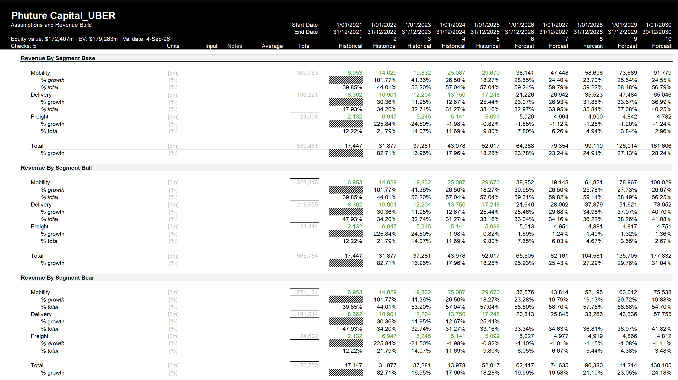
Revenue Build

Slide 17
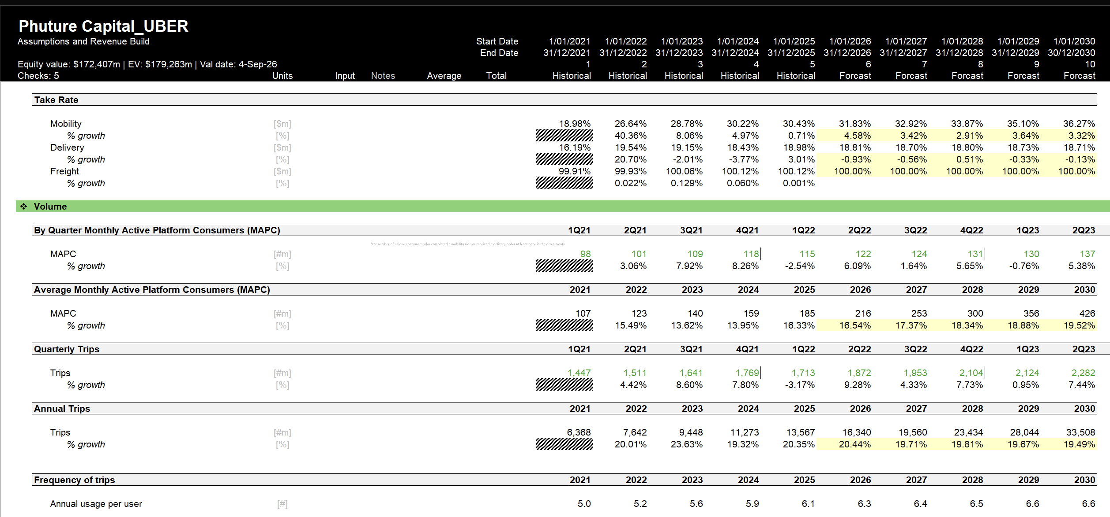
Assumptions – Volume and Take Rate

Slide 18
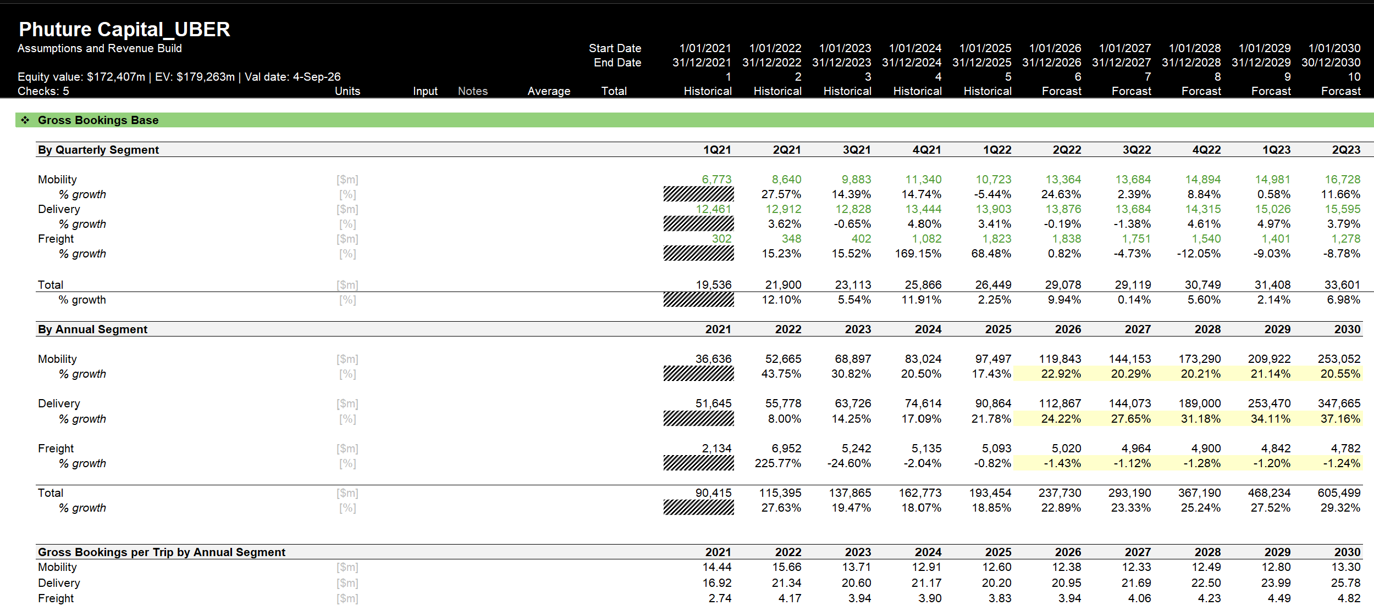
Assumptions – Gross Bookings

Slide 19
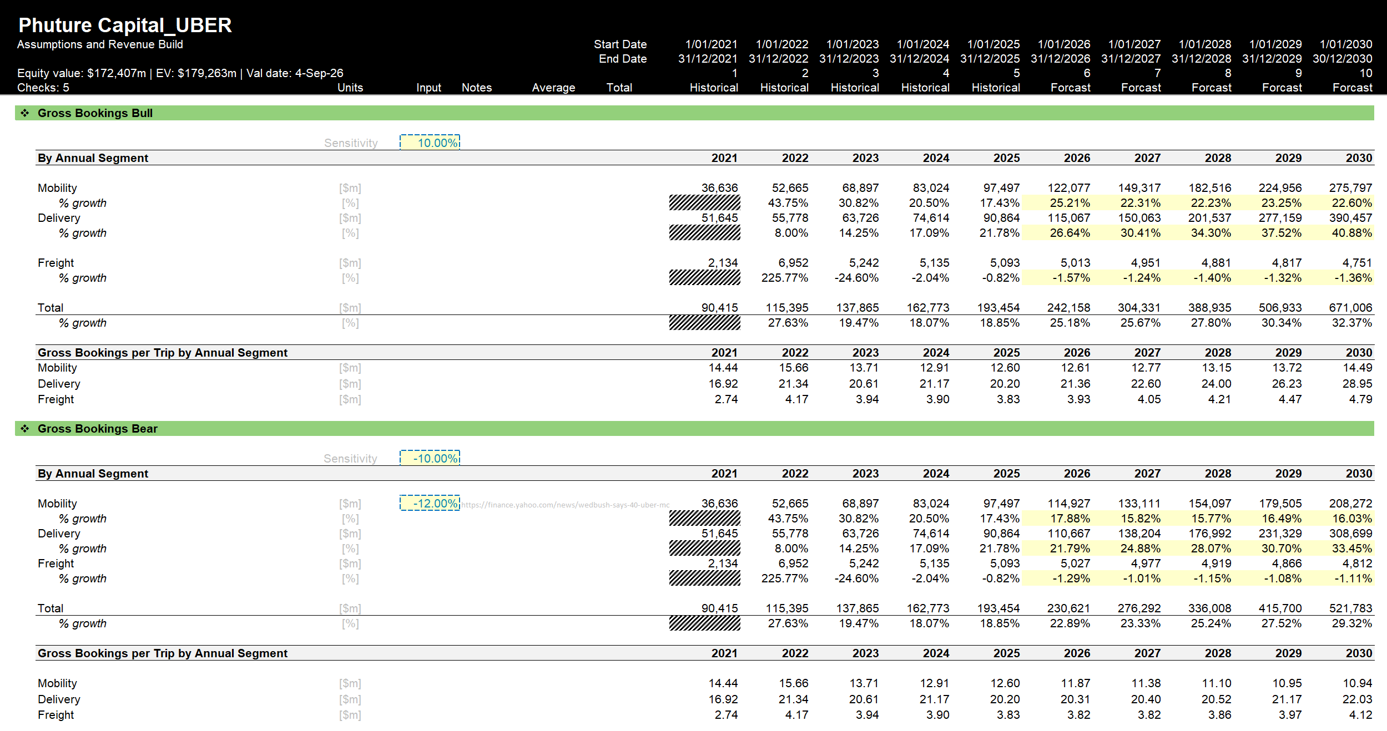
Assumptions – Gross Bookings

Slide 20
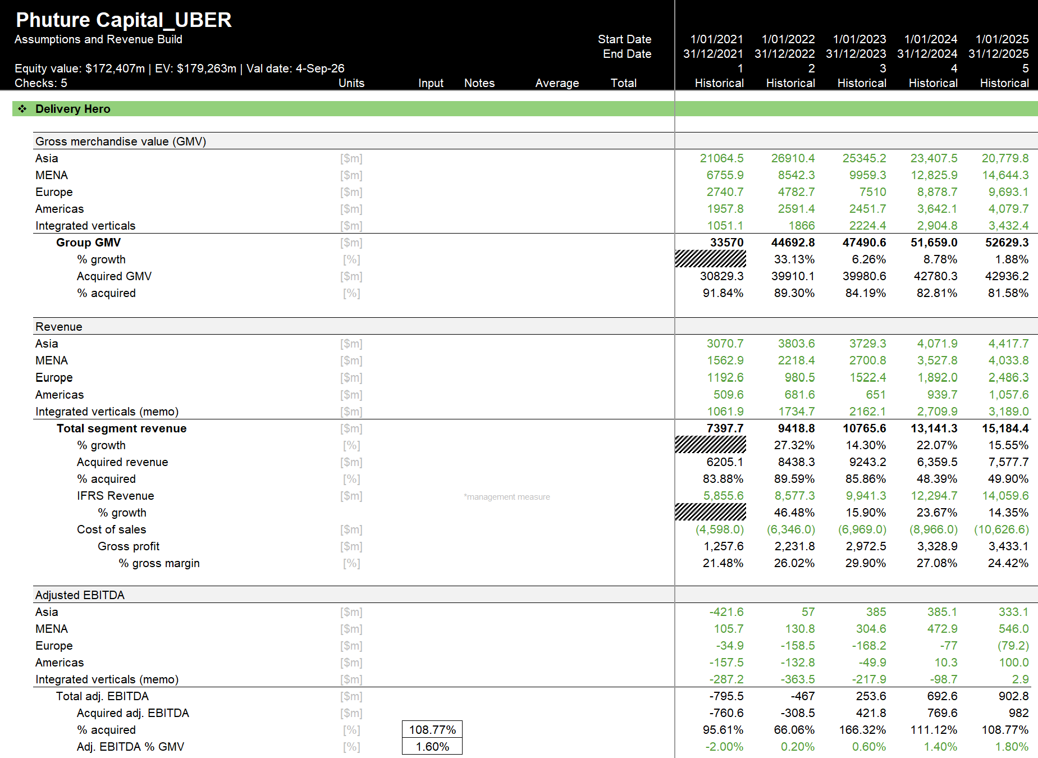
Delivery Hero Build

Slide 21
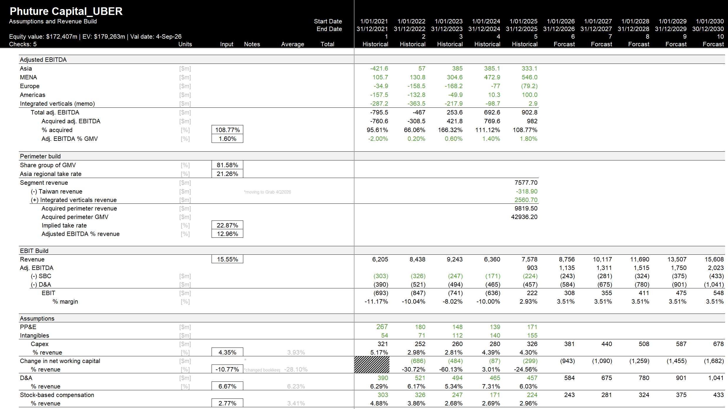
Delivery Hero Build

Slide 22
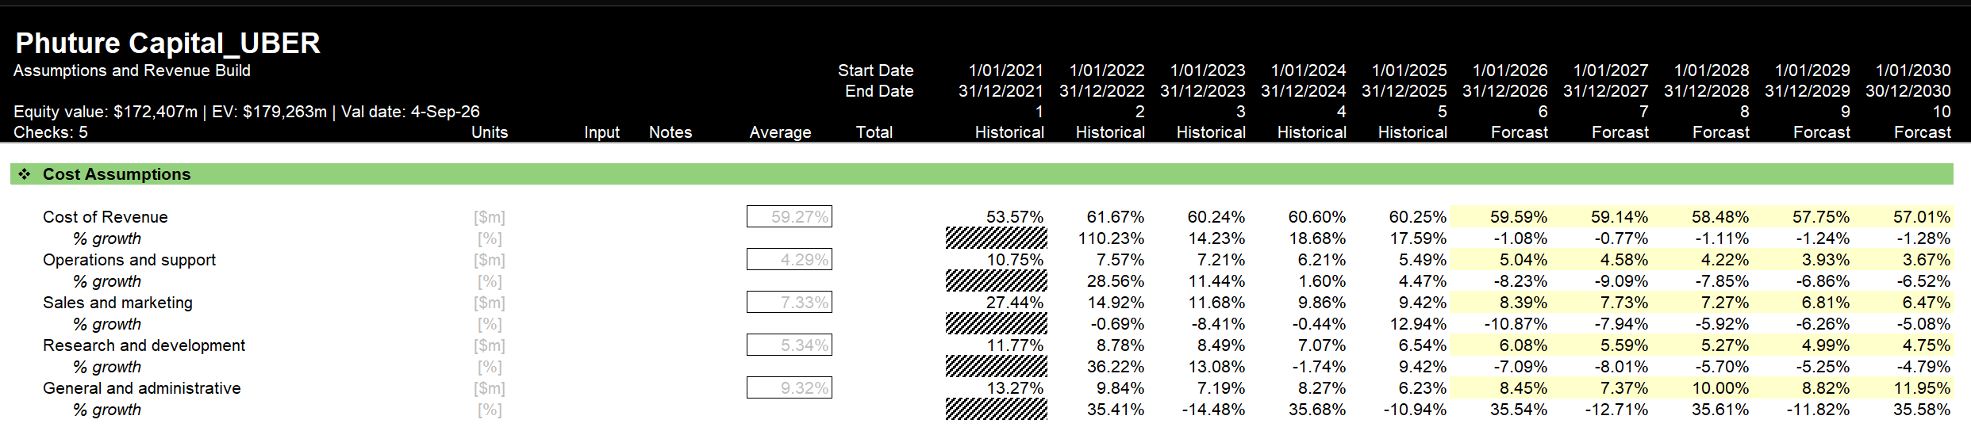
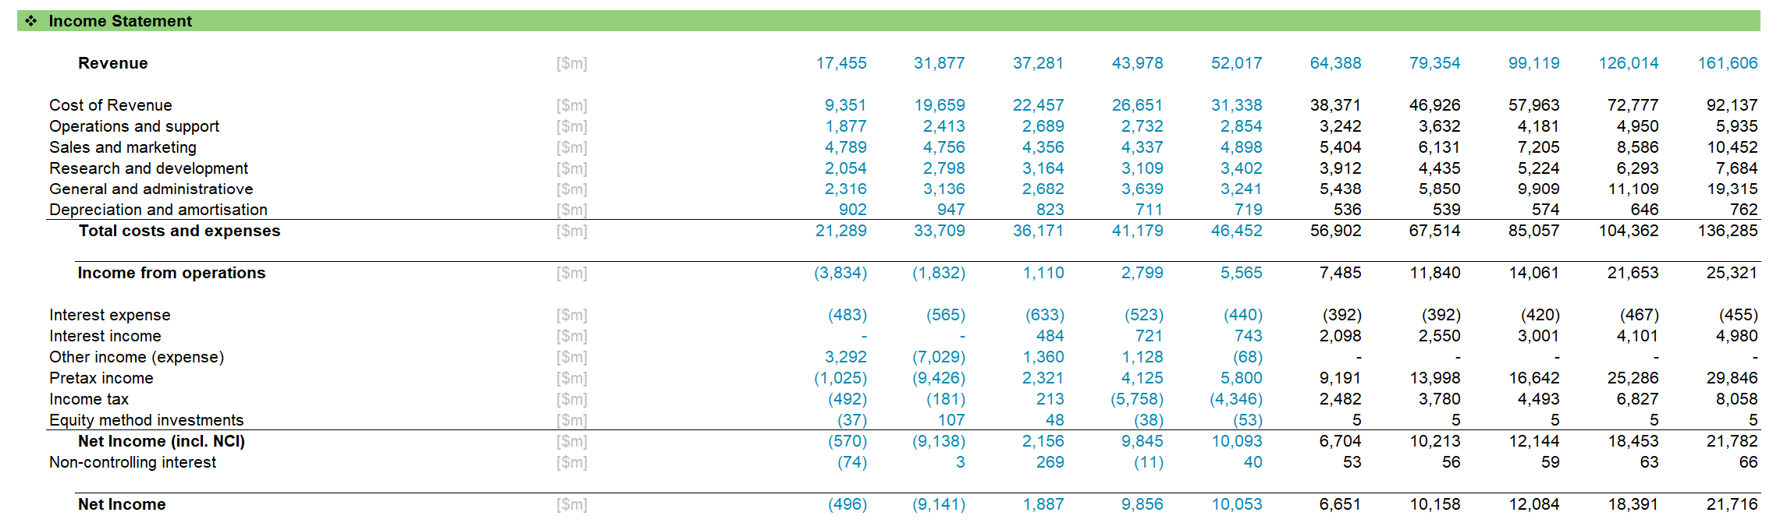
Cost & Income Statement

Slide 23
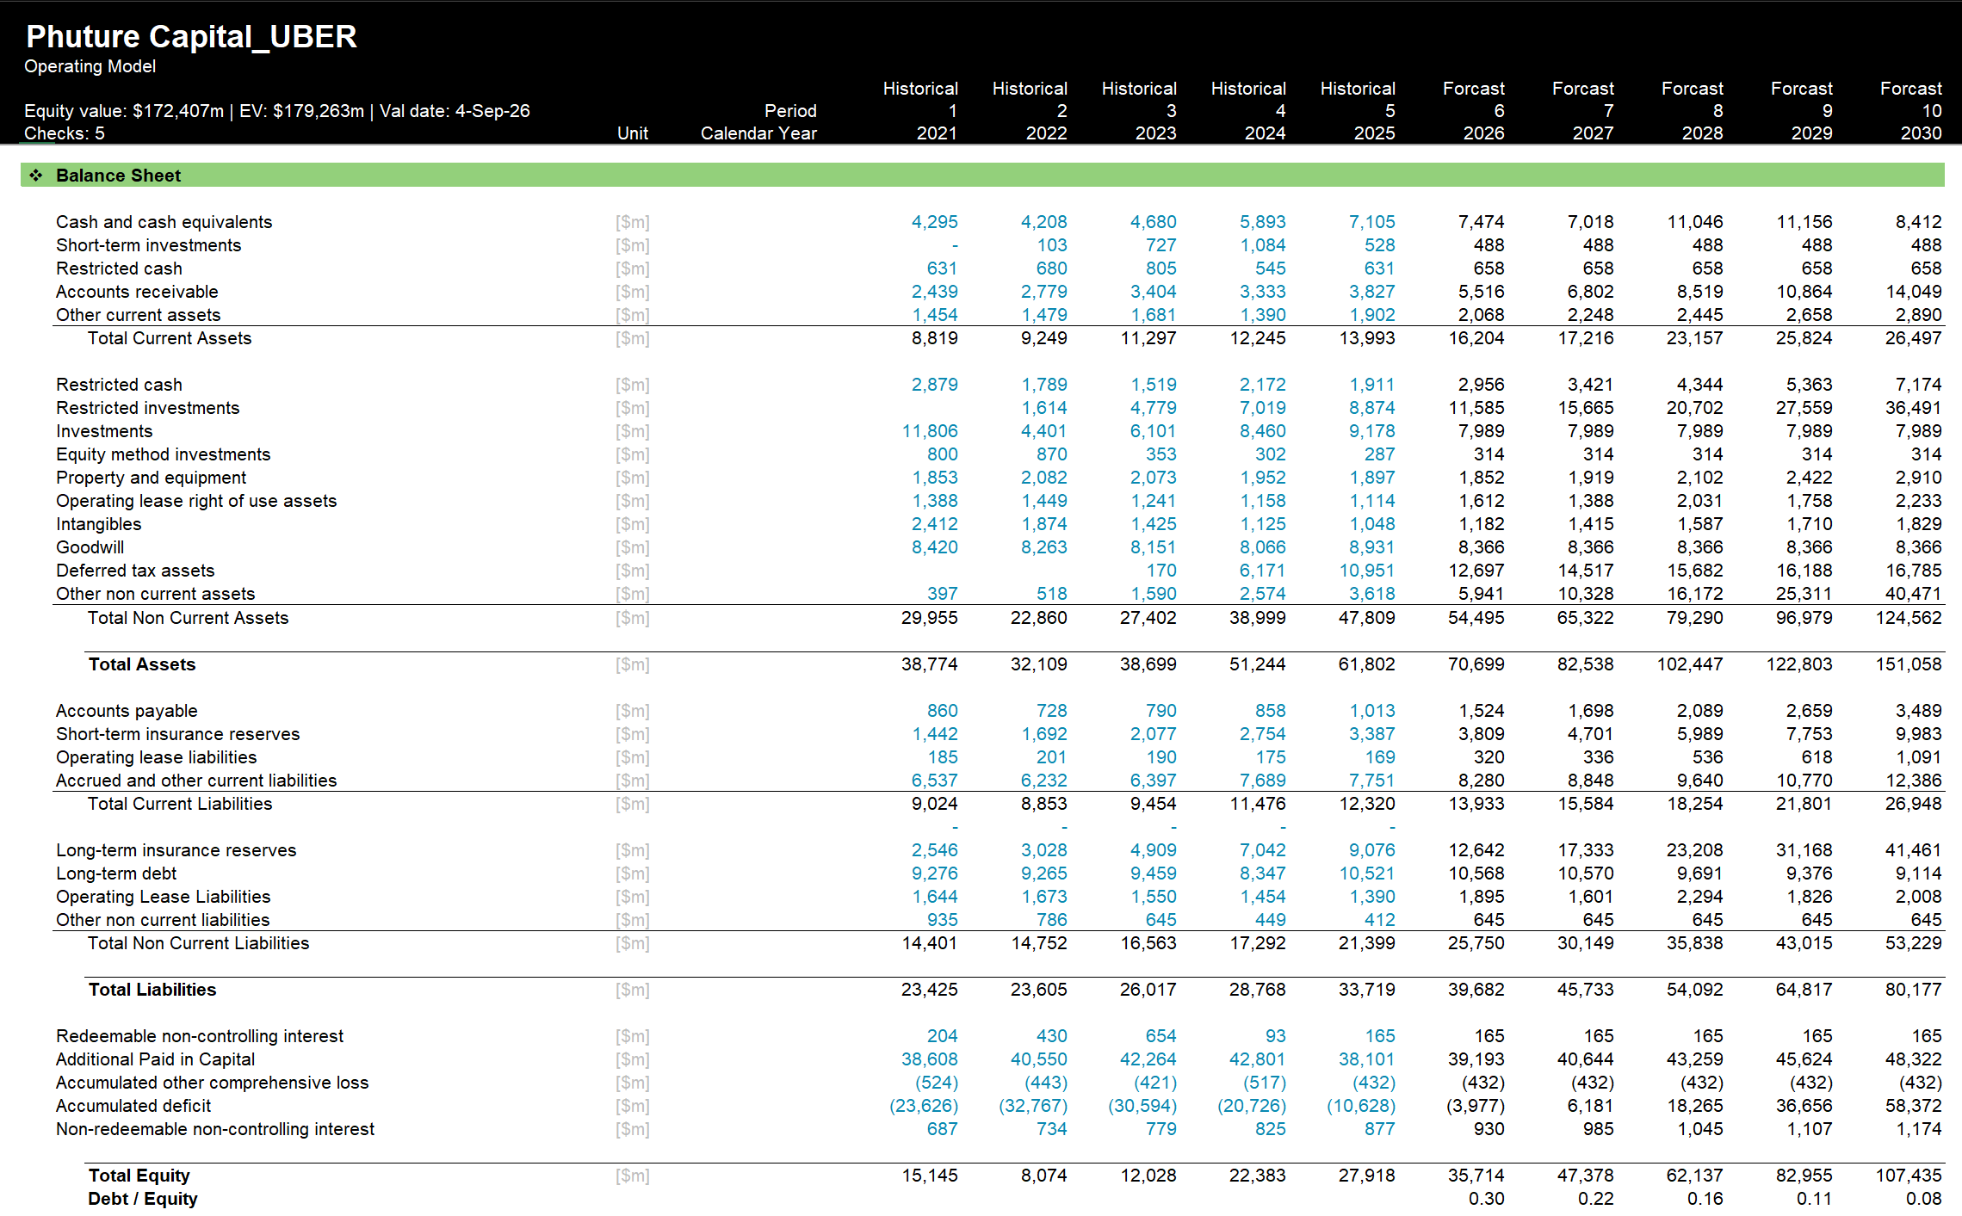
Balance Sheet

Slide 24
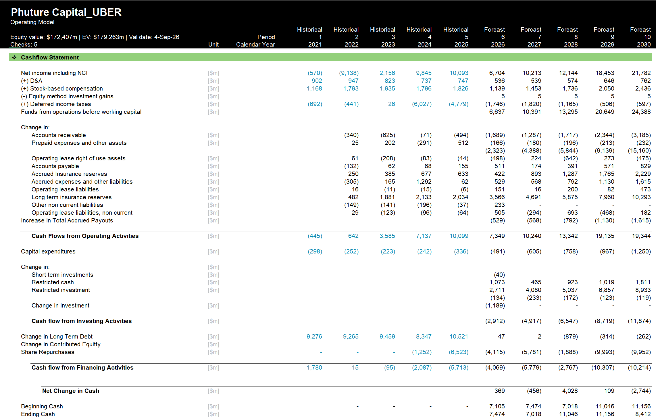
Cash Flow Statement

Slide 25
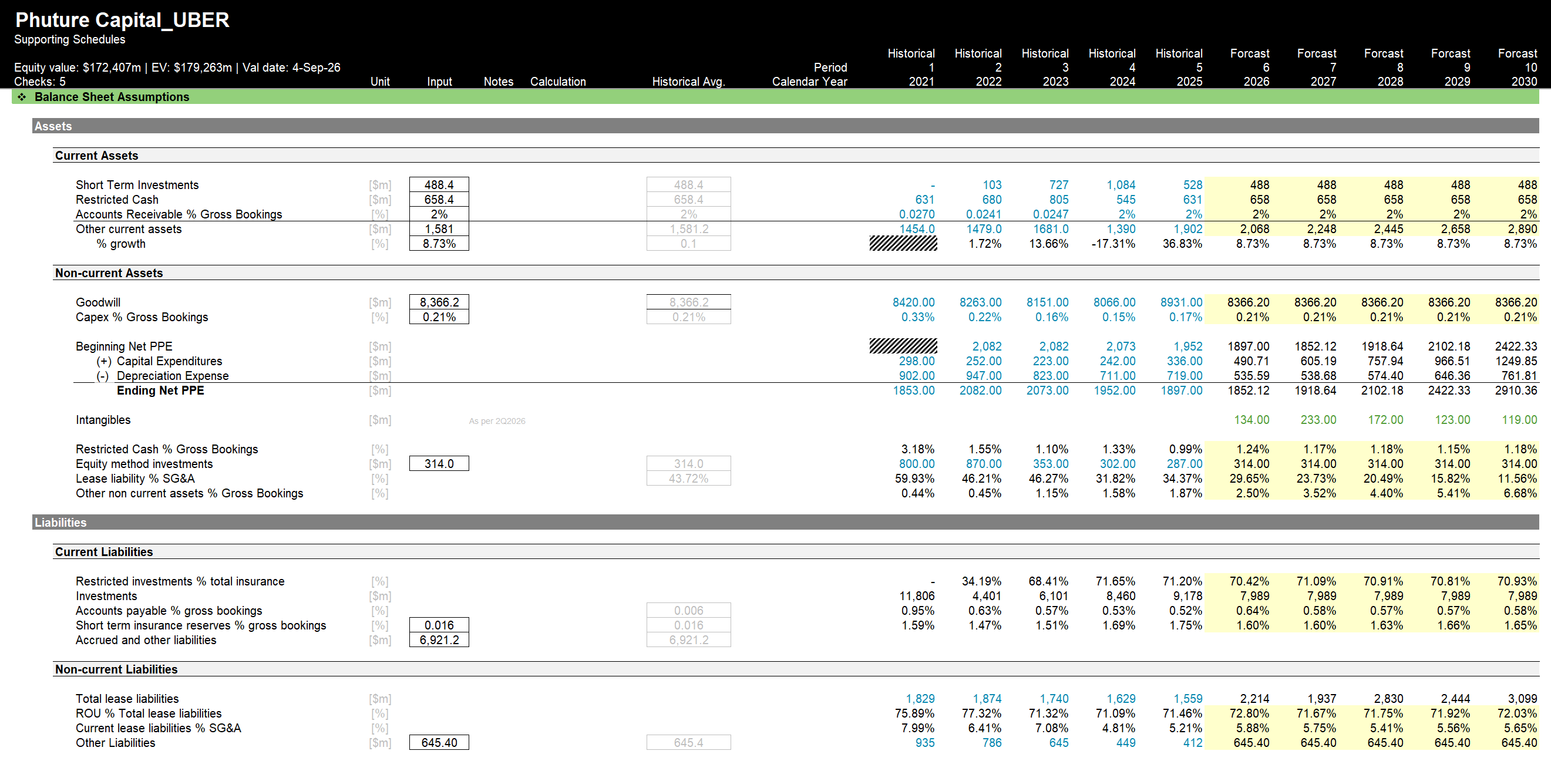
Supporting Schedules

Slide 26
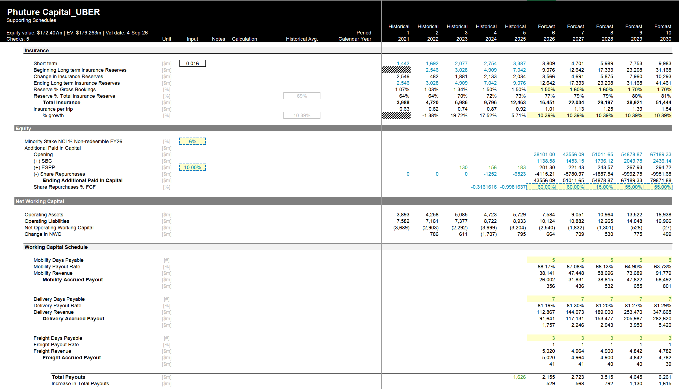
Supporting Schedules

Slide 27
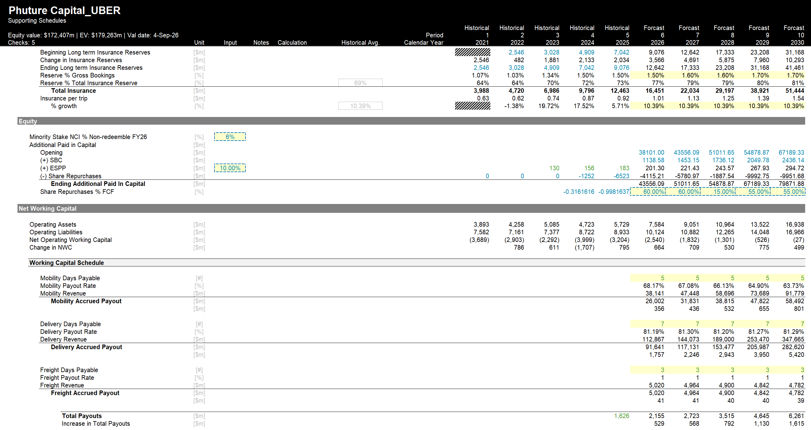
Supporting Schedules

Slide 28
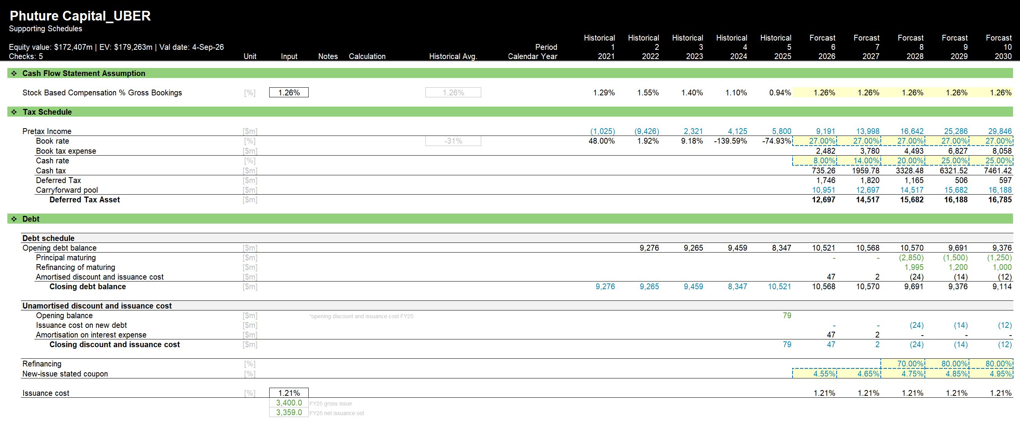
Supporting Schedules

Slide 29
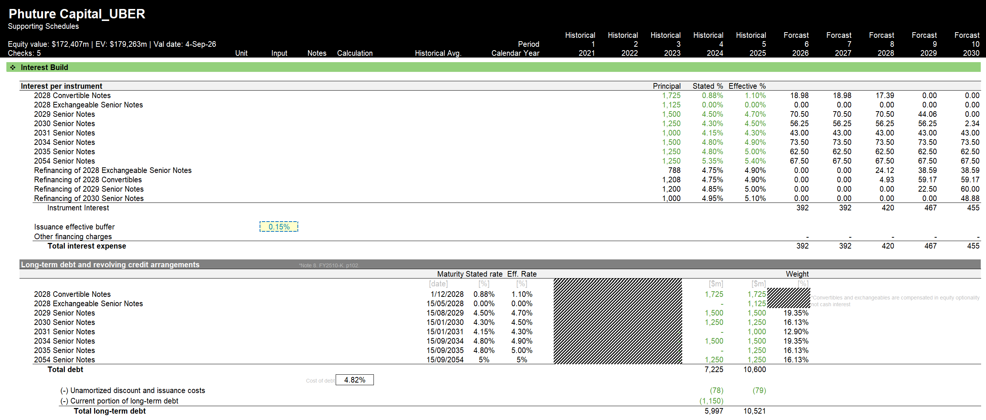
Interest Build

Slide 30
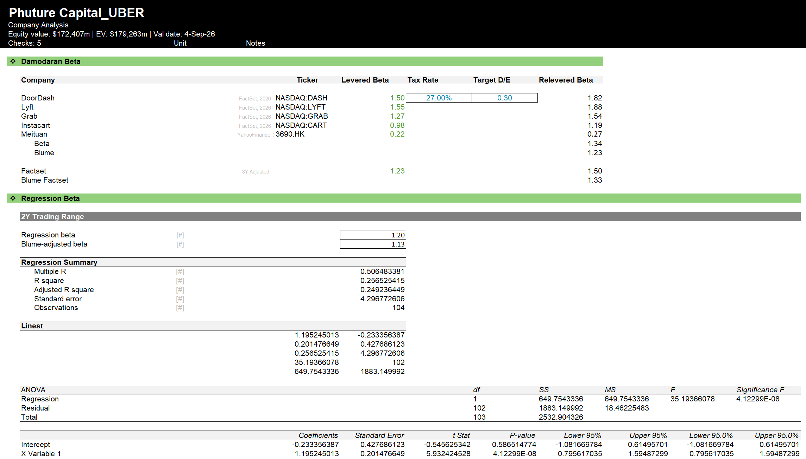
Beta

Slide 31
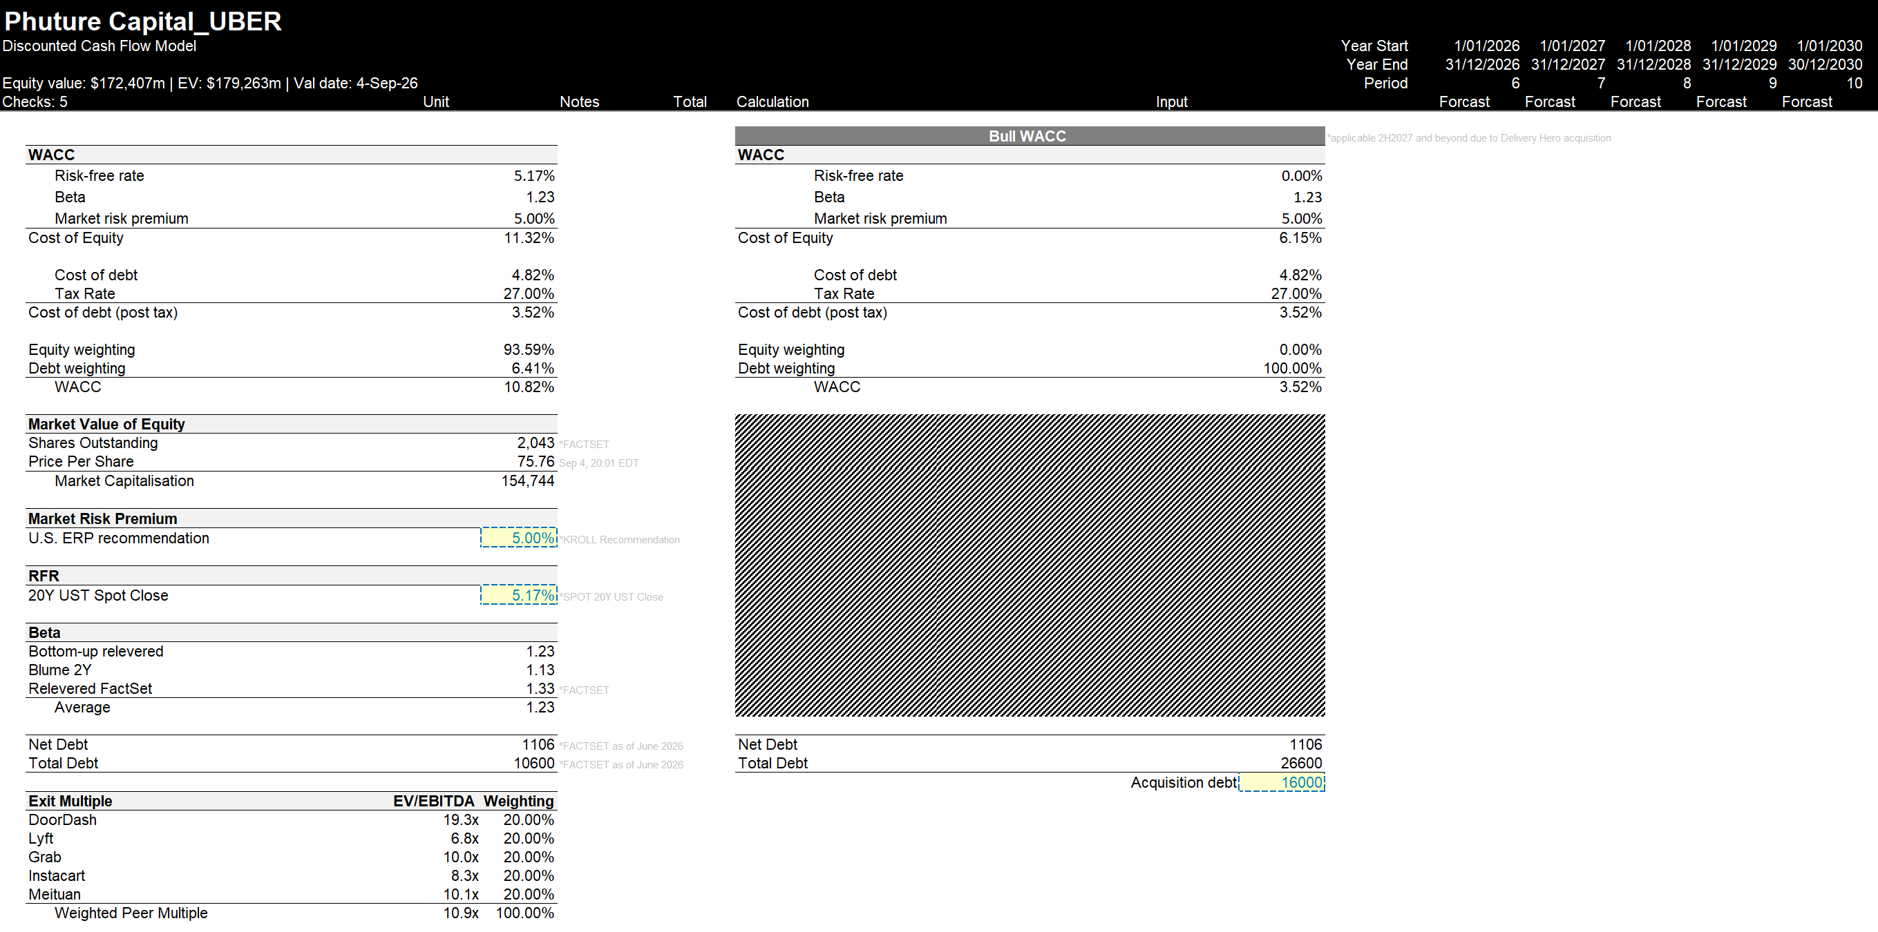
DCF Assumptions

Slide 32
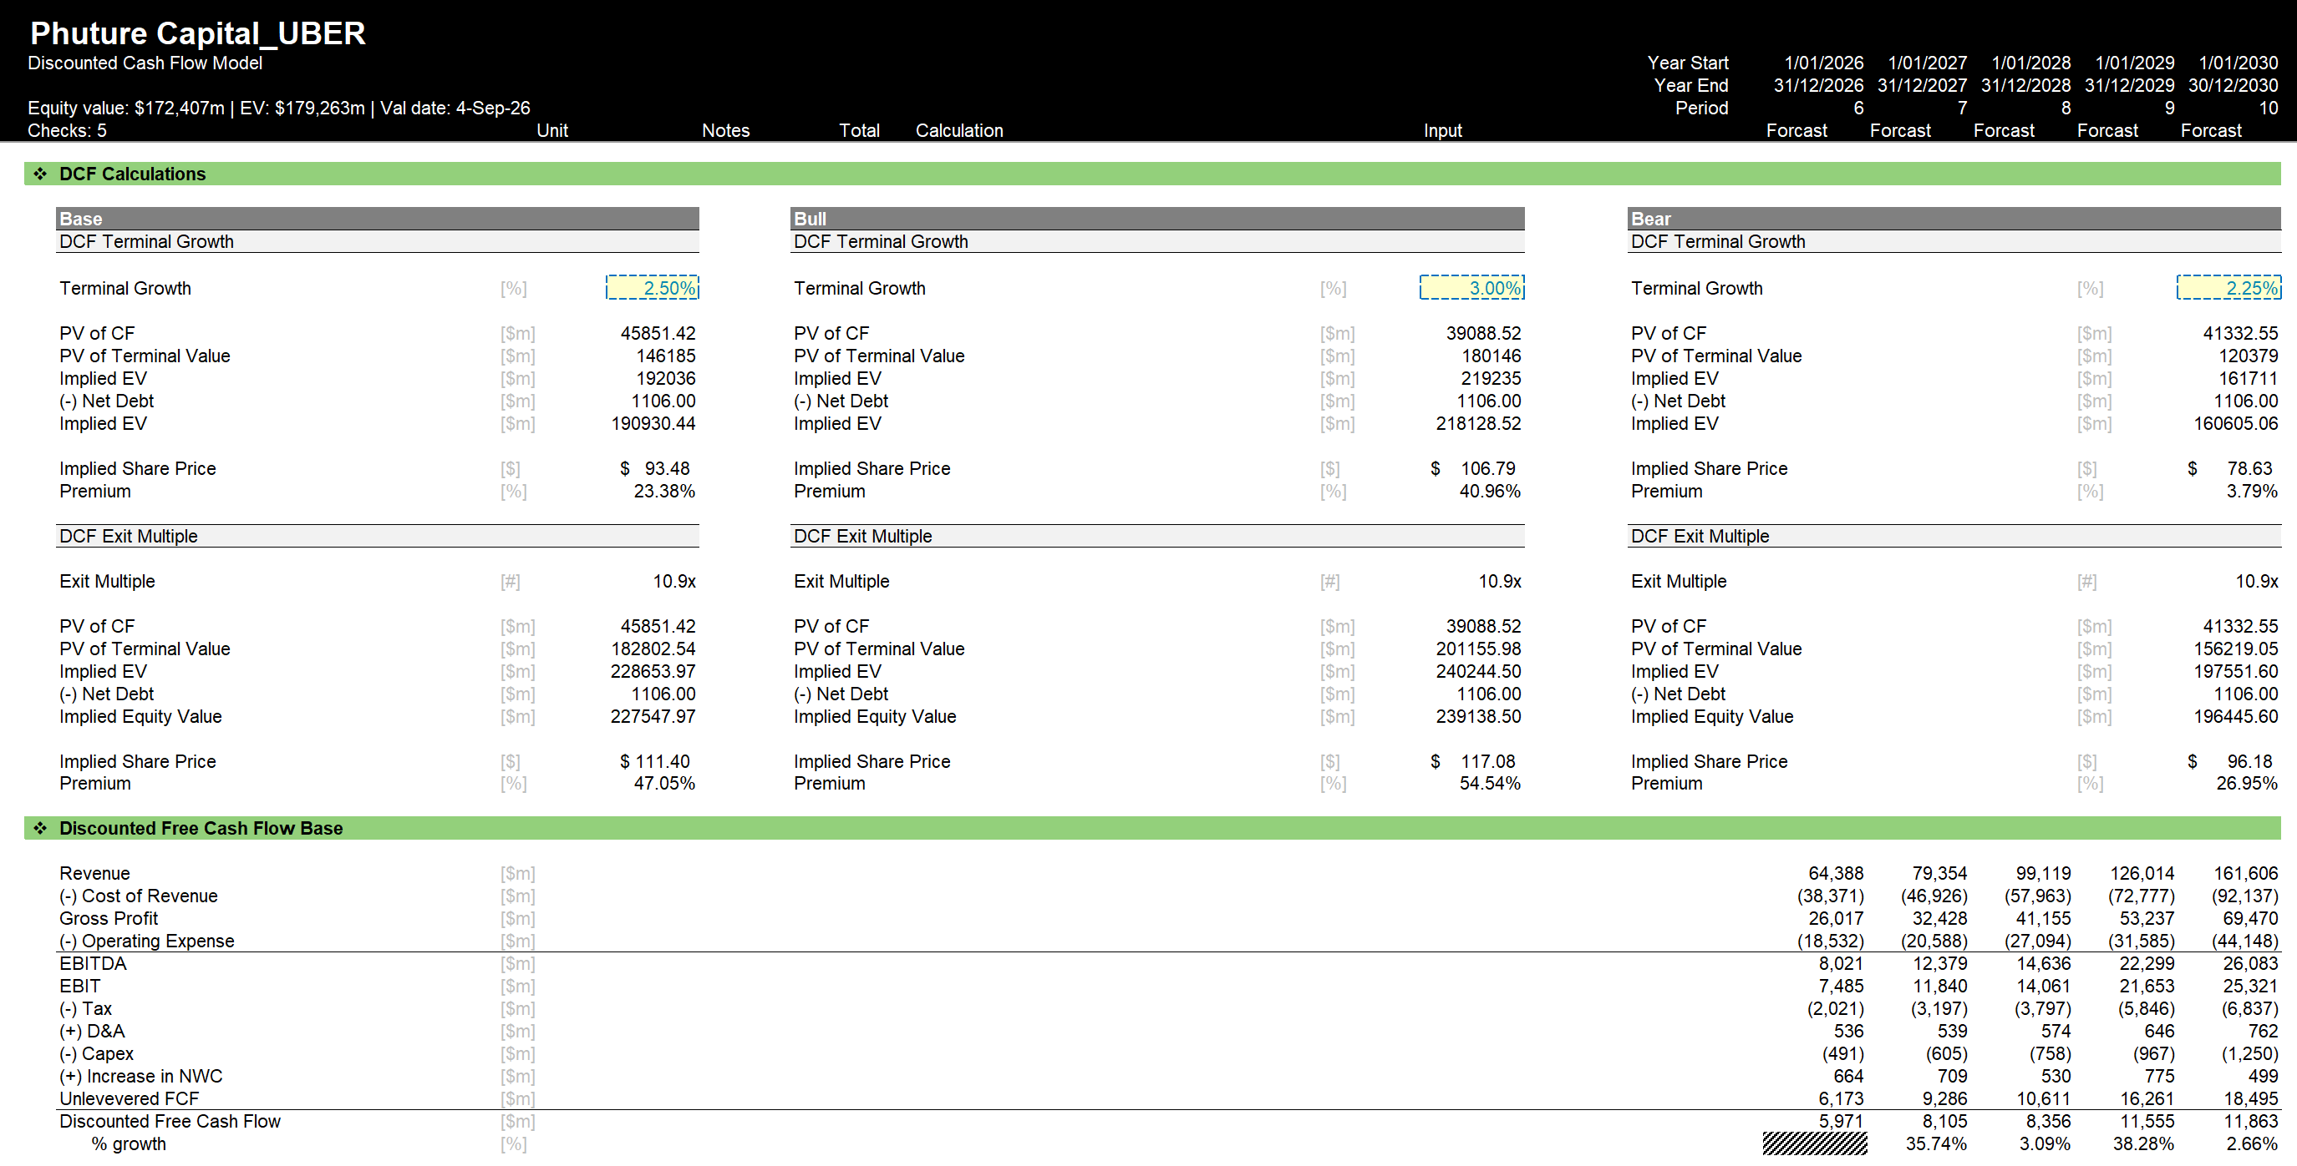
DCF Calculations

Slide 33
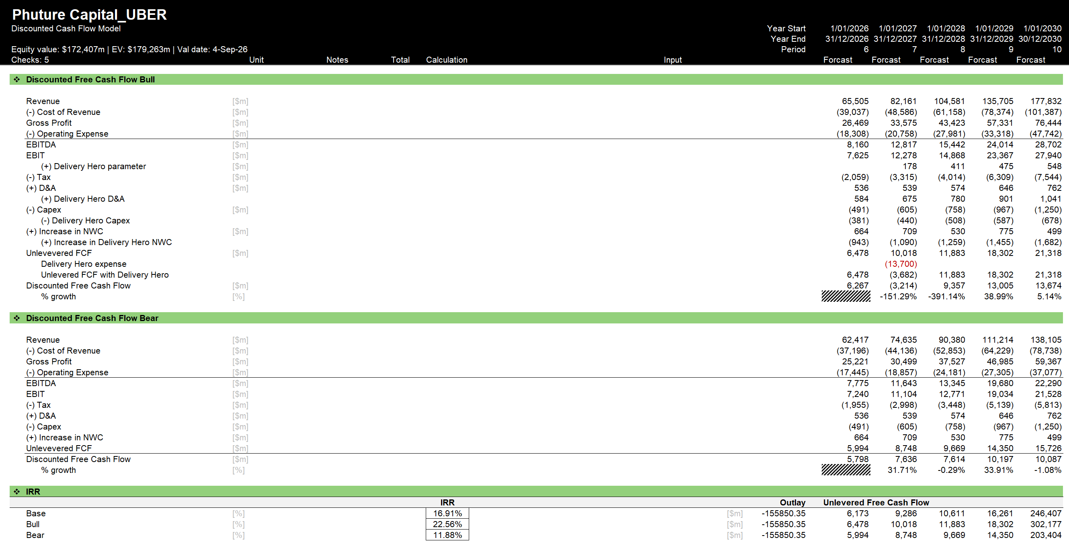
DCF Free Cash Flow

Slide 34
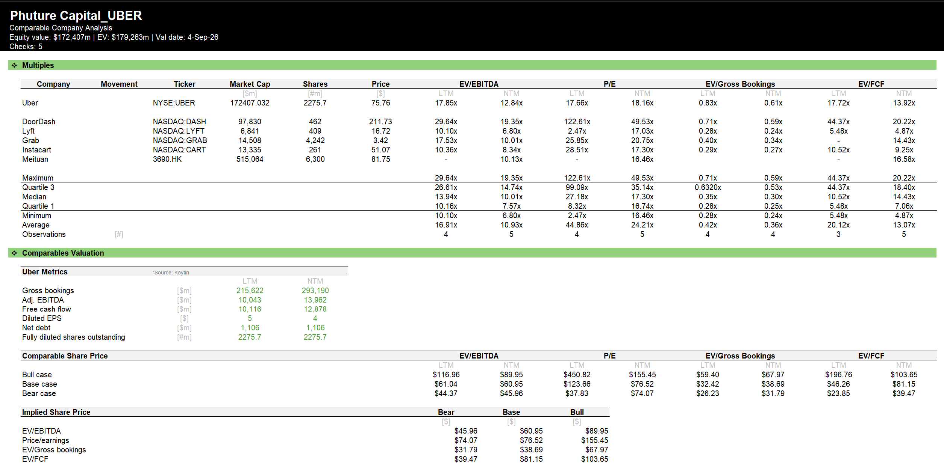
Company Comparable Analysis

Slide 35
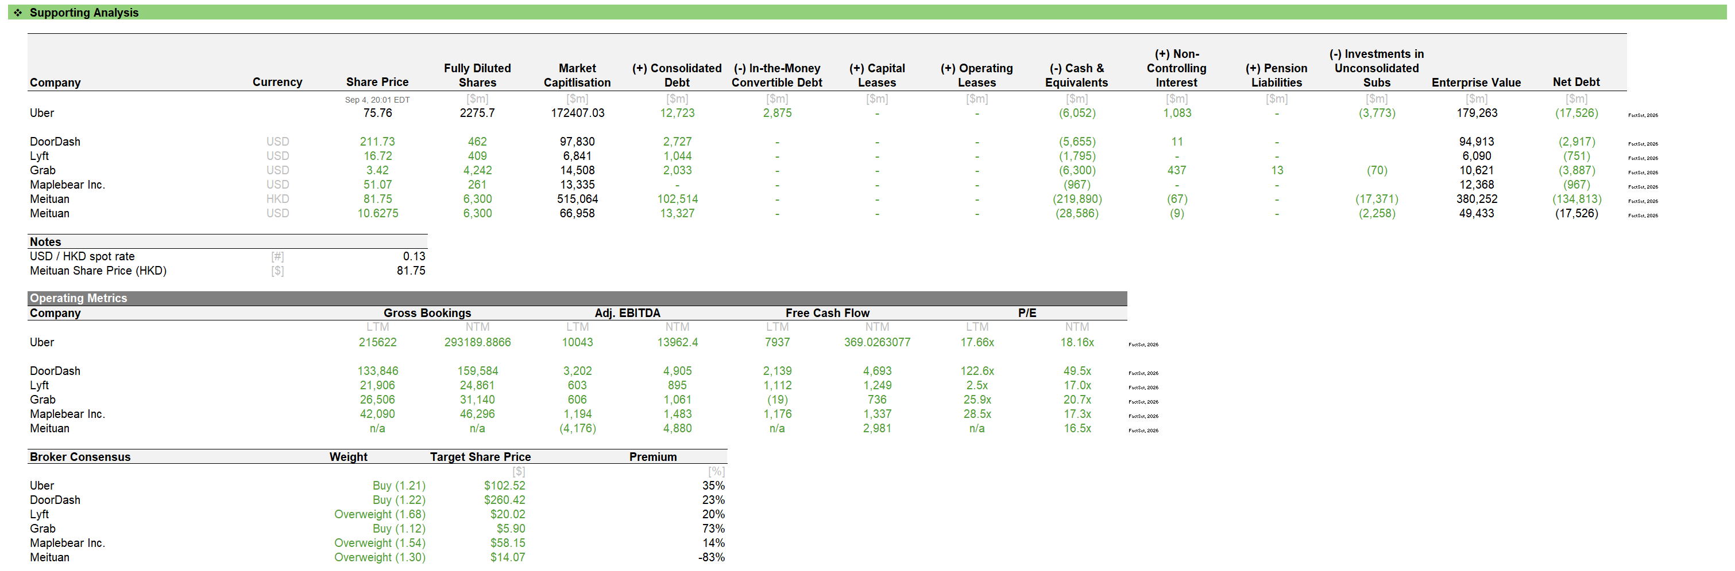
Company Comparable Analysis

Slide 36
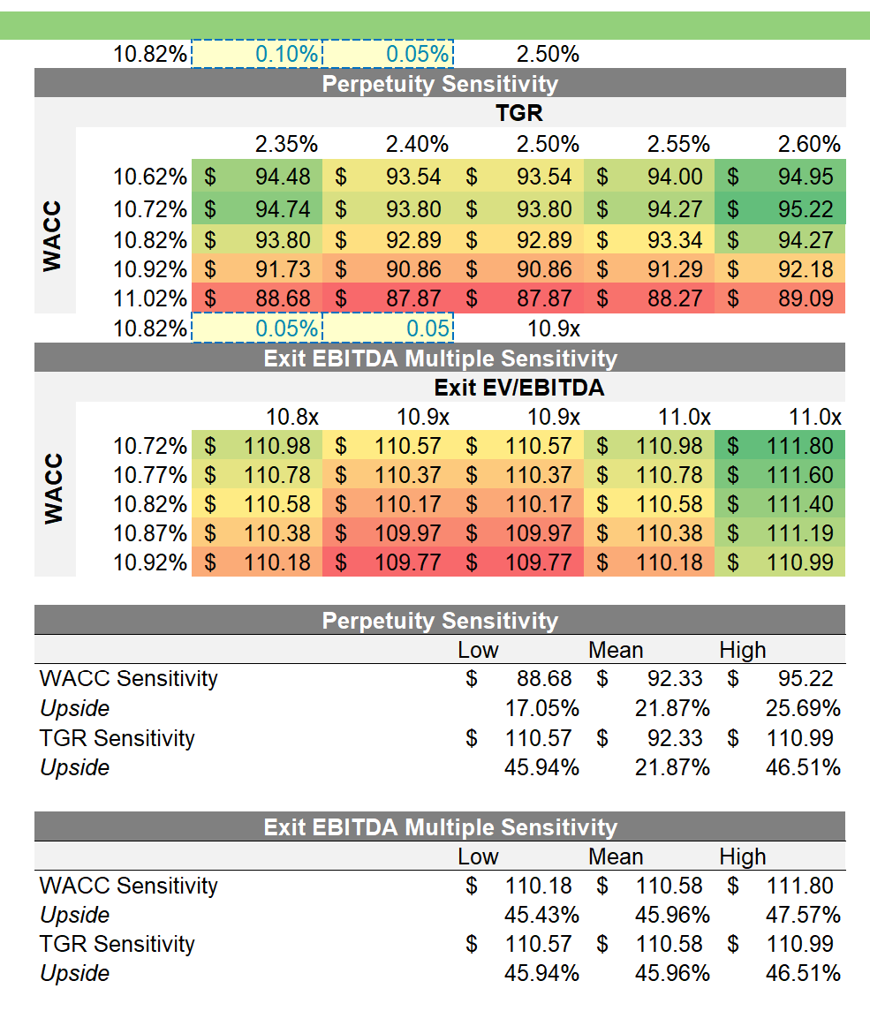
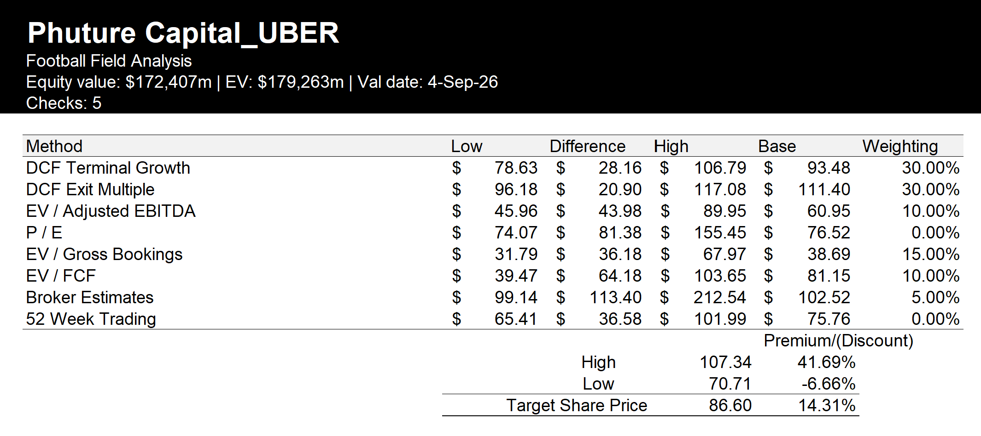
Football Field and Sensitivity

Slide 37
Delivery Hero as a Catalyst: What would drive a recommendation to BUY?
1
Merger clearance preserves the 34 → 58 perimeter
Uber One is proven to travel into acquired markets
2
Thesis 2 is priced on cross-platform overlap where Uber has already agreed to sell 14 markets to SSW Partners; what matters is whether anything further is taken out. A clean Phase I decision confirms that the 58-market perimeter → Cross-sell to have full effect.
Uber One works in Uber's markets, and Delivery Hero already has paying subscribers. Cannot confirm that the two will cross-sell or Uber One can capture Delivery Hero's existing customers on Delivery Hero's own brands.
Phase I
58
~3x
43%
clearance with no further divestiture
cross-platform markets preserved
gross bookings per cross-platform user
of Delivery Hero GMV from subscribers
BUY IF:
BUY IF:
The European Commission clears in Phase I with no remedies beyond the agreed 14 SSW markets, and no behavioural restriction on cross-app conversion or data sharing.
Uber discloses how many of Delivery Hero's existing customers it has converted onto Uber One inside a foodpanda or PedidosYa market, and those members spend like Uber's own cross-platform users, at roughly 3x.
Control and synergies land inside the holding period
The financing does not crowd out shareholder returns
3
4
Deal timeline against our four-year holding period
Uber is paying cash, funded from the balance sheet and a €14 billion bridge, coming out of the buyback. Which has been cut by roughly three-quarters to 5.0% of trailing free cash flow in Q2'26. Until repurchases resume, shareholders are funding the acquisition out of their own return.
H2 2027 expected close
2030 DPLTA earliest: full control of cash flows
Offer pending – no consolidation
Consolidated; brands run separately
2029 platform migration; synergy run-rate builds
16-20%
<2x
Our four-year holding period
pre-deal buybacks as % of TTM FCF
gross leverage commitment
BUY IF:
BUY IF:
The DPLTA is entered at the earliest permitted date and the 2029 migrations are delivered, so synergies are earned inside the four-year hold rather than assumed after it.
Buybacks recover toward 16-20% of TTM free cash flow by Q4 2026, with gross leverage below 2x, the investment grade rating affirmed, and management reaffirming EPS accretion at close.

Slide 38
What would drive a recommendation to NOT BUY?
1
Regulatory remedies shrink what Uber is acquiring from Delivery Hero
Cash cost of Delivery Hero deal crowds out shareholder returns
2
The strategic rationale for the deal hinges on expanding Uber One’s footprint from 34 to 58 cross-platform markets. However, this perimeter remains uncertain until merger review is complete, with 14 already being divested.
Quarterly buybacks
TTM Free Cash Flow
Buybacks / TTM FCF
$ bn
%
DO NOT BUY IF:
19.5%
9.8
1
The European Commission opens an in-depth Phase II review
A signal of serious concern that more divestitures could follow.
16.4%
16.2%
0.5
5.0%
2
Any approved remedy requires divestiture in the core 34 → 58 cross-platform markets
Beyond the 14 markets already agreed for sale to SSW Partners.
Q1’25
Q2’25
Q3’25
Q4’25
Q1’26
Q2’26
DO NOT BUY IF:
Buybacks have not recovered toward the pre-deal 16-20% of TTM FCF range by Q4 2026
If Uber has sustained weakness in buybacks, we view this as evidence that the acquisition and its debt financing are materially crowding out shareholder returns.
3
The deal terminates
Uber must pay Delivery Hero a €700m reverse termination fee.
Underlying customer or usage growth weakens
AVs or competitors marginalise Uber’s platform
3
4
Frequency growth
MAPC growth
Reported Trips growth
We assume that AVs will change how trips are supplied, not how demand is aggregated, i.e. Uber still retains majority control of customers. However, in practice, first-party AV operators like Waymo are already scaling their own consumer apps:
YoY percentage points
DO NOT BUY IF: Volume growth continues to deteriorate
2 consecutive quarters of …
Frequency growth ≤ 0%
MAPC growth <12%
Trips growth < MAPC growth
… would signal that Uber is extracting more from existing users rather than sustainably growing usage.
>500k
14
7
2%
paid Waymo rides per
week (50k in May 2024)
US cities with paid Waymo service
vs
active Uber AV cities (targeting 15 by year-end)
DO NOT BUY IF:
First-party AV apps gain a material share of rides in major US cities, making Uber a secondary rather than primary marketplace.
First party operators still significantly outpace Uber in city count throughout 2027
Uber’s utilisation advantage (~30% more trips per vehicle daily and ~25% lower ETAs than AV deployments; Q4 AV Spotlight) narrows or reverses
Q3 ’24
Q4 ’24
Q1’25
Q2’25
Q3’25
Q4’25
Q1’26
Q2’26

Slide 39
Macroeconomic Exposures
FX Currency Translation
Consumer Demand and Labour Supply
FX movements can materially distort underlying growth – its impact is reported by Uber.
Uber is a two-sided marketplace …
Gross Bookings Growth (% YoY)
FX contribution
Constant-currency GB growth
Riders
Uber
Drivers
23%
25%
24%
In Q2 2026, US & Canada made up 53.6% of revenue, so ~46% of revenue is exposed to currency translation.
FX has previously provided tailwinds, but is expected to become a ~1pp headwind by Q3’26 (Q2 26 Prepared Remarks).
Uber’s underlying growth is therefore best assessed on a constant-currency basis.
(demand)
(supply)
1%
~17-21%
… creating a natural hedge, where weaker demand
can be partially offset by greater driver supply
~18-22%
→ Consumers become more price sensitive
→ Riders shift down the barbell (lower-cost)
→ Gross Bookings growth decelerates
Net margin impact cushioned
Weaker Gross Bookings growth partially absorbed by reduced driver incentive spend
Macro Downturn
Weaker consumer confidence & household spending power
-1%
→ Fewer alternative jobs available
→ Driver supply loosens – more liquid market
→ Costs to maintain liquidity fall
Q4’25A
Q1’26A
Q2’26A
Q3’26E
Cost Inflation and Insurance
Interest Rates and Financing
1. Macro cost pressures
  Interest rates ↑
Vehicle repair costs
Medical costs
Wage costs
Insurance premiums
These pressures ultimately flow into Uber's cost base
2. US auto insurance is Uber’s key cost exposure
  Financing Effect
  Valuation Effect
In the past, rising insurance costs created a margin headwind and increased pricing pressure.
Currently, the insurance market is improving. Better renewal rates and greater risk transfer to third-party insurers are reducing Uber’s insurance costs.
Debt more expensive
Interest expense ↑
FCF ↓
Higher WACC
DCF value ↓
Expected IRR ↓
3. Implications for Uber
Rates are a critical macro sensitivity: increasing the borrowing costs for financing Uber’s acquisition, whilst also reducing the value of future cash flows.
→ Higher rates place a downward pressure on Free Cash Flow and our IRR hurdle
Margin Benefit
Lower insurance costs directly reduce Uber’s cost base, supporting higher Mobility margins.
Demand Benefit
Lower insurance costs can reduce pricing pressure, allowing Uber to offer lower prices and gain more trips.
Notes:
Interest rates ↑ → cost of borrowing ↑ → interest payments ↑ → FCF ↓ → less cash available for shareholders
Interest rates ↑ → required return/WACC ↑ → future FCF worth less today → DCF value/share ↓ → IRR ↓

Slide 40
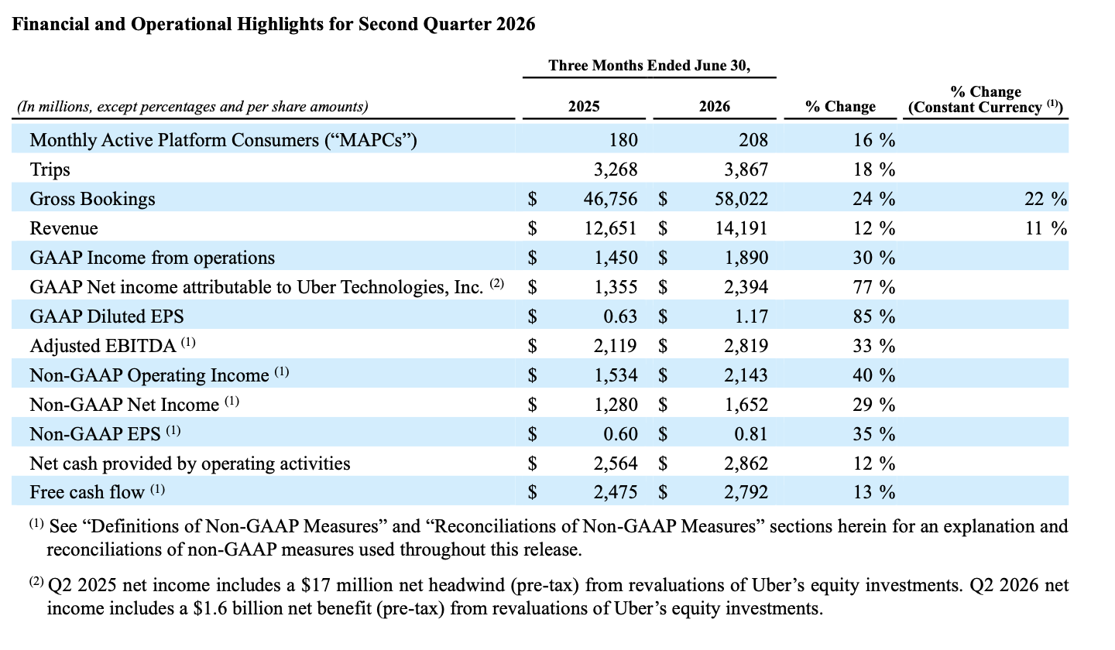
Financial and Operational Highlights for Second Quarter 2026

Slide 41
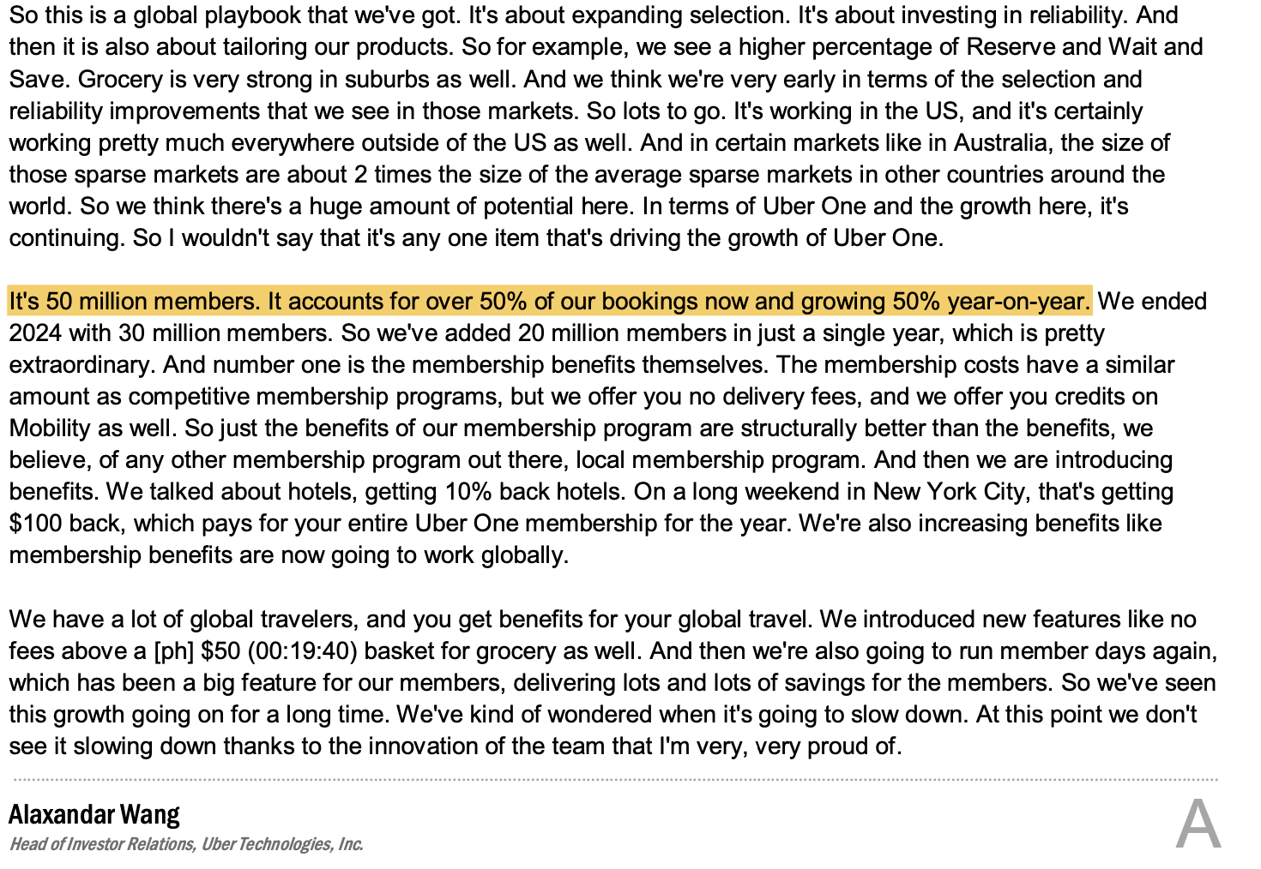
Q1 2026 Earnings Call Transcript

Slide 42
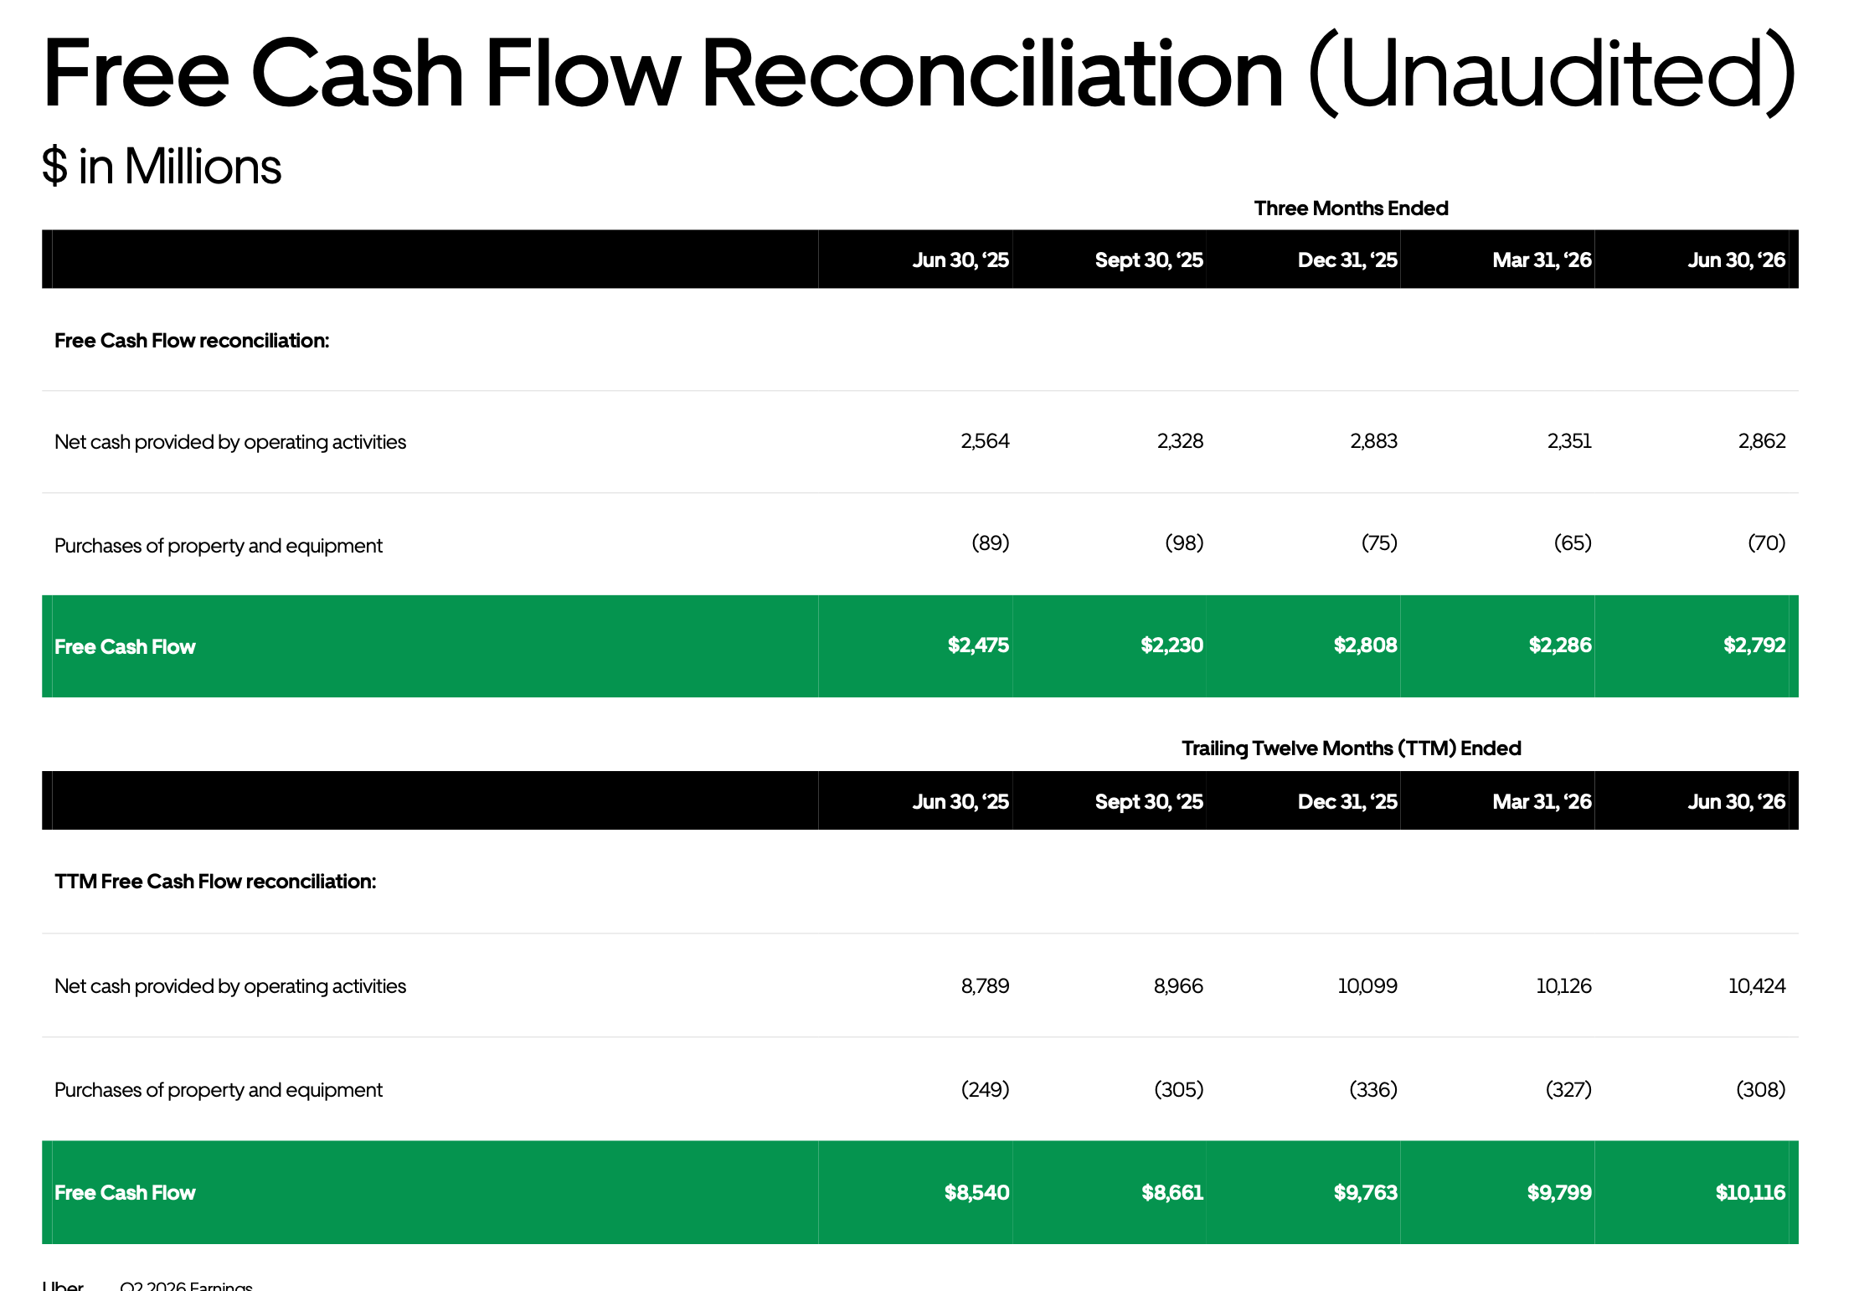
Free Cash Flow (Q2 26 Earnings Supplemental Data)

Slide 43
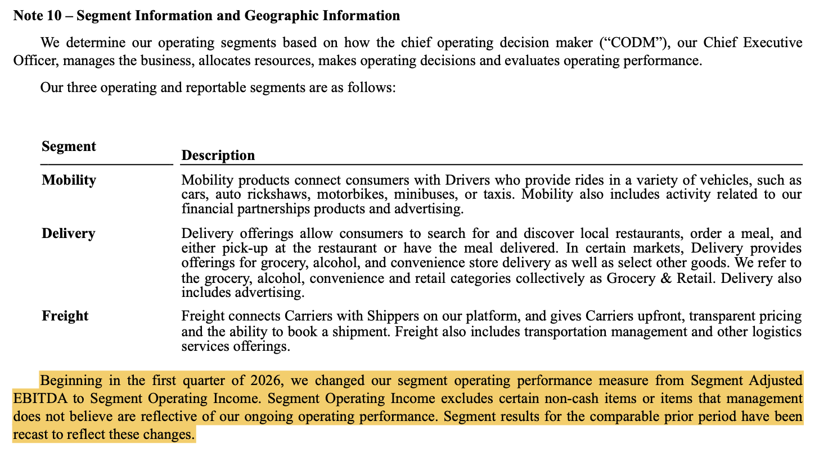
Segment Operating Performance Measure Change, Effective Q1 2026
Segment Operating Income is a narrower set of add-backs than the old Adjusted EBITDA was – it now absorbs stock-based compensation, most D&A, legal/regulatory settlements, impairments, and restructuring charges that used to be excluded.

Slide 44
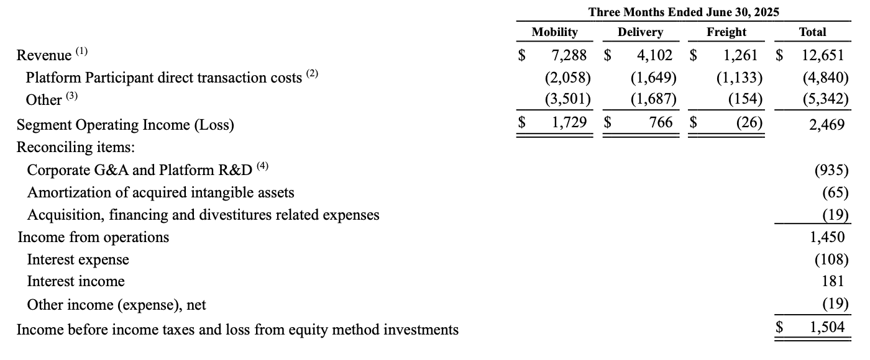
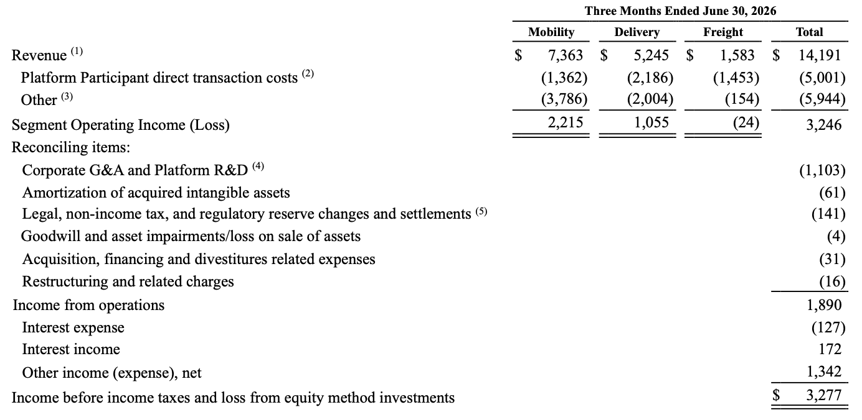
Segment Operating Performance Measure Change – Reconciliation Tables
Segment Operating Income is a narrower set of add-backs than the old Adjusted EBITDA was – it now absorbs stock-based compensation, most D&A, legal/regulatory settlements, impairments, and restructuring charges that used to be excluded.

Slide 45
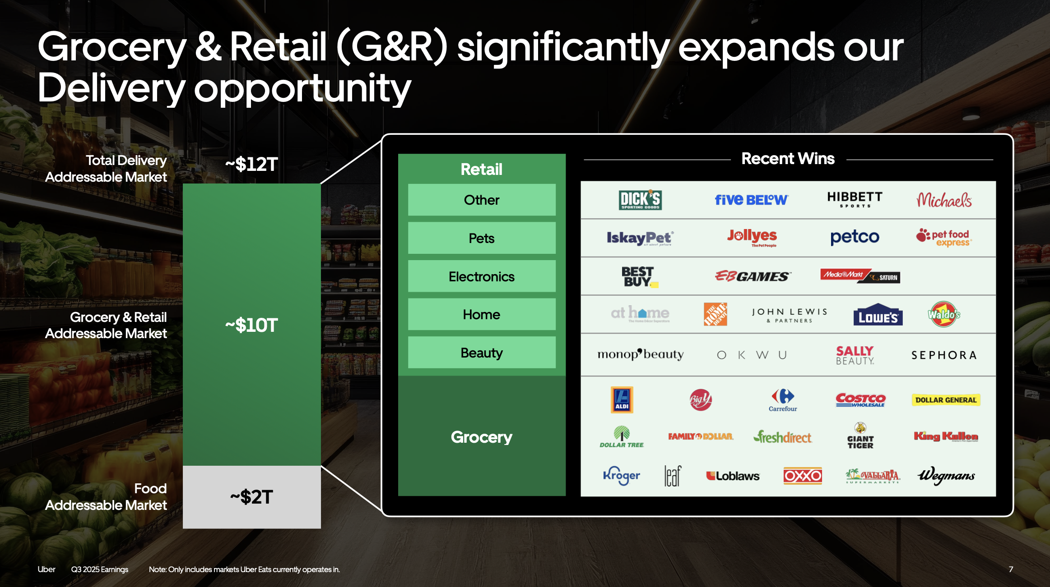
Expanding TAM (Q3 2025 Earnings Supplemental Data)

Slide 46
UK Mobility Reclassification
The market misreads Uber as a decelerating, take-rate-constrained aggregator
… under a temporary reporting distortion masking strong underlying growth
(%)
Q2 2026 reported revenue growth
Revenue margin
(Mobility segment)
UK reporting adjustment
+8 ppt
Revenue growth
Underlying revenue-growth proxy
Q2 2025
Q3 2025
Q4 2025
Q1 2026
Q2 2026
From January 2026, Uber shifted UK Mobility reporting to record only commission revenue following regulatory changes.
This reduced Q2 2026 reported revenue by ~US$1.1bn, with Mobility's revenue margin down ~500bps YoY.
Gross bookings and underlying profitability per trip are unaffected, with this distortion annualising from Q1 2027.
Of that 500 basis points, about 400 basis points is entirely related to this UK business model change, and it’s an optical impact … the net take rate disclosed in our 10-Q will largely show take rate remaining broadly stable.
Balaji Krishnamurthy (CFO), Q2 2026 earnings call

Slide 47
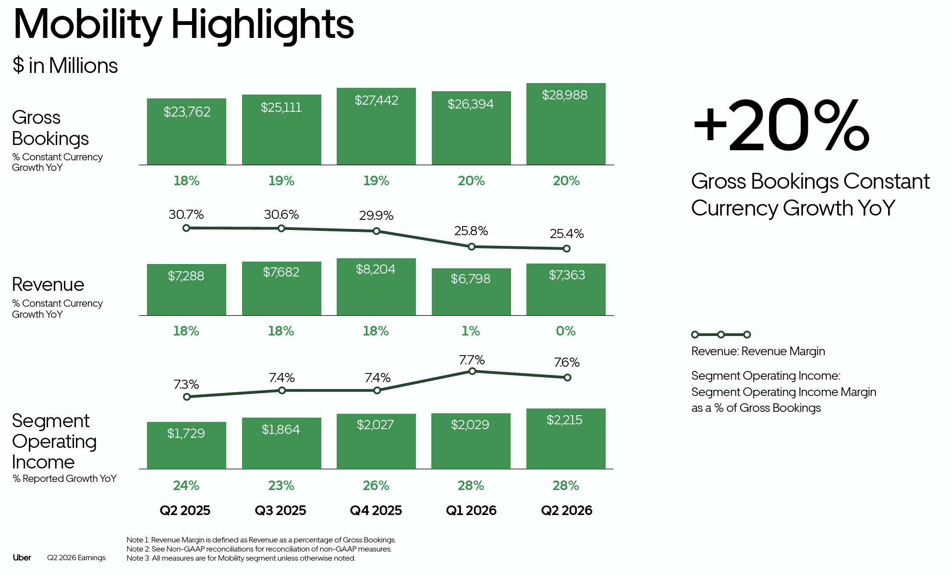
Uber Gross Bookings by Segment (Form 10-Q, Q2 2026)

Slide 48
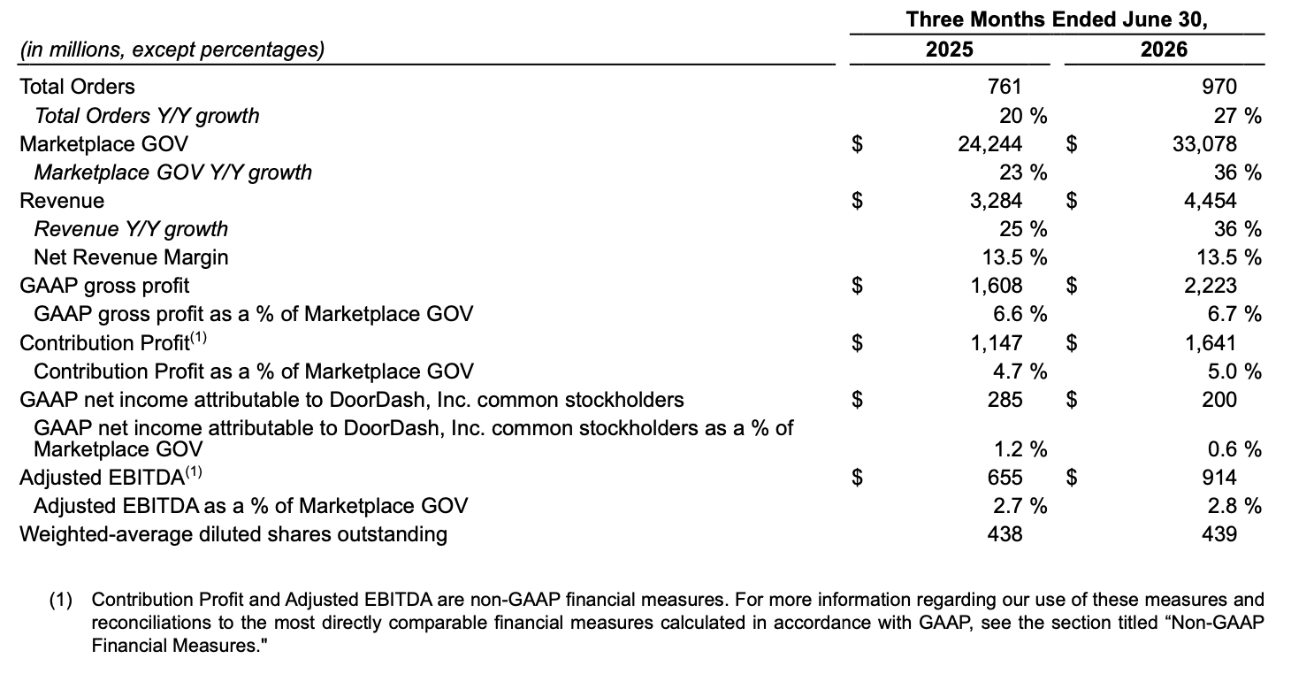
DoorDash Marketplace GOV and Adjusted EBITDA (Form 10-Q, Q2 2026)

Slide 49
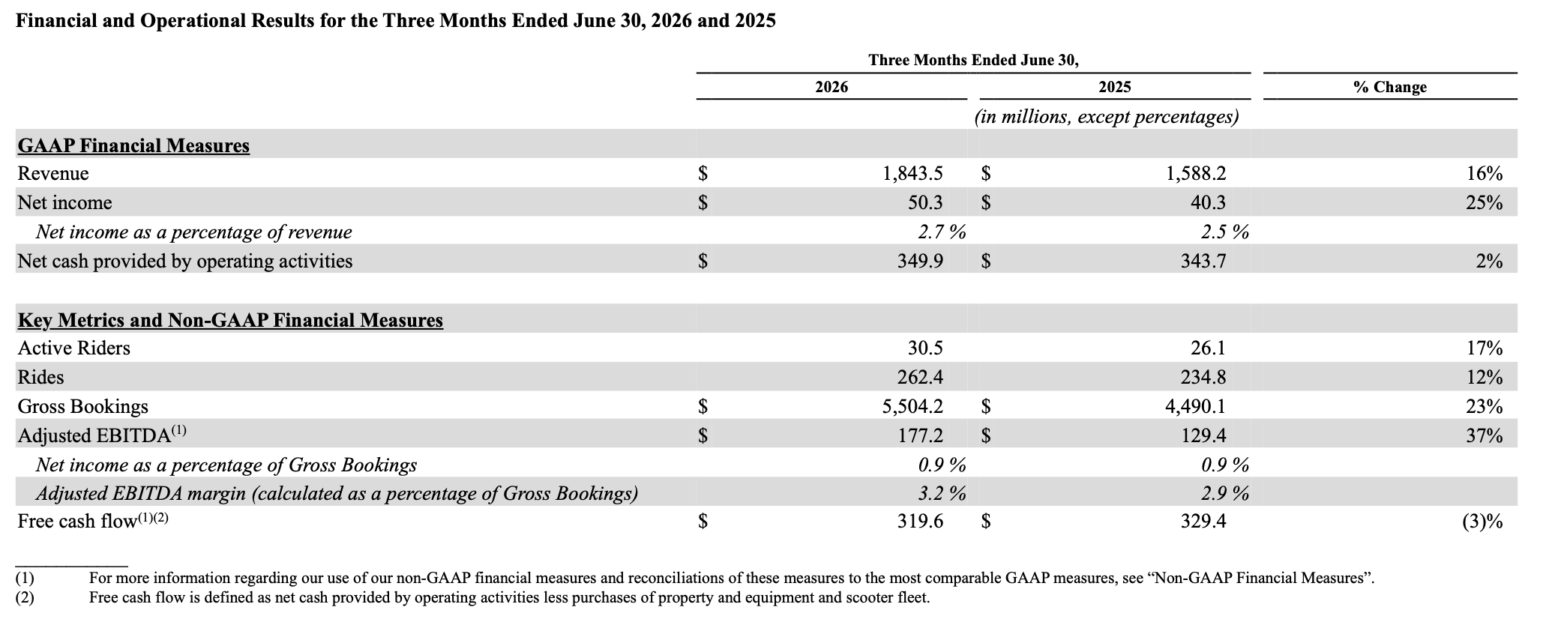
Lyft Gross Bookings and Adjusted EBITDA (Form 10-Q, Q2 2026)

Slide 50
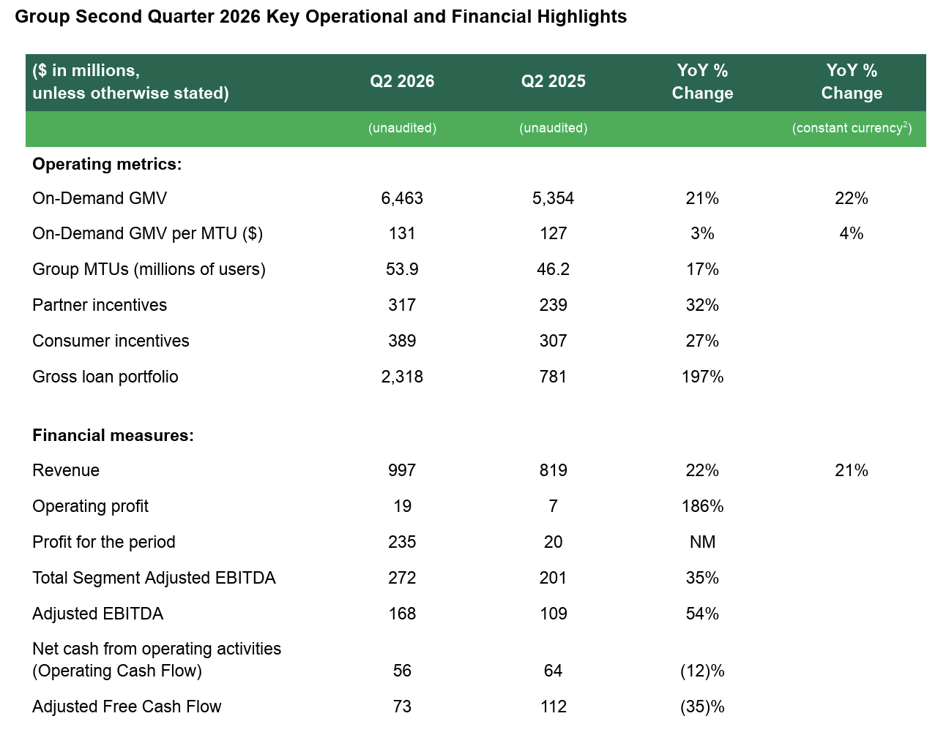
Grab Gross Merchandise Value and Adjusted EBITDA (Form 20-F / Earnings Release, Q2 2026)

Slide 51
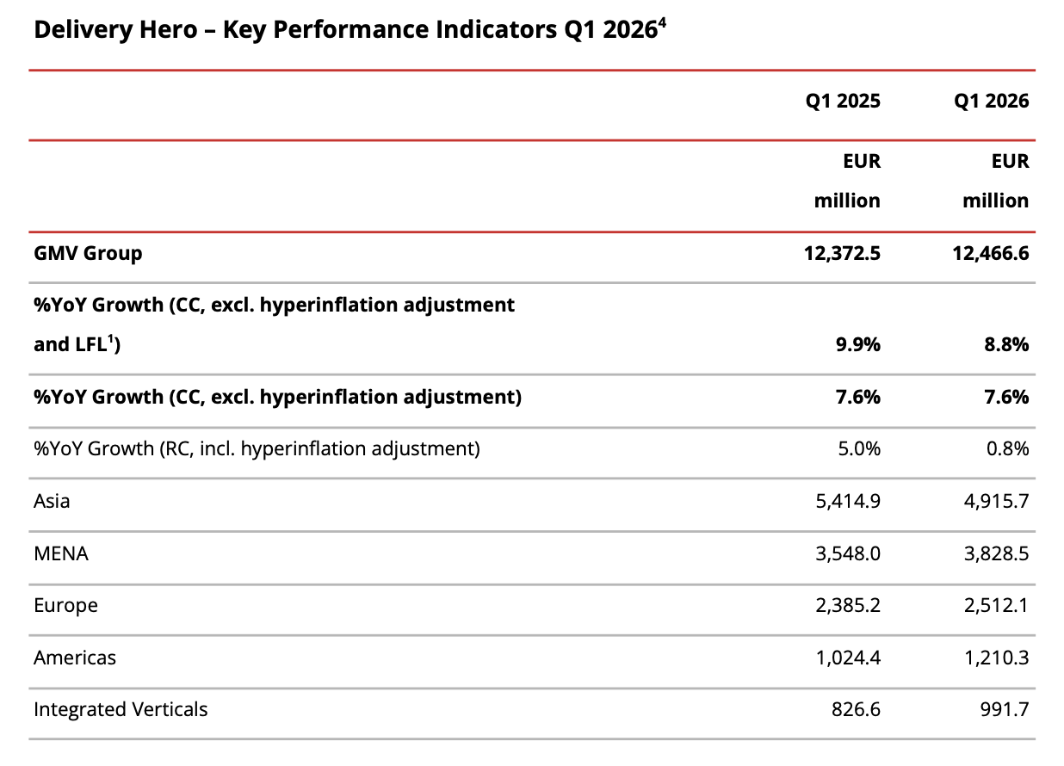
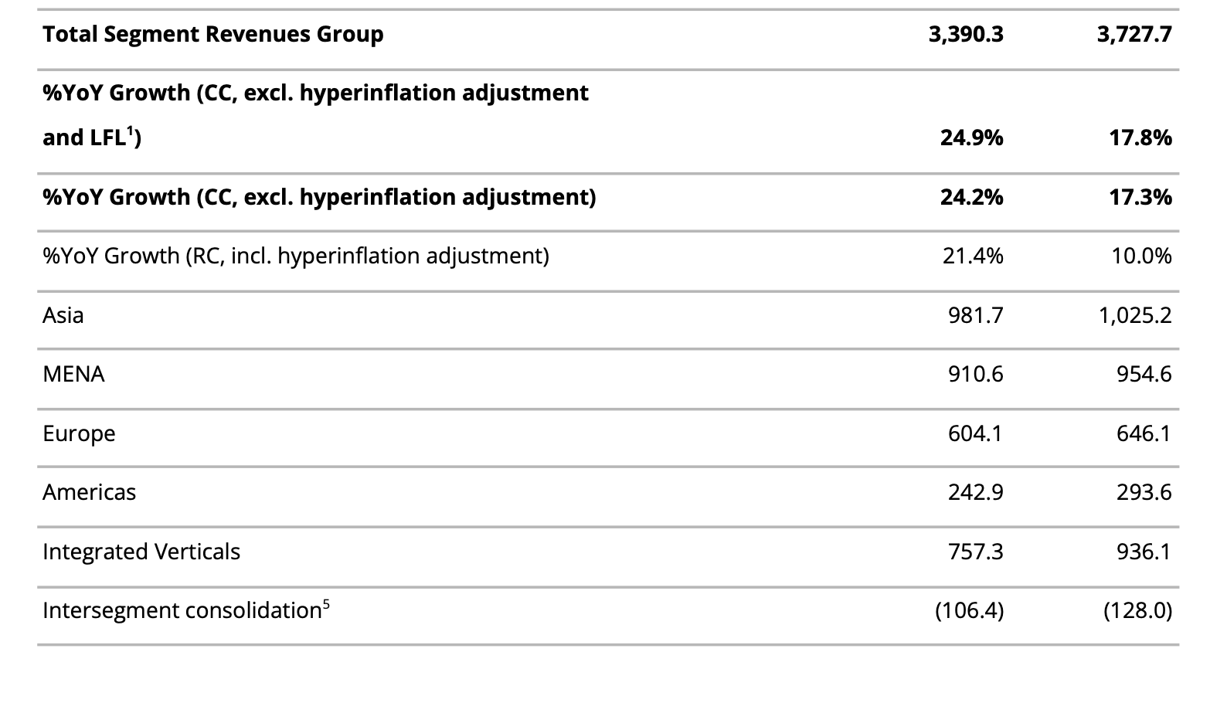
Delivery Hero Group GMV (Quarterly Statement, Q1 2026)

Slide 52
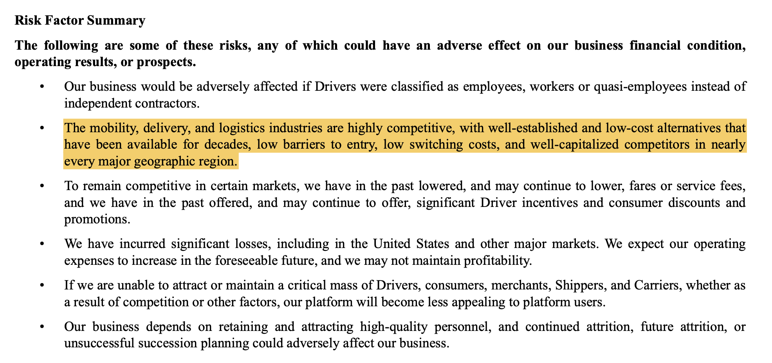
Local Competitive Intensity – Risk Factor Summary

Slide 53
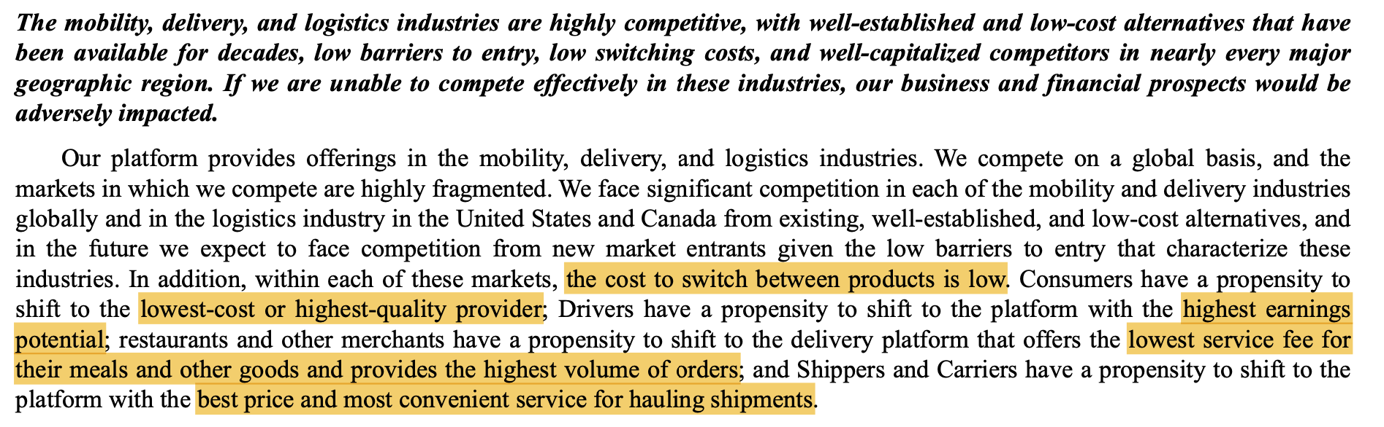
Local Competitive Intensity – Risk Factor Summary (cont.)

Slide 54
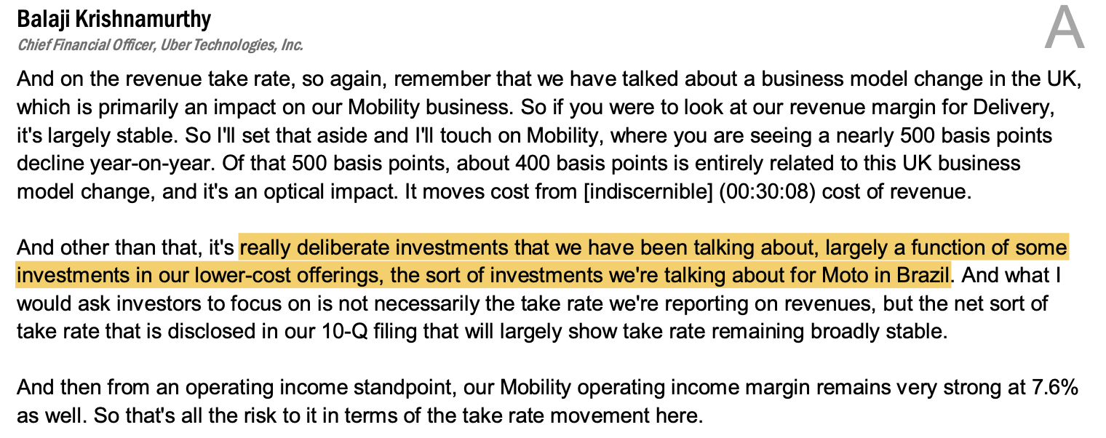
Uber Pricing and Incentive Strategy

Slide 55

Uber Barbell Portfolio (Q1 26 Earnings Supplemental Data)

Slide 56

Barbell Strategy: Trip Frequency and Profit-per-User by Price Tier (Q1 26 Earnings Call Transcript)

Slide 57

Delivery Gross Bookings – Base Figure for Ad Revenue Sensitivity (Q2 2026 Supplemental Data)

Slide 58

Advertising Run-Rate – Context for Sensitivity Range (Q2 2026 Prepared Remarks)

Slide 59

Delivery Gross Bookings and Adjusted EBITDA (Q4 2025 Supplemental Data)

Slide 60

Grocery & Retail Annualised Run-Rate (Q2 2026 Prepared Remarks)

Slide 61

Case Study: Delivery Hero / Woowa Brothers (Korea, 2019-21)
In December 2019, Delivery Hero acquired Woowa Brothers, owner of Baemin, Korea’s leading food-delivery platform, for $4.0 billion. The deal combined Delivery Hero’s logistics technology with Baemin’s local brand, merchant base, and delivery density.
Outcome
Korea’s competition regulator found the combined business would control around 97% of food-delivery transactions. It required Delivery Hero to divest its entire Yogiyo business.
Pending the sale, Delivery Hero could not raise restaurant commissions, reduce promotions, shift users between apps, poach riders, or share data.
Yogiyo was sold 22 months later for KRW 800 billion – well below the reported ~$1.8 billion expectation – and Delivery Hero recognised up to €1.4 billion in impairment.
Relevance to Uber
Uber has pre-emptively agreed to sell overlapping Delivery Hero operations in 14 markets to SSW Partners. However, the key risk is now behavioural remedies – particularly restrictions on cross-app conversion or data sharing.
Those restrictions would directly weaken Uber One cross-sell, which underpins much of the deal’s strategic value.
Uber also cannot fully control Delivery Hero’s cash flows immediately: it has committed not to enter a DPLTA for three years, delaying meaningful control until at least 2030.
Valuation Implication
We value Uber as if the deal does not close, with closing expected in H2 2027, with platform migration in 2029, placing the >$1.2 billion synergy run-rate beyond a four-year holding period.
Source: Woowa Brothers Annual Report, 1 Dec 2021

Slide 62

Case Study: Just Eat Takeaway / Grubhub (2020-25)
Just Eat Takeaway acquired Grubhub in an all-stock deal to build a global delivery platform. With no geographic overlap, the deal cleared without remedies.
The asset was later sold to Wonder Group for $650 million. Prosus then acquired all of Just Eat Takeaway for €4.1 billion – less than JET had paid for Grubhub alone.
Why It Failed
Grubhub had national reach but lacked local density in its most important markets. By April 2026, US delivery share was approximately DoorDash 56%, Uber Eats 23%, and Grubhub 16%.
More importantly, JET had no adjacent platform to cross-sell, no mobility business to share customer acquisition costs, and no ecosystem mechanism to retain consumers beyond food delivery.
The lack of regulatory remedies reflected the lack of overlap – and therefore the lack of meaningful synergies.
Relevance to Uber
The lesson is that delivery scale alone is not a moat. The relevant metric is not total markets; but overlapping markets where Uber can cross-sell Uber One, share demand, and deepen customer engagement. That is why the increase from 34-58 cross-platform markets matters more than the increase from 79-99 total markets.
Delivery Hero’s subscriber base provides some support: subscribers already generate 43% of Group GMV. However, Uber has not disclosed attach rates, migration targets, or market-by-market rollout plans, so cross-sell value cannot yet be underwritten.
Valuation Implication
We treat Delivery Hero as upside optionality, not base-case value. Grubhub shows that if expected synergies fail to materialise, the downside can be a near-total write-down rather than a modest miss.
We would become more constructive only after Uber discloses post-close, market-level cross-platform attach and retention rates for acquired Delivery Hero customers.
Source: GrubHub Report, 1 Dec 2020

Slide 63
Case Study: Uber / Postmates (US, 2020-22)
In July 2020 Uber agreed to acquire Postmates for $2.65 billion in an all-stock transaction, completing on 1 December 2020. Uber acquired an overlapping US delivery network – merchants, couriers and consumers – in a market where it already competed.
Outcome
Uber did not merge the brands. At close it stated the consumer-facing Postmates and Uber Eats apps would “continue to run separately, supported by a more efficient, combined merchant and delivery network.”
Delivery segment Adjusted EBITDA moved from –$145 million in Q4 2020 to +$25 million in Q4 2021 – the segment’s first profitable quarter – with margin on Gross Bookings improving from (1.4)% to 0.2%.
That turn was delivered within twelve months of close, while Delivery Gross Bookings continued to grow year-over-year.
Relevance to Uber
This is the only precedent in which the current management team – same CEO, same COO – integrated a delivery acquisition, and it used the same structure now proposed for Delivery Hero: separate consumer brands, one shared merchant and fulfilment network.
It is not a full analogue: single-country, no membership migration, no behavioural remedies, and a fraction of the size – $2.65 billion against $13.7 billion.
What transfers is execution on the operating layer, not the cross-sell thesis – which Postmates never tested.
Valuation Implication
We do not capitalise integration skill, Postmates supports the assumption that Uber can absorb Delivery Hero without margin leakage through the remedy period, what our base case requires – but it does not underwrite the >$1.2 billion synergy run-rate, which sits beyond our four-year horizon.
Source: Uber Q4 2021 earnings release (SEC); Uber press releases 6 Jul 2020, 1 Dec 2020

Slide 64

Case Study: DoorDash / Wolt (2022-present)
DoorDash acquired Helsinki-based Wolt in an all-stock transaction announced in November 2021, reported at approximately $8.1 billion, completing on 1 June 2022. DoorDash went from 4 countries to 27 – 23 of which operate under the Wolt product and brand, not DoorDash’s.
Outcome
A listed US marketplace acquiring an international platform, keeping the acquired brand, and running two paid membership tiers side by side: DashPass in DoorDash markets, Wolt+ in Wolt markets – still separately branded, and still being launched into new countries four years after close.
DoorDash has extended the template rather than retreated from it, completing the acquisition of Deliveroo on 2 October 2025 and again retaining the acquired brand across its nine markets.
That is the structure the Delivery Hero deal implies: local brands retained, with Uber One as the layer intended to span them.
Relevance to Uber
Wolt proves the structure is operable – not that the membership travels. Four years after close, DoorDash has published no cross-brand attach or retention data, and DashPass and Wolt+ remain separate products. There is no completed public precedent for one membership spanning two brands across dozens of markets.
Delivery Hero’s subscriber base gives Uber a starting point – subscribers already generate 43% of Group GMV.
This is the same gap the Grubhub case identifies from the other side: overlap without a working cross-sell mechanism is scale, not a moat.
Valuation Implication
Consistent with our treatment of Delivery Hero as optionality, we underwrite none of the Uber One cross-sell. Wolt sets the disclosure bar: we move Delivery Hero from optionality into base case only on market-level evidence that a single membership converts across brands.
Source: DoorDash press releases 9 Nov 2021, 1 Jun 2022, 5 May 2025, 2 Oct 2025; Wolt; Delivery Hero

Slide 65

Case Study: Amazon Prime (2005-present)
Before Prime, Amazon paid for each order twice – once in price, again in a conditional shipping subsidy offered above a minimum basket and withdrawn when it became expensive. Customers optimised against it: padding baskets, consolidating orders, comparison-shopping every purchase. The spend bought transactions, not habit.
The Mechanism
Prime launched in February 2005 at $79 a year: unlimited two-day shipping, no minimum order.
Bezos: “no minimum purchase to think about, and no consolidating orders – two-day shipping becomes an everyday experience rather than an occasional indulgence.”
The conditional subsidy became a fixed fee paid in advance. Once it is sunk, the customer maximises usage – the behaviour Amazon was trying to buy.
Amazon then raised the fee four times, $79 (2005) to $139 (2022), up 76%, while disclosed members doubled from 100 million (2018) to over 200 million (2021). Subscription services: $49.6 billion in FY2025.
Relevance to Uber
Uber One is the same instrument on a marketplace. The leakage it closes is multi-homing: every trip and order is otherwise a fresh auction against Lyft, DoorDash or a local incumbent, won with a promotion. A prepaid fee makes Uber the default across both categories.
Uber’s disclosure already shows it: 50 million members at Q1 2026, roughly one in four of 199 million monthly consumers, “now driving half of our Gross Bookings across Mobility and Delivery.”
The demand side of Thesis 1: profit per trip rises because the customer is retained, not because the fare rises.
Valuation Implication
Prime shows the instrument holds price and holds customers for two decades. It does not show Uber One will – Amazon has published no member count since 2021, and Uber discloses membership and Gross Bookings share, but not churn or member-level margin.
Source: Amazon press releases (Feb 2005; Q4 2025 results); Amazon 2020 Letter to Shareholders; CNBC (Feb 2022); Uber Q1 and Q2 2026 results

Slide 66
Delivery Hero Acquisition Financing
1 · What the offer actually is
2 · Where the cash goes
3 · What it does to the IRR
$bn · net debt / (net cash)
+1.1
−51.9
−38.7
Four-year IRR at a 10.9x exit multiple
All cash at €41.50 per share
16.91% Base Case
Zero dilution with no equity issued
16.8%, under an irrevocable to tender
+13.7
−1.6
+ acquired EBITDA $2.5bn and $1.2bn synergies
18m to synergy run-rate; close H2 2027
Net debt
today
Cumulative
FCF
Delivery Hero
cash
SSW
proceeds
Net cash
at exit
20% Bull Case
Funded from existing cash and ~€14bn committed,
Gross leverage stays below 2x and the investment-grade rating is retained
Uber still exits with roughly $38.7bn of net cash after paying for Delivery Hero → still liquid

Slide 67
Market Expansion through Delivery Hero
1 Contract Agreement
2 How Uber Stands After
3 · The acceptance condition
14 markets sold to SSW Partners
How this helps Uber
Committed acceptances vs the 50% + 1 minimum
Spain
Turkey
50% + 1
Poland
Portugal
EMEA → 27 Total Markets → #1 in 20
Greece
Austria
Czechia
Romania
Uber, direct
24.8%
Sweden
Norway
Uber, via derivatives
11.7%
Chile
Ecuador
LATAM → 13 Total Markets → #1 in 11
Prosus, irrevocable
16.8%
Cyprus
>
>
Moldova
APAC → 10 Total Markets → #1 in 7
Reduced Shareholder risk what remains is merger control in individual jurisdictions
$1.6bn consideration from SSW Partners + $11bn 2025 Gross Bookings Divested

Slide 68
EV / 2025 gross bookings costs + trades
Paid for Delivery Hero
0.33x
$13.7bn net / $42bn 2025 gross bookings
DoorDash
0.88x
two-sided delivery marketplace, category leader
Uber
0.85x
the multiple Uber's own book trades at
Grab
0.46x
mobility and delivery, emerging-market discount
Instacart
0.32x
single-vertical delivery, no mobility leg
0.00x
0.25x
0.50x
0.75x
1.00x
Uber paid in line with the lowest-rated single-vertical peer → for an asset it will run as part of a two-sided network, not as a standalone delivery business

Slide 69
Gross Bookings, 2025 Basis
+$42bn
$236bn
+22%
$193bn
added to Uber's 2025 gross bookings by the acquired markets alone
50m+
users become newly eligible for both products
Uber standalone
FY2025
+ Delivery Hero
acquired markets
Combined
pro forma
50
79 → ~100
34 → 58
3.0x
-50%
markets acquired, after 14 carve-outs
total market footprint
markets carrying both products
gross bookings per cross-platform user
incremental cost to acquire them

Slide 70


Our estimates are in line with consensus ratings
Source: Marketbeat

Slide 71


Our estimates are in line with consensus ratings
Source: Marketbeat

Slide 72
The AV industry is scaling fast and getting structurally cheaper - Waymo leads on volume, Uber leads on distribution
AV Industry Overview: Tier System, Market Structure & Cost Trajectory
SAE Autonomy Levels
Why Costs Are Falling
Why The Market Is Projected to Grow
L2
Driver-assist. Most new cars, incl. Tesla "FSD as marketed - driver must supervise.
Goldman Sachs Research, cost per mile (representative AV, US)
$0.50
$7bn → $400bn
US robotaxi revenue, 2030 est. → global market size by 2035
$0.35
$0.23
L4
No driver needed, but geofenced to specific cities/conditions. Waymo, Zoox operate here.
$0.15
L5
Depreciation
Insurance
35,000
US robotaxis on the road by 2030, up from -1,500 today
Drive anywhere, any condition. No commercial system exists yet.
2025
2040 (projected)
1 remote operator can manage:
3 cars today → 10 by 2030 → 35 by 2040
US Market Structure
<1% → 8%
Share of US rideshare market captured by Avs, today vs. 2030
Waymo: 500k paid weekly rides, 10 US cities, -3,000-vehicle fleet - the largest standalone operator by a wide margin
Uber doesn't build AVs - it aggregates: Waymo (Austin, Atlanta), Zoox (Las Vegas), Lucid/Nuro (35k vehicles), WeRide, Wayve, Pony.ai, Avride and more, reaching 183m MAUs across 70+ countries
Even at scale, still early: Waymo's weekly rides < what Uber/Lyft do in one day in NYC alone
Hardware is also getting cheaper: successive AV generations use fewer, more purpose-built sensors (e.g., materially fewer cameras gen-5-gen-6), pulling down average US AV unit cost - though still above China, which launched earlier under different market economics.
Structural tailwinds:
Falling hardware + insurance + remote-ops cost stack, compounding together
AV cost/mile converging toward personal car ownership (-$1/mile) vs. today's >$2/mile average rideshare
Population and urbanization growth expanding addressable rideshare demand independent of AV-specific factors
Leading operators targeting 15+ cities globally by YE26

Slide 73

AV rollout predictions
Source: McKinsey & Company

Slide 74

Expectations for future of AV recalibrated, with 2+ functions emerging as dominant focus for mass-market adoption
Source: McKinsey & Company

Slide 75

Costs for more advanced autonomy levels are higher than expected
Source: McKinsey & Company

Slide 76

High costs are by far the largest pain point for advanced driver assistance system developers
Source: McKinsey & Company

Slide 77

Autonomous-vehicle survey respondents bet on a hybrid approach for autonomous vehicles.
Source: McKinsey & Company

Slide 78

Case Study: Waymo - the AV leader Uber depends on most, and increasingly competes with
Company Overview
The Deteriorating Partnership
Why it’s not a significant threat
Alphabet's autonomous driving subsidiary; the most commercially advanced AV operator globally, running fully driverless (L4) paid rides at scale.
Scale gap remains vast
500k weekly Waymo rides vs. -675k Uber/Lyft trips daily rides in NYC alone - Waymo significantly below Uber's total volume.
Geofenced, not national
L4 autonomy is city-by-city and weather/condition-limited; Waymo's -10-city US footprint is a fraction of Uber's 15,000+ city presence.
Capital-intensive, loss-making
Alphabet's Other Bets posted a $1.2bn Q1 26 operating loss;
Waymo still depends on Alphabet's balance sheet, unlike Uber's self-funded $10bn+ TTM FCF.
Uber diversifies the risk away
30+ AV partners and a dedicated Autonamous Solutions division
mean no single operator, including Waymo, can hold Uber's network hostage.
Demand aggregation is sticky
Even a direct-to-consumer Waymo app must independently rebuild brand habit, marketing spend and cross-platform bundling (Uber One) that Uber already owns.
Only 2 of Uber's markets affected - so far
The Jan 2028 exclusivity end applies to Austin & Atlanta specifically, not Uber's global footprint; timeline gives Uber -18 months to prepare substitutes.
Current division of labour
Uber: local fleet mgmt — cleaning, depot operations
Waymo: autonomous driving system, roadside assistance, vehicle testing
Reported friction points
Financial terms • vehicle cleanliness • weather-related availability • routing performance
$126bn
Valuation (Feb 2026 raise)
~$27bn
Valuation (Feb 2026 raise)
$500k/wk
Valuation (Feb 2026 raise)
Losses
Other bets: $1.2bn op. loss Q1 26
Tension extends to the statehouse
Per the FT, both companies are actively lobbying for robotaxi legislation engineered to favour their own business model at the other's expense – Uber pushing hybrid human/AV network rules, Waymo pushing broad driver-free authorization.
Partnership with Uber - Timeline
2023
Partnership launches; Waymo integrated into Uber app
Uber’s strategic response
Diversifying AV roster: Zoox, Lucid/Nuro, WeRide, Wayve, Poryai, Avride, Momenta and more - 30+ partners globally
Launched dedicated Autonomous Solutions division (Feb 2026) to package network access for any AV builder
2024
Expanded to Austin & Atlanta; Phoenix deployment later concludes
2026
Operational friction surfaces - financial terms, cleanliness, weather availability, routing performance
Jan 2028
Waymo's exclusivity window ends; company has notified Uber of plans to launch its own app in Austin & Atlanta
Source: Yahoo finance

Slide 79
US robotaxi-legislation is fragmenting by jurisdiction
Robotaxi Legislation: Regulatory Landscape & Diligence Framework
Regulatory Landscape
Scenario Framework (3-5yr horizon)
A
Federal acceleration/ state fragmentation
FEDERAL
Pro-deployment turn (Jul 2026)
~ 50%
NHTSA granted Zoox the first-ever commercial robotaxi exemption (2,500 vehicles/year)
Proposed eliminating the manual brake-pedal requirement for purpose-built Avs
Launched a 3-year AV performance-standards initiative (A2SCEND)
BASE CASE – favours diversified aggregators (Uber) and strong regulatory-affairs team
B
Labor coalition wins meaningful ground
~ 30%
Hybrid-network mandates favour Uber’s model over pure-play robotaxi operators
STATE
Fragmented and slower
C
Safety-incident-driven freeze
Seven states (IL, MN, NY, OR, WA, MD, VA) declined AV authorization bills in 2026 citing safety and labor displacement concerns
Volume remains concentrated in permissive states (TX, AZ, NV, CA).
Federal approval necessary but not sufficient
~ 18%
Tail risk – Cruise-style incident triggers moratorium; highest risk to deal timeline
Diligence Checklist
KEY BATTLEGROUND
Labor – not liability
Permit status by market
Lobbying and special trends
Insurance & liability framework by state
Pending legislation (quotas, per-mile tax, sensor mandates)
Labour/ unionization exposure
Litigation/ NHTSA enforcement history
Uber has aligned with unions against broad robotaxi bills (e.g., D.C., proposing human-driver quotas up to 85% in NJ) to protect its driver-supply base against Waymo's driver-free model
California's 350,000 Uber/Lyft drivers unionized in August 2026, the largest gig unionization in US history
This may paradoxically accelerate automation by raising labor costs, even as unions fight AVs legislatively.
Bottom Line
Uber’s asset-light aggregator model and active lobbying position it to absorb regulatory fragmentation better than single-market or pure AV operators, however, the base case still assumes multi-year, market-by-market delay not linear national rollout

Slide 80




Uber highlights the significant potential of the AV market
Autonomous vehicles likely to drive incremental category growth
with San Francisco being a uniquely favourable market for AV deployments
Where AV’s on Uber are significantly busier and ore reliable than 1P deployments
with Uber’s network delivering the highest AV utilisation against variable demand
Austin operating AV zone

Slide 81


Captured by Uber’s geographic dominance and AV partnerships
Operating in 8,000+ US markets, covering 95% of the US population
Intending to become the largest facilitator of AV trips globally by 2090
Source: Uber, Russell Reynolds

Slide 82
TDM treats People and Culture as an eighth power – durable only when deeply embedded
TDM’s Investment Framework: Pillar 3 – People & culture
TDM’s Definition
Why it is significant – departing from Buffett
“The embedded culture within an organization that enables structurally lower costs or consistently superior products or services.”
TDM was built on Buffett/Munger philosophy - but breaks from the view that "if you combine a poor business with a good manager, it is the business that maintains its reputation." TDM has seen great leaders build great businesses despite low initial business quality.
Three barriers: why it is difficult to replicate
The Proof Case: Mineral Resources (18-year hold)
Time
Culture emerges over years, not quarters
18 yrs
100x
Low-quality
Held since 2005
Return on invested capital
Business quality at inception
Path Dependence
Shaped by unique leaders, crises, and histories specific to that firm
TDM's read: one of the toughest industries in the world, transformed into an outstanding, wide-moat business - the foundational, durable power was People & Culture, delivering structurally lower costs and lower investment requirements (Helmer's 'benefit') that competitors have proven unable to replicate over 20 years (Helmer's 'barrier').
Human Complexity
Relies on trust, judgment, and norms that cannot be installed like software
TDM's synthesis
"A great culture is defined by a great leadership team" - TDM continuously analyses both the character and competence of leadership at any current or prospective portfolio
Compare to Process Power: both are the culmination of countless iterations and adaptations over time, but for real power, the culture must be developed over many years and be enduring.

Slide 83







The CEO has been with Uber since 2017, well exceeding the average tenure of 7 years
Management Overview
Dara Khosrowshahi
Chief Executive Officer
Dara Khosrowshahi has been CEO of Uber since 2017, overseeing operations across more than 70 countries. He previously served as CEO of Expedia, growing it into one of the world's largest online travel companies, after rising from CFO of IAC Travel. Khosrowshahi holds a bachelor's degree in engineering from Brown University and serves on the boards of Expedia and Catalyst.org. 9 years at Uber.
Andrew Macdonald
Chief Operating Officer and President
Andrew Macdonald is President and COO of Uber, leading Mobility, Delivery, and cross-platform initiatives including autonomous vehicles. He joined Uber in 2012 as its first General Manager in Toronto and previously led Uber's global Mobility business across 70+ countries. Macdonald studied business at the Ivey Business School at Western University and serves on the boards of Maple Leaf Foods, Lime, and Careem. 13 years at Uber.
Jill Hazelbaker
Chief Corporate Affairs Officer and President
Jill Hazelbaker leads Uber's global marketing, communications, public policy, safety, HR, and real estate functions. Before Uber, she led communications and public policy at Snap Inc. and Google, and began her career in U.S. politics, including as National Communications Director for Senator John McCain's 2008 presidential campaign. She sits on the boards of the McCain Institute and Mothers Against Drunk Driving.
Balaji Krishnamurthy
Chief Financial Officer
Balaji Krishnamurthy is CFO of Uber, responsible for financial strategy, capital allocation, and investor relations. He previously served as divisional CFO for Mobility and Delivery and led Uber's Investor Relations team. Krishnamurthy holds a CFA charter, a B.S. in Electronics Engineering from Manipal Institute of Technology, and an MBA from Management Development Institute, and serves on the board of Waabi.
Tony West
Senior Vice President, Chief Legal Officer and Corporate Secretary
Tony West leads Uber's Legal, Compliance and Ethics, and Security functions. He previously served as U.S. Associate Attorney General and Assistant Attorney General under the Obama administration, and as General Counsel of PepsiCo. West holds a law degree from Stanford Law School and serves on the BXP Board of Directors.
Madhu Kannan
Chief Business Officer
Madhu Kannan oversees Uber's global business development, corporate development, and investment functions. He previously served as CEO of the Bombay Stock Exchange and held senior roles at Bank of America and NYSE Euronext. Kannan holds degrees from BITS Pilani and an MBA from Vanderbilt University.
Sachin Kansal
Chief Product Officer
Sachin Kansal leads product for Uber's Mobility and Delivery businesses, as well as autonomous vehicles and other new initiatives, having joined in 2017 as Uber's first product leader focused on safety technology. He previously served as VP of Product at Lookout and Chief Product Officer at Flywheel Software. Kansal holds a master's in management science and engineering from Stanford University. 8 years at Uber.
Sarfraz Maredia
Head of Autonomous Mobility & Delivery
Sarfraz Maredia leads Uber's autonomous marketplace and fleet operations, commercial strategy, and partnerships. He joined Uber in 2014 and has since led the U.S. & Canada Mobility business and Uber Eats Americas. Maredia previously worked at Bain & Company and TPG, and is a graduate of the University of Texas at Austin. 11 years at Uber.
Praveen Neppalli Naga
Chief Technology Officer
Praveen Neppalli Naga leads Uber's engineering and science strategy, having joined the company in 2015. He previously spent seven years in engineering leadership at LinkedIn. Naga holds a master's in computer science from the University of Nebraska. 10 years at Uber.
Pradeep Parameswaran
Head of Mobility
Pradeep Parameswaran oversees Uber's global Mobility business across more than 70 countries, having joined the company in 2017. He previously served as CEO of DEN Networks and spent over a decade at McKinsey & Company. Parameswaran holds degrees from the University of Mumbai and Vanderbilt University, and serves on the board of Nykaa. 8 years at Uber.
Source: Uber, Russell Reynolds

Slide 84
Supported by a dedicated team
Andrew Macdonald
Chief Operating Officer and President
Balaji Krishnamurthy
Chief Financial Officer
Tony West
Senior Vice President, Chief Legal Officer and Corporate Secretary
Tenure and Internal Trajectory
Rapid Ascent & Tenure Risk
Proven Cultural & Safety Reform
Joined Uber in 2012 as its first-ever general manager in Toronto, a ground-floor operational hire, spending 13 years working up through the organization
Uber's first COO appointment since Barney Harford stepped down shortly after the 2019 IPO → Uber operated without anyone in this role for roughly six years
Barriers to replication signal: Uber's talent systems can identify, train, and promote leadership from within
Advanced internally from divisional VP to CFO in just 13 months, signaling strong internal mobility.
Thin runway in senior roles leaves executive durability and bench depth unresolved.
Tenure & Mandate: Appointed in 2017 as Khosrowshahi’s first executive hire to implement the 47 recommendations of the Holder Report; served 9 years in the role (2017–2026).
Actionable Reforms: Hired report architect Tammy Albarrán as chief deputy, ended mandatory arbitration/confidentiality for sexual assault claims, partnered with 200+ anti-violence organizations, and published the industry's first US Safety Transparency Report.
Industry Honors: Awarded 2023 General Counsel of the Year by The American Lawyer.
Credibility & Market Alignment
Third-Party Recognition: Ranked a top Investor Relations professional three separate times by Institutional Investor magazine.
Insider Share Retention: Form 4 filings from July and August 2026 show he acquired shares via option exercises across six separate lots and retained all except the minimum sold for tax withholding ("F" transactions).
Market Impact: Attributed with funding the capital allocation strategy behind a 10% two-day stock price recovery in August 2026.
Contribution to people and culture
during the height of Uber's 2017 governance crisis, when "many were looking to Mac,” → Logic's investigative profile portrays Macdonald less as a spreadsheet operator and more as a culture-builder within a specific ecosystem
"empowering super-coach" attribute in TDM's broader CEO framework
Macdonald as Uber's "heir apparent"
Durable, Institutionalized Governance
  Board Integration: 2026 proxy filings (DEFR14A) confirm safety is structurally embedded at the Board level via a four-pillar Global Safety Management System.
  Team Bench Strength: Built an internal team recognized as the Most Innovative Legal Department alongside a Lifetime Achievement Award for Uber's first Chief Privacy Officer.

Slide 85



Uber utilising deliberate board refreshments and clear CFO transition
1 Deliberate board refreshment aligning with company direction
3 Market reaction reveals limited governance concerns
Wan Ling Martello (2017-2025)
Rotates off after 2025 annual meeting
decision to leave the board was not due to any disagreements with the company's operations, policies, or practices
Likely due to misalignment with strategic vision
-6%
Share more on CEO announcement (Feb 4) – attributed to Q1 guidance miss, not the transition itself
Buy
Analyst rating held steady: $109 PT maintained through the transition
+10%
=2-day stock recovery (Aug 2026) partly credited to new CFO's AV capital-allocation messaging
David Trujillo (2017-2026)
Rotates off after 2026 annual meeting
Likely due to misalignment with strategic vision → was on board of media-based companies: e.g. Univision, Vice media, etc
4 Governance Interpretation
Nikesh Arora (2026 addition)
(CEO, Palo Alto Networks) joins as independent director - recruited specifically for cybersecurity/Al expertise
Two founding-era (2017) directors rotating off after -8-9 years, replaced with capability-specific expertise reveals consistency with deliberate curation, not crisis-driven struggles.
Upgraded from prior view
Severance-plan disclosure + 5-month overlap - managed process, not abrupt exit
Krishnamurthy's 6+ yr tenure understates continuity vs. "13 manths pre-CFO" framing alone
Board refreshment (Arora in) is capability-driven, not reactive
Sharpened, not resolved
Krishnamurthy is both CFO and a Waabi (AV) board member → AV capital discipline now concentrated in one AV-advocate executive
No visibility yet on his own successor bench in Strategic Finance
2 CFO transition & COO promotion
2018 - 2023: Nelson Chai → led Uber through 2019 IPO
2023 - Feb 2026: Prashanth Mahendra-Rajah qualifying termination under executive severance plan: departure disclosed; stayed as senior finance advisor through Jul 1, 2026 (5-month overlap)
Feb 16, 2026 - present: Balaji Krishnamurthy - 6+ years at Uber (joined Nov 2019, IR → VP Strategic Finance → CFO): also a Waabi (AV) board member since Sep 2024
Improves the prior 'unresolved, leaning cautious' verdict — but narrows the open question to whether AV capital discipline is now over-concentrated in one relatively new, personally AV-advocating
Chairperson’s 2026 letter to shareholders
Andrew Macdonald's promotion to President & COO explicitly credited
CFO transition
Signals a single, successfully-executed leadership evolution

Slide 86








With a board with a wealth of experience across multiple sectors
Board of Directors Overview
Ronald Sugar
Chair of the Board
Brings decades of leadership at the intersection of technology, defense, and global enterprise management to Uber's board. Prior to serving as Independent Chairperson since 2018, Sugar spent nearly a decade as Chairman and CEO of Northrop Grumman, steering the aerospace and defense giant through a period of major growth and consolidation. He rose through the ranks as President and COO of both Northrop Grumman and Litton Industries, and earlier served as CFO of TRW Inc. Sugar also sits on the board of Apple.
Dara Khosrowshahi
Executive Director
Brings nearly a decade of experience steering Uber through one of the most closely watched corporate turnarounds in modern business history. Since becoming CEO in 2017, he has expanded Uber's operations across more than 70 countries while leading the company to sustained profitability. Prior to Uber, Khosrowshahi spent over a decade as CEO of Expedia, transforming it into one of the world's largest online travel companies through aggressive investment in mobile and a series of strategic acquisitions.
Revathi Advaithi
Non-Executive Director
Brings a long track record of operational leadership in global manufacturing and technology to Uber's board. She has served as CEO of Flex since 2019, guiding the electronics manufacturing giant through significant supply chain and geopolitical disruption. Before Flex, Advaithi spent roughly a decade at Eaton, rising to Chief Operating Officer of its global electrical business, following earlier leadership roles at Honeywell. She has been named to Fortune's Most Powerful Women list every year since 2019.
Nikesh Arora
Non-Executive Director
Brings extensive leadership experience across technology, cybersecurity, and global platform businesses to Uber's board. He has served as Chairman and CEO of Palo Alto Networks since 2018, building it into one of the world's leading cybersecurity companies. Earlier in his career, Arora held senior executive roles at SoftBank and Google, where he served as Chief Business Officer overseeing the company's global revenue operations.
Robert Eckert
Non-Executive Director
Brings decades of consumer-facing brand leadership and governance experience to Uber's board. He served as Chairman and CEO of Mattel for over a decade, overseeing major growth in the company's global toy and entertainment portfolio, and now serves as Operating Partner at FFL Partners. Eckert also serves on the board of Amgen and chairs Uber's Compensation Committee.
John Thain
Non-Executive Director
Brings extensive experience in finance, capital markets, and corporate governance to Uber's board. He previously served as Chairman and CEO of CIT Group and, earlier in his career, as CEO of Merrill Lynch and President of the NYSE, giving him a rare vantage point across both Wall Street institutions and public exchanges. Thain is now Founding Partner of Pine Island Capital Partners and serves on Uber's Audit Committee.
Turqi Alnowaiser
Non-Executive Director
Brings deep expertise in sovereign investment strategy and global capital markets to Uber's board. He serves as Deputy Governor and Head of the International Investments Division at Saudi Arabia's Public Investment Fund, one of the world's largest sovereign wealth funds, where he oversees a global portfolio spanning technology, mobility, and infrastructure. Alnowaiser also serves on the board of Lucid Group, reflecting his broader focus on high-growth technology and transportation investments.
Ursula Burns
Non-Executive Director
Brings a groundbreaking track record as a champion for representation, operational discipline, and large-scale transformation to Uber's board. She previously served as Chairman and CEO of VEON, and before that made history as the first Black woman to lead a Fortune 500 company as Chairman and CEO of Xerox. Burns is also Co-Founder of Integrum Holdings LP and serves on the boards of Taiwan Semiconductor Manufacturing Company and IHS Holding.
Mandy Ginsberg
Non-Executive Director
Brings a proven record in consumer technology and platform growth to Uber's board. She served as CEO of Match Group, where she led the company's portfolio of dating and relationship platforms through a period of significant international expansion, and now serves as Operating Partner at Advent International. Ginsberg also serves on the board of ThredUp.
Alexander Wynaendts
Non-Executive Director
Brings decades of international financial services leadership to Uber's board. He served as CEO and Chairman of Aegon NV, a major global insurance and asset management company, where he led significant international expansion and strategic restructuring across markets in Europe, the Americas, and Asia.
Source: Uber

Slide 87

Whilst insiders account for 0.2% of shares, average tenure of management team is above average
Dara Khosrowshahi’s pay structure
3.2%
7.9%
Stock Awards = $1.1 million
C-Suite Average: 4.9 years
Uber's Average: 5.9 years
Option Awards = $23.7 million
Non-Equity Incentive Compensation = 2.8 million
Base salary = $1.1 million
Source: Yahoo Finance

Slide 88

With governance performing exceptionally well
Source: Bloomberg

Slide 89
Capital allocation has been disciplined and value-accretive, but alignment relies on incentives rather than ownership, and the Delivery Hero deal is an untested step-up in size
1 Buybacks have been the primary use of a record free cash flow base
2 Q2 2026 is the pivot point – from returning capital to committing it
$3.0bn
>$10bn
$3.5bn
$1.8bn
Buybacks, H1 2026
Delivery Hero stake
(37% economic, Q2)
Takeover offer
(Net of prior stake)
Remaining buyback
authorisation
$1.4bn
~$4.0bn
$0.51bn
$13.7bn
Q1 25
26.6m sh
Q2 25
16.4m sh
Q1 26
39.7m sh
Q2 26
6.9m sh
TTM FCF
At Q2 26
$15.7bn
~40m shares retired in Q1 2026 alone versus ~-80m across the whole of 2025. Diluted share count -4% YoY in Q2 2026 despite the quarter's step-down in repurchases — the reduction is real, not an SBC-offset optic.
Funded from cash plus a ~€14bn committed bridge facility; management guides gross leverage to stay below 2x with investment-grade rating intact, and states the buyback framework is unchanged. Close targeted H2 2027 - beyond two years of our four-year hold.
Uber 10-Q, Q2 2026 (Note 7, Share Repurchase Program); 10-Q, Q1 2026 (Note 7); Uber Q1 2026 Prepared Remarks, p. 6; Uber Q2 2026 Prepared Remarks, p. 8.
Uber Q2 2026 Prepared Remarks, p. 8; Uber press release "Uber Announces Acquisition Offer for Delivery Hero", 16 July 2026; Uber 10-Q, Q2 2026 (Note 7). Equity value $14.8bn gross / $13.7bn adjusted for prior stake purchases.
3 Alignment is engineered through pay structure, not through ownership…
The Structural Offset
THE OWNERSHIP GAP
96%/77.5%
3.81%
Of CEO target total direct comp at risk; of CEO target annual equity subject to TSR and performance hurdles
All executive officers & directors as a group (16 people), 2 Mar 2026
One class
3.57pp of that 3.81% is one director - Turqi Alnowaiser, Deputy Governor of Saudi Arabia's Public Investment Fund. Ex-PIF, insiders hold
~0.25%.
All Class B converted to Class A in Q3 2025 – one share, one vote, no dual-class overhang
SBC in the bonus
982, 544
Adj. EBITDA less SBC retained as a bonus metric; evergreen share increase waived on investor
Shares held outright by the CEO (~0.05% of shares out). No founder- operator remains.

Slide 90
Uber's culture reforms have concentrated at the employee/ rider layer – the driver workforce carries a growing, quantifiable cost instead
People & Culture: Worker Protection Issues
1 Worker Classification: Settle, not reclassified
2 Algorithmic Management & Driver Data: €1.12bn+ Cumulative Dutch DPA Fines
~$100m
California/Massachusetts (2016) - tips
& classification
2018
€600k
Failure to report a data breach
$175m
Massachusetts (2024, w/ Lyft) - contractor status preserved
$8.44m
California misclassification (2024)
2023
€10m
Opaque data retention/sharing disclosures to driver
Pattern repeats across a decade: pay for the specific harm, never concede employment status. Regulatory tailwind favors Uber - DOL's Feb 2026 proposed rule eases contractor classification.
2024
€290m
Unlawful transfer of EU drivers' data to the US w/o safeguards
Uber BV v Aslam
Uber drivers only reclassified in the UK because Uber lost a landmark legal battle in the UK Supreme Court in February 2021 → Uber had too much control over the drivers to be contractors.
2026
€825m
Fully automated driver deactivations (2018-22), no human review - 2nd-largest GDPR fine ever
3 Driver Safety: Reported vs. Actual Gap
Origin: 171 French drivers → Ligue des droits de l'Homme → CNIL → Dutch AP as lead authority. Forward catalyst: EU Platform Work Directive (2024/2831) requires algorithmic-decision transparency , national transposition due Dec 2, 2026. Uber is appealing both the 2024 and 2026 fines.
Uber's own safety reports credit drivers as victims — riders account for -half of accused parties in the most serious assault categories
NYT investigation of sealed court records: >400,000 US sexual assault/misconduct reports (2017-2022) - "far exceeding" public disclosures
MDL No. 3084 (N.D. Cal.) consolidating assault litigation; first 2026 federal bellwether verdict: $8.5m (Arizona)
Driver-specific harms (assault, wrongful deactivation from account fraud) draw markedly less advocacy/investigative attention than rider-focused coverage
Bottom line
Tony West's genuine, well-documented culture reforms - ending mandatory arbitration, safety transparency, board-level governance - sit almost entirely on the employee/rider side.
The driver/courier base, whose labor the marketplace model depends on, has instead generated >$1.1bn in cumulative EU regulatory fines plus ongoing US litigation exposure: a genuine culture-scope gap, not a resolved risk.

Slide 91
Uber's ESG profile is mixed with credible governance reform, a retracted climate pledge, and unresolved social risks
Environmental
Social
Governance
Score: 7.15
Score: 3.49
Score: 7.60
Jan 2026: Withdrew 2030 Net-Zero Pledge
CEO stated the fully-electric fleet target for US/Canada/Europe was no longer achievable signifying a real reversal of environmental policy.
Gig-economy & treatment of workers
Worker classification: pattern of settling financially ($175m MA, ~$100m CA/MA, $8.44m CA) without conceding employee status
Algorithmic mgmt & data: €1.12bn+ cumulative Dutch DPA fines, incl. €825m (~$966m) 2026 fine for automated driver deactivations — both largest fines under active appeal
Union relations: CA Gig Workers Union (350k drivers) formed Aug 2026 — largest gig unionization in US history
Safety and security concerns
Driver safety: >400,000 US assault/misconduct reports (2017–22) per NYT investigation, exceeding public disclosure; MDL No. 3084 ongoing, first bellwether verdict $8.5m
Genuine positives:
annual People & Culture Report tracking D&I; Uber WAV/Assist accessibility programs; safety transparency reporting pioneered by Uber (industry first)
Board independence:
90% independent (9 of 10 directors); avg. tenure 5.9 years; avg. independent director age 63
Compensation:
CEO pay ~77%+ at-risk equity; stock retention guidelines require 50% of vested shares held until ownership thresholds are met
Post-Kalanick reform:
Tony West-driven governance overhaul, ended mandatory arbitration for assault claims, board-level safety oversight now structurally embedded (per 2026 proxy)
Open flag:
three CFOs in three years (Chai → Mahendra-Rajah → Krishnamurthy), unresolved finance-function continuity question
Global net-zero-by-2040 commitment still stands (unaffected by the reversal)
SBTi-validated targets: -42% Scope 182 GHG by 2030 (2021 base):
-90% by 20-40
Progress to date: drivers electrifying -5x faster than average motorist (U5/EU/Canada): 100% renewable-matched US offices
HOW-EVER Uber's own emissions estimates receive only "limited assurance* from third parties; induced-demand vs. displaced-car-ownership trade-off remains genuinely unresolved, not a settled positive
Conclusion for TDM → 5.47 (Leading score):
Genuinely mixed, not uniformly weak or strong. Governance reform (post-2017) is real and credible, consistent with the People & Culture pillar's strongest evidence (Tony West). Environmental credibility just took a real hit with the 2030 pledge withdrawal. Social risk is the least resolved: >$1.1bn in EU regulatory fines plus unresolved US classification litigation represents ongoing, quantifiable cost, not a settled risk to discount.
Note: ESG ratings (Nov 2025): MSCI ‘A’ (Average); Refinitiv 82/100; Sustainalytics 26.2 (medium risk) — ratings diverge meaningfully by methodology; treat as directional, not consensus.
Source: Bloomberg

Slide 92
With improving ESG scores indicating a reformative people and culture
ESG scores per year
While governance trends reflect the commitment of the executive team
Governance per year
Pay governance per year
Source: Bloomberg

